Slide 1




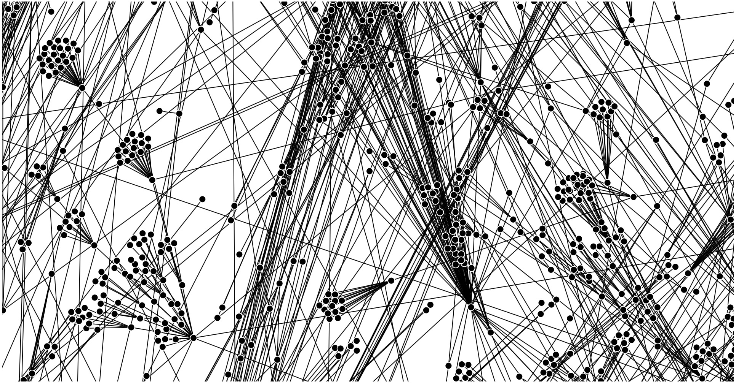
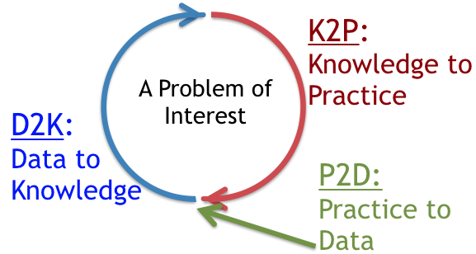
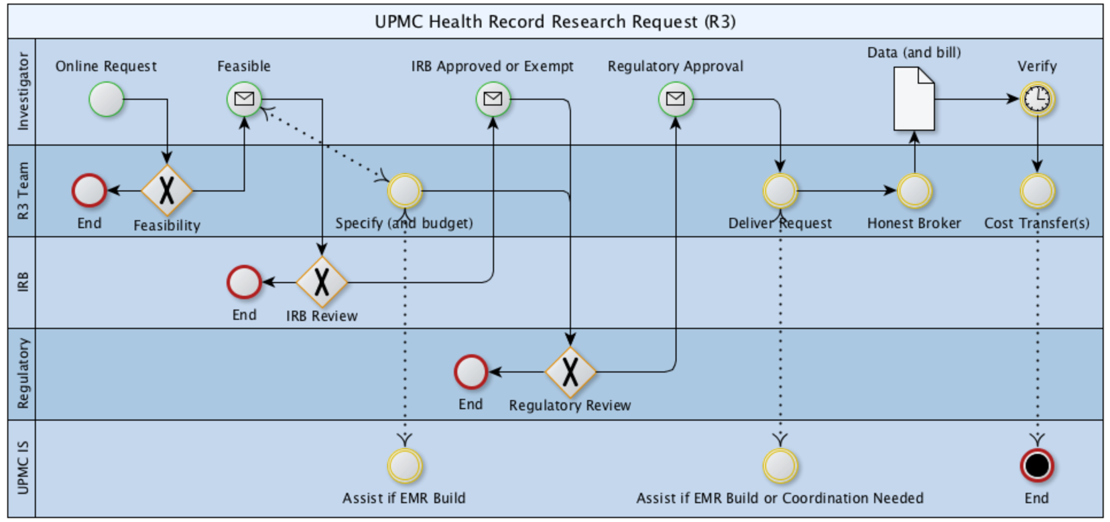
Jonathan C. Silverstein, MD, MS, FACS, FACMI
Chief Research Informatics Officer
Health Sciences and Institute for Precision Medicine
Professor, Department of Biomedical Informatics
Affiliate Scholar, Pitt Cyber
Board Member
Areas of Discovery/Innovation
1. Biomedical Informatics Infrastructures (SaaS, vocab, viz)
2. Learning Health Systems
3. Secure Data Liquidity, Collaborative Networks
PEER-REVIEWED PUBLICATIONS: Curated bibliography at NCBI/PubMed. Curated citations at Google Scholar.

Slide 2
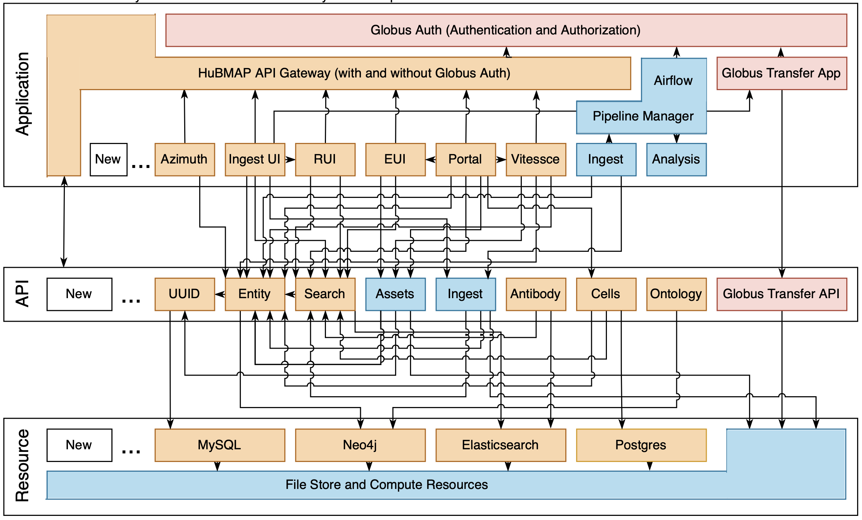
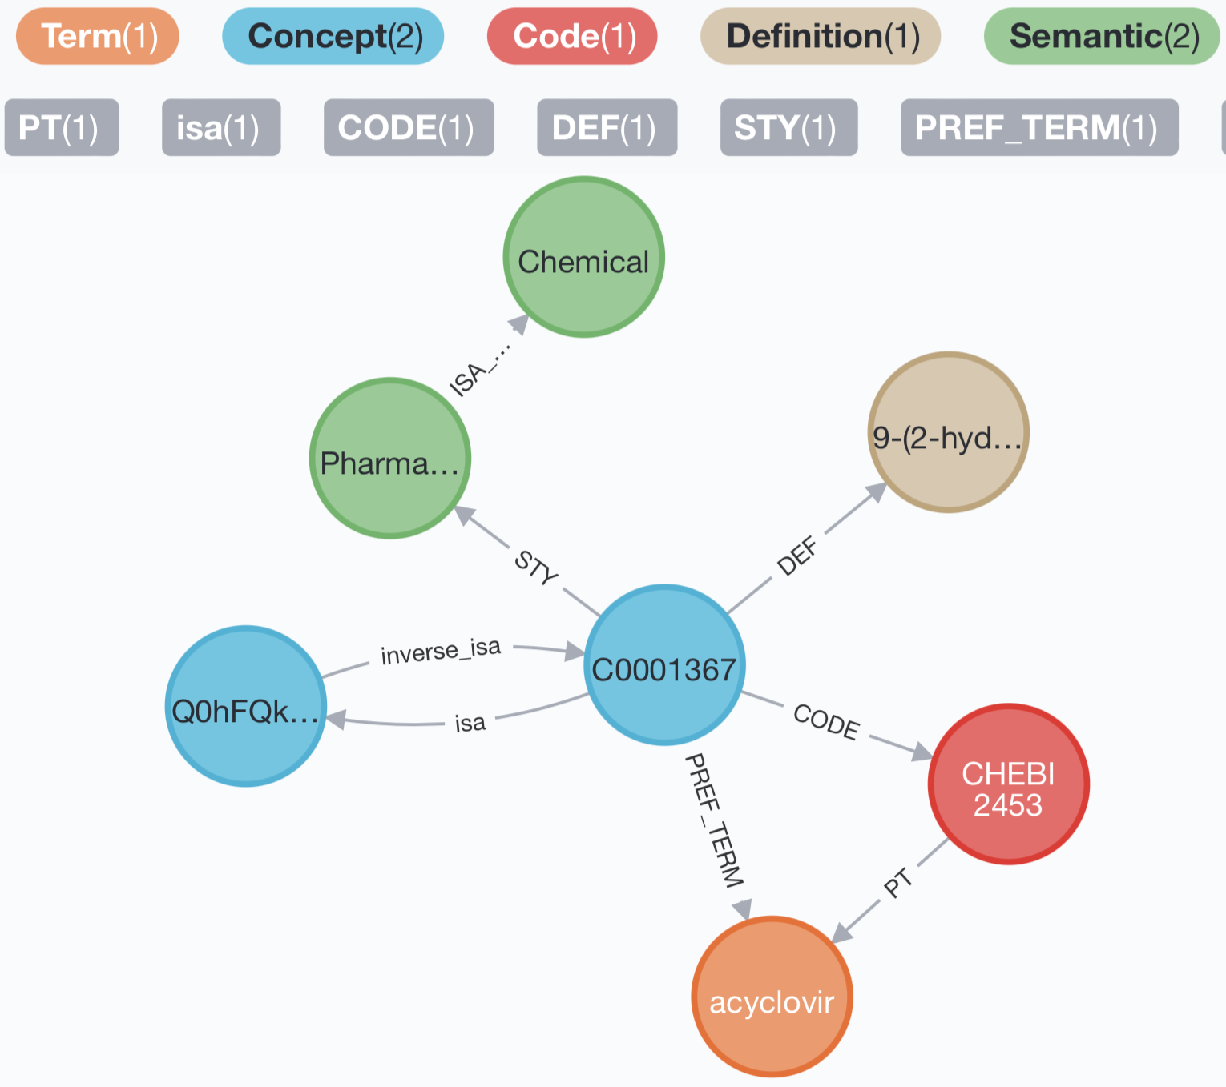
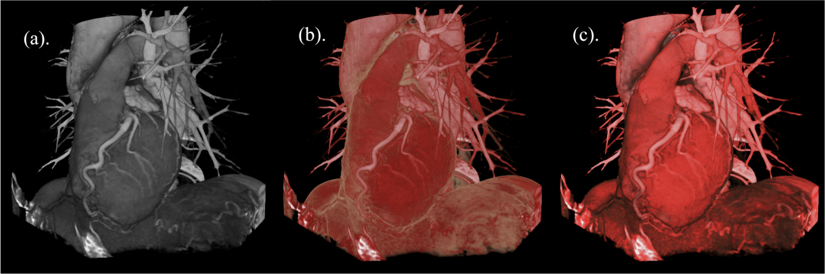
Biomedical Infrastructures (service architectures, vocabularies, interactive viz)
HuBMAP
Hybrid Cloud
Microservices
Architecture
https://software.docs.hubmapconsortium.org
Grayscale + Realistic Color = Perceptual
Knowledge Graph ‘Schema’

Slide 3

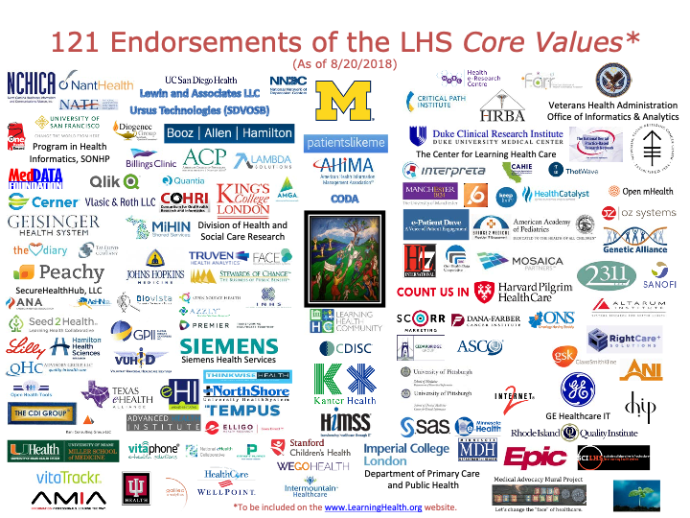
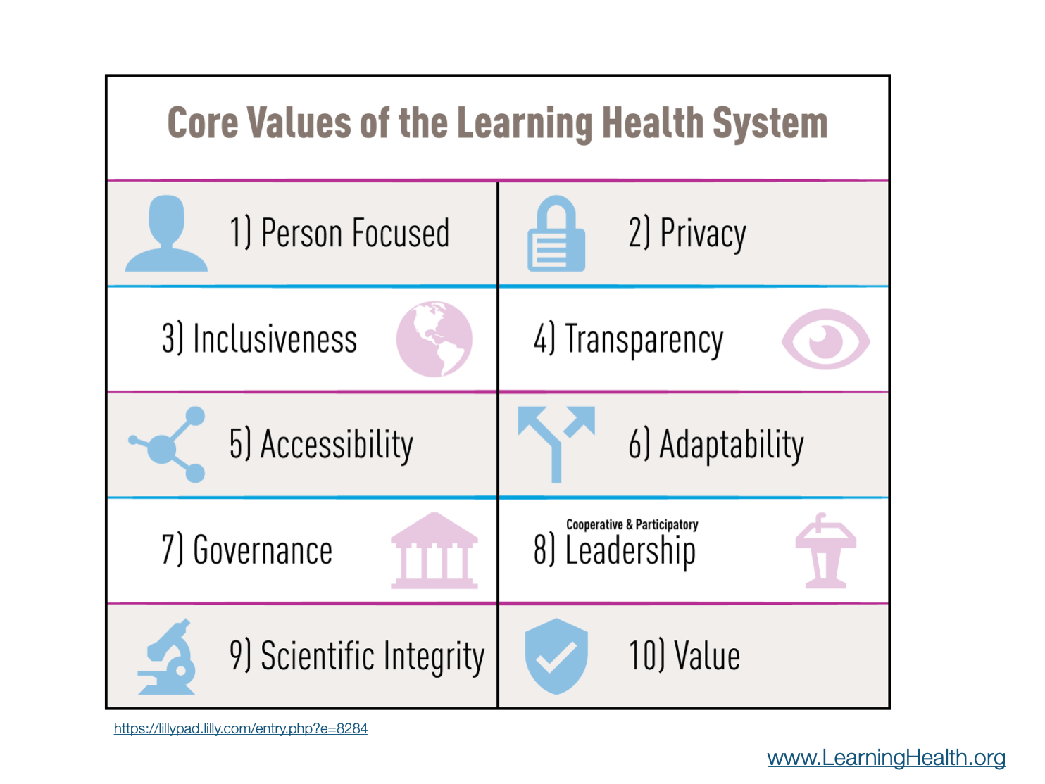
Learning Health Systems

Slide 4













Secure Data Liquidity, Collaborative Networks
R3
Health Record Research Request
Cellular Senescence Network

Slide 5
Active Research Networks as of Dec 2024
U24OH009077 (Becich) CDC/NIH/NIOSH 0.6 calendar
Sustaining the Expansion of the National Mesothelioma Virtual Bank (NMVB)
RI-CRN-2020-006 (McTigue; Becich) PCORI 1.2 calendar
Advancement of PCORnet Infrastructure: Clinical Research Network Project
UL1TR001857 (Reis) NIH/NCATS 1.8 calendar
Biomedical Informatics Core, Clinical and Translational Science Institute
OT2OD026675 (Blood; Silverstein) NIH/Office of the Director 2.4 calendar
Flexible Hybrid Cloud Infrastructure for Seamless Management of HuBMAP Resources
U24CA268108 (Silverstein; Blood; Bar-Joseph) NIH/NCI 2.4 calendar
Cellular Senescence Network (SenNet) Consortium Organization and Data Coordinating Center (CODCC)
SPEC-20-009 (Silverstein) BCRF 1.2 calendar
Breast Cancer Research Foundation Global Data Hub
U24OD038422 (Taylor; Silverstein) NIH/CF Data Ecosystem 0.6 calendar
Uncovering the Shared Genetic Origins of Childhood Cancer and Structural Birth Defects
Through Enhanced Data Integration and Analysis with the CFDE Data Distillery Knowledge
Graph

Slide 6
2025 Publications
Turner ML, Smits TC, Liaw TS, Honick B, Shirey B, Choy L, Akhmetov N, An S, Betancur D, Bordelon D, Burke K, Cao-Berg I, Conroy J, Csonka C, Cuda P, Donahue S, Fisher S, Furst D, Hanna E, Hardi J, Kakar T, Keller MS, Li X, Ma Y, McWilliams A, Money A, Morgan R, Moerth E, Muerto J, Musen MA, Nic E, O’Connor MJ, Phillips G, Ropelewski A, Sablosky R, Saripalli S, Sibilla M, Simmel D, Simmons A, Tang X, Welling J, Yuan Z, Hemberg M, Ruffalo M, Silverstein J, Blood P, Gehlenborg N. HuBMAP Data Portal: A resource for multi-modal spatial and single-cell data of healthy human tissues [Internet]. arXiv [q-bio.QM]. 2025. Available from: http://dx.doi.org/10.48550/arXiv.2511.05708
Taneja SB, Boyce RD, Malec SA, Albert SM, Shaaban CE, Levine AS, Munro P, Bian J, Xu J, Maraganore D, Schliep K, Silverstein JC, Kienholz M, Karim HT. Predicting Alzheimer’s disease diagnosis, a decade or more years before onset using the electronic health record and random forest machine learning models [Internet]. medRxiv. 2025. p. 2025.11. 04.25338396. Available from: https://doi.org/10.1101/2025.11.04.25338396 PMID: 41292647
Ahooyi TM, Stear B, Simmons JA, Metzger VT, Kumar P, Evangelista JE, Clarke DJB, Xie Z, Kim H, Jenkins SL, Maurya MR, Ramachandran S, Fahy E, Gillespie TH, Imam FT, Kokash N, Roth ME, Fullem R, Jevtic D, Mihajlovic A, Tiemeyer M, Bakker C, Schroeder AJ, Markowski J, Nedzel J, Hill DD, Terry J, Nemarich C, Boline J, Park PJ, Ardlie KG, Vora J, Mazumder R, Ranzinger R, de Bono B, Subramaniam S, Grethe JS, Yang JJ, Lambert CG, Resnick A, Milosavljevic A, Ma’ayan A, Silverstein JC, Taylor DM. The data distillery: A graph framework for semantic integration and querying of biomedical data [Internet]. bioRxivorg. 2025. Available from: https://doi.org/10.1101/2025.08.11.666099 PMID: 40832351
Tanaka T, Sierra F, Gladyshev VN, Wyss-Coray T, Cuervo AM, Perez V, Ferrucci L, Hevolution Alliance for Aging Biomarkers. Recommendations for implementing the Hevolution Alliance for Aging Biomarkers initiative. Nat Aging [Internet]. Springer Science and Business Media LLC; 2025 Feb 1;5(2):188–192. Available from: http://dx.doi.org/10.1038/s43587-025-00812-6 PMID: 39915640
Schmidt S, Jacobs MA, Hall DE, Stitzenberg KB, Kao LS, Brimhall BB, Wang CP, Manuel LS, Su HD, Silverstein JC, Shireman PK. One cutoff is not enough: Assessing different area deprivation index cutoffs for insurance types on surgical Desirability of Outcome Ranking (DOOR). Healthcare [Internet]. Elsevier BV; 2025 May 14;13(1):100762. Available from: http://dx.doi.org/10.1016/j.hjdsi.2025.100762 PMID: 40378775
Börner K, Blood PD, Silverstein JC, Ruffalo M, Satija R, Teichmann SA, Pryhuber GJ, Misra RS, Purkerson JM, Fan J, Hickey JW, Molla G, Xu C, Zhang Y, Weber GM, Jain Y, Qaurooni D, Kong Y, HRA Team, Bueckle A, Herr BW 2nd. Human BioMolecular Atlas Program (HuBMAP): 3D Human Reference Atlas construction and usage. Nat Methods [Internet]. Nature Publishing Group; 2025 Mar 13 [cited 2025 Mar 18];1–16. Available from: https://doi.org/10.1038/s41592-024-02563-5 PMID: 40082611
Mohseni Ahooyi T, Stear B, Simmons JA, Nemarich CM, Silverstein JC, Taylor DM. Homo Sapiens Chromosomal Location Ontology: A Framework for Genomic Data in Biomedical Knowledge Graphs. Sci Data [Internet]. Nature Publishing Group; 12, 52 (2025). Available from: https://doi.org/10.1038/s41597-024-04358-x PMID: 39799122

