Slide 1
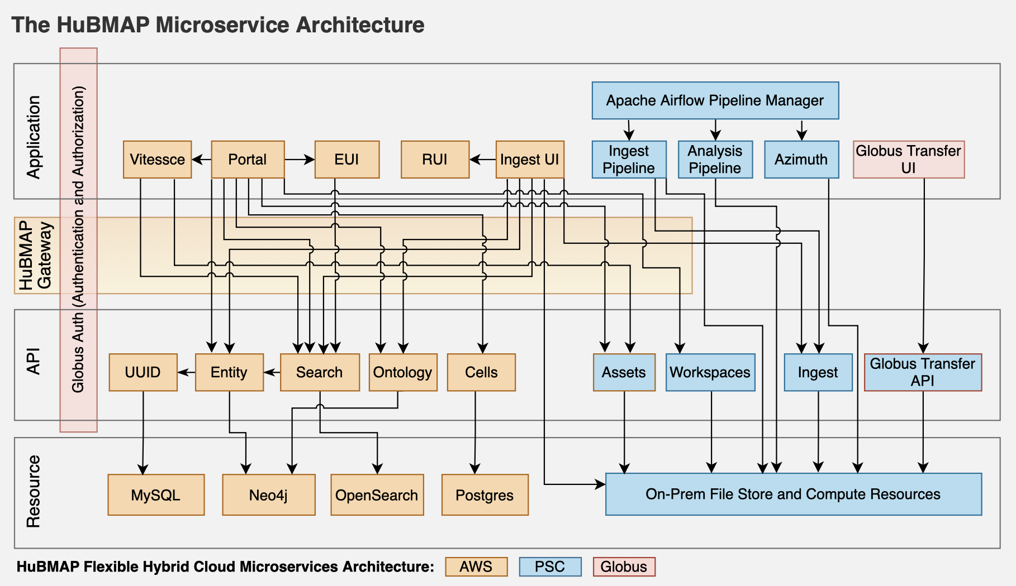
Human BioMolecular Atlas Program (HuBMAP): 3D Human Reference Atlas construction and usage
Jonathan C. Silverstein, MD
See The HuBMAP Microservices Architecture (flexible hybrid cloud infrastructure) at: https://docs.hubmapconsortium.org/
The Human BioMolecular Atlas Program (HuBMAP) aims to construct a 3D Human Reference Atlas (HRA) of the healthy adult body. Experts from 20+ consortia collaborate to develop a Common Coordinate Framework (CCF), knowledge graphs and tools that describe the multiscale structure of the human body (from organs and tissues down to cells, genes and biomarkers) and to use the HRA to characterize changes that occur with aging, disease and other perturbations. HRA v.2.0 covers 4,499 unique anatomical structures, 1,195 cell types and 2,089 biomarkers (such as genes, proteins and lipids) from 33 ASCT+B tables and 65 3D Reference Objects linked to ontologies. New experimental data can be mapped into the HRA using (1) cell type annotation tools (for example, Azimuth), (2) validated antibody panels or (3) by registering tissue data spatially. This paper describes HRA user stories, terminology, data formats, ontology validation, unified analysis workflows, user interfaces, instructional materials, application programming interfaces, flexible hybrid cloud infrastructure and previews atlas usage applications.
Funding Source: NIH
U24CA268108 SenNet
OT2OD026675 HuBMAP
Börner K, Blood PD, Silverstein JC, Ruffalo M, Satija R, Teichmann SA, Pryhuber GJ, Misra RS, Purkerson JM, Fan J, Hickey JW, Molla G, Xu C, Zhang Y, Weber GM, Jain Y, Qaurooni D, Kong Y, HRA Team, Bueckle A, Herr BW 2nd. Human BioMolecular Atlas Program (HuBMAP): 3D Human Reference Atlas construction and usage. Nat Methods [Internet]. Nature Publishing Group; 2025 Mar 13 [cited 2025 Mar 18];1–16. Available from: https://doi.org/10.1038/s41592-024-02563-5 PMID: 40082611

