Slide 1
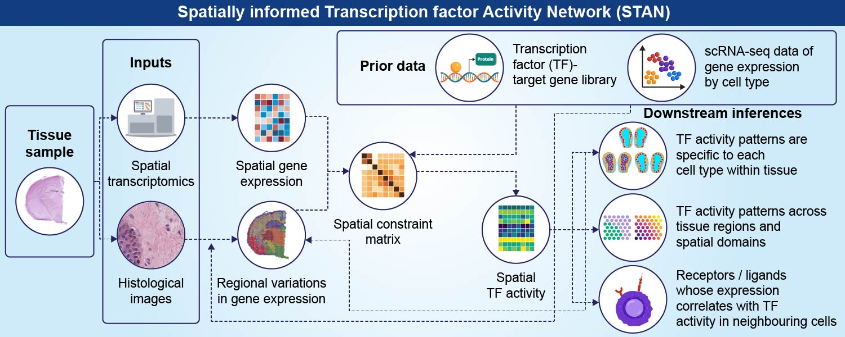

Department of Biomedical Informatics – Hatice Ulku Osmanbeyoglu
STAN estimates spot-specific TF/pathway activities that explain gene expression in a spatially coherent manner across the tissue
Collaborator: Baoli Hu
Zhang L, Sagan A, Qin B, Wang H, Kim E, Hu B, Osmanbeyoglu HU. STAN, a computational framework for inferring spatially informed transcription factor activity across cellular contexts. Nucleic Acids Res. 2025
Funding: NIH/NIGMS R35 GM146989 — PI: Osmanbeyoglu (Computational methods for delineating cell context-specific regulatory programs)
Department of Biomedical Informatics

