Slide 1

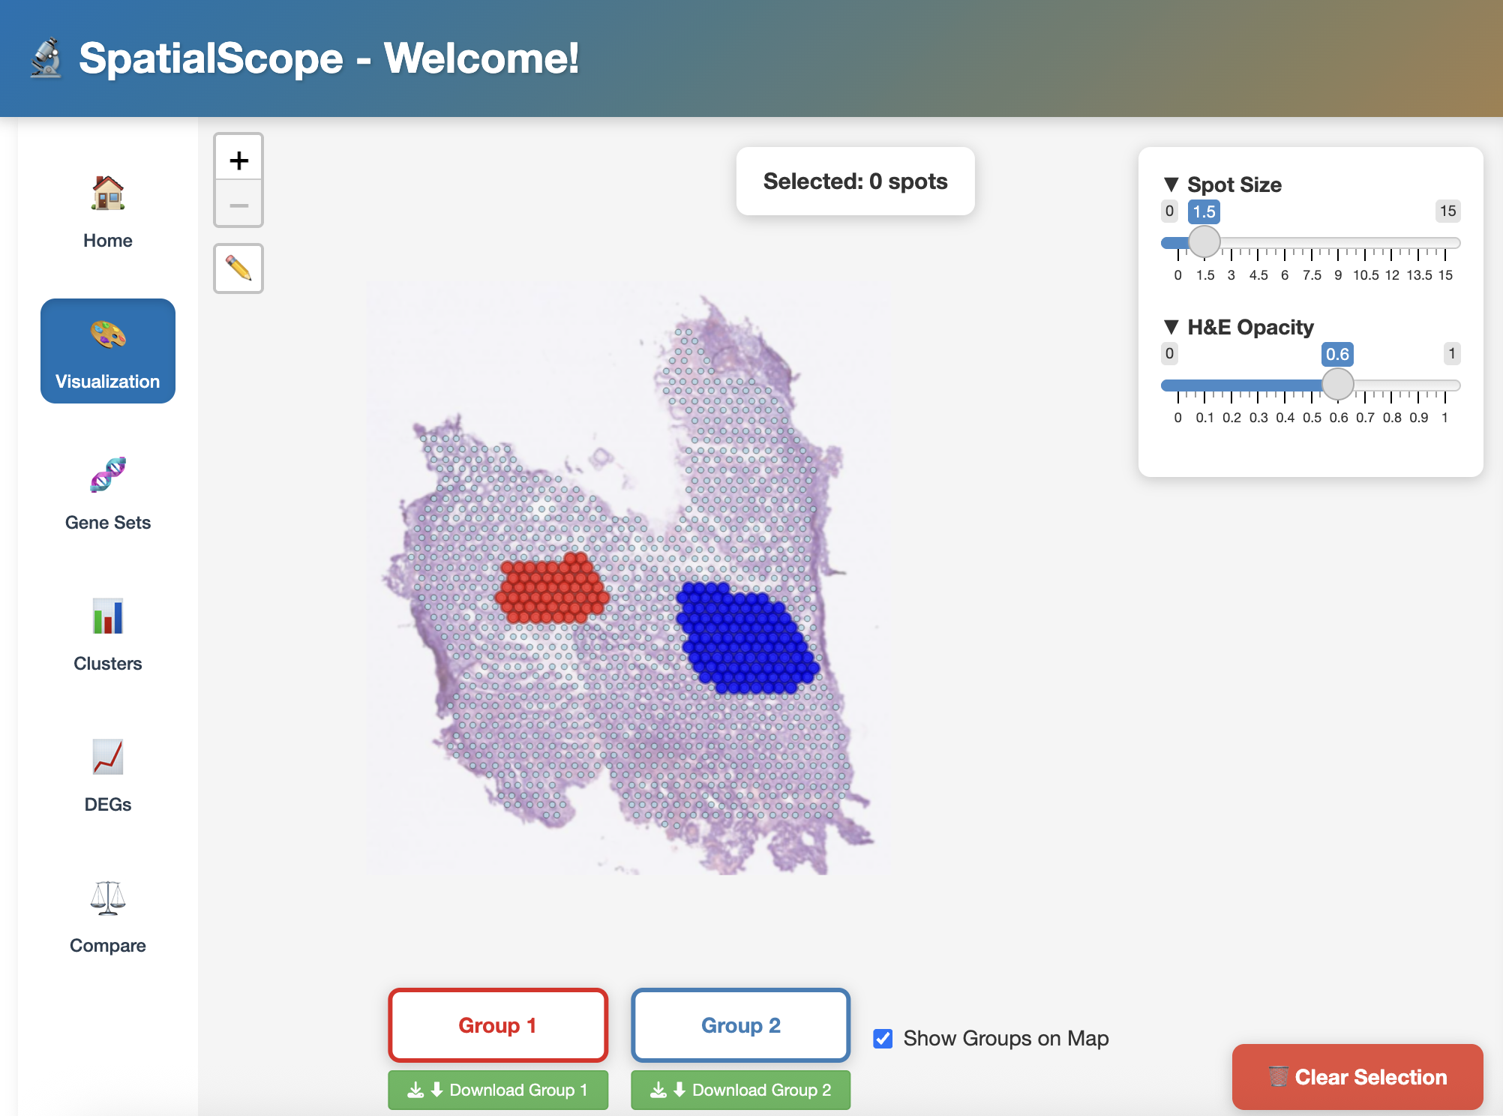
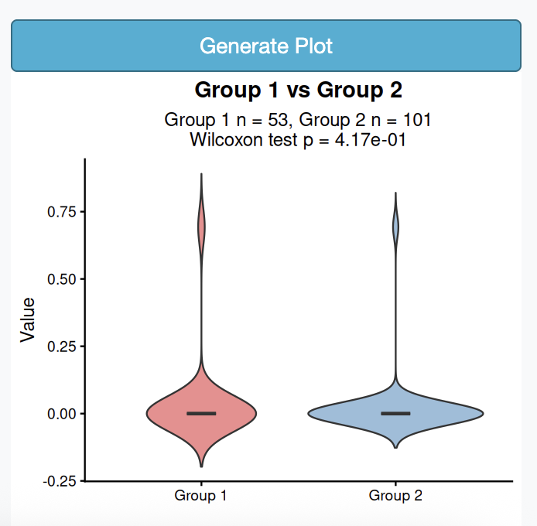
Department of Biomedical Informatics
AI-guided framework to learn the cell-cell communication using the spatial transcriptomic data
1) A microenvironment often consists of heterogeneous spatial domains hosting different cell compositions and thereby distinguishable cell-cell communication networks (CCCNs).
2) We aim to use spatial transcriptome to decipher the complex heterogeneity in the biological system by providing location-indexed gene expression for studying CCCNs.
3) The advantage of our approach compared with contemporary spatial transcriptomic studies include 1) inferring the functional composition instead of traditional cell types in each spatial spot. 2) inferring the CCCNs in an individual spot and then identifying patterns of CCCNs shared by spots in a spatial domain of interest
4) We developed an Rshiny API, SpatialScope, an interactive R Shiny platform for spatial transcriptomics analysis that enables researchers to select, visualize, and compare regions of interest on tissue maps with H&E overlays. Our tool integrates comprehensive cell type gene signatures from CellMarker 2.0, performs spatial clustering and differential expression analysis, and allows multi-feature comparisons with statistical testing (https://shiny.crc.pitt.edu/spatial_api/)
Qiu, A, Lu, M., Lu, X., Xu, M., and Chen., L. (2025) SpatialScope, an interactive R Shiny platform for spatial transcriptomics analysis that enables researchers to select, visualize, and compare regions of interest on tissue maps with H&E overlays. Preprint in preparation.

