Slide 1



Developing deep learning models for precision oncology
Lujia Chen, PhD
Assistant Professor
Department of Biomedical Informatics, School of Medicine, University of Pittsburgh
Contact: luc17@pitt.edu
Phone: 412-736-7952
Google scholar profile: https://scholar.google.com/citations?user=L7f-43gAAAAJ&hl=en

Slide 2
Major goals of current research
Uses machine learning, especially deep learning models, to simulate the hierarchical organization of cellular signaling systems and to systematically identify major cancer signaling pathways.
Detect tumor-specific aberrations in signaling pathways, and predict cancer cells’ sensitivity to anti-cancer drugs, which help guide the personalized treatment based on patients’ individual genomic status.
Use individual patient’s genomic data (e.g. bulk RNA-seq, single-cell RNA-seq and spatial transcriptomics) to select candidate drugs (single drug/drug combination) and predict drug response rate.
Use the combination of deep learning and causal discovery to study the intercellular communication in the tissue microenvironment.
Provide insights on gene signatures and representation of transcriptomic processes that are most sensitive to drug response.
Publications:
H Zhang, B Lu, A Qiu, GF Cooper, A Saeed, JW Paisley, X Lu, L Chen. (2025) Deconvoluting single-cell transcriptomics reveals cellular programs regulated by cell-cell communication in colorectal cancer. bioRxiv, 2025.04.09.648030.
Chen, L, et al. (2024) Machine learning predicts oxaliplatin benefit in early colon cancer. Journal of Clinical Oncology.
Shuang, X., Chen, L., Cooper, G., Lu, X., et al. (2024) An interpretable deep learning framework for genome-informed precision oncology. Nature Machine Intelligence.
Zhang, H., Lu, X., Lu, B. and Chen, L. (2023) scGEM: Unveiling the Nested Tree-Structured Gene Co-Expressing Modules in Single Cell Transcriptome Data. Cancers, 15(17), p.4277.
Chen, X.*, Chen, L.*, et al (2022) An individualized causal framework for learning intercellular communication networks that define microenvironments of individual tumors. PLOS Computational Biology, 18(12), p.e1010761.
Funding Support:
Developing a Novel Causal Discovery Framework to Unveil Individualized Cell-Cell Communication Networks (PI, NIH NHGRI R01, R01HG014023, March 2025 - Feb 2030).
Developing deep learning models for precision oncology (PI, NIH NLM R00, 4R00LM013089, Feb 2022 - Feb 2025)
Notes:
Developing a Novel Causal Discovery Framework to Unveil Individualized Cell-Cell Communication Networks

Slide 3
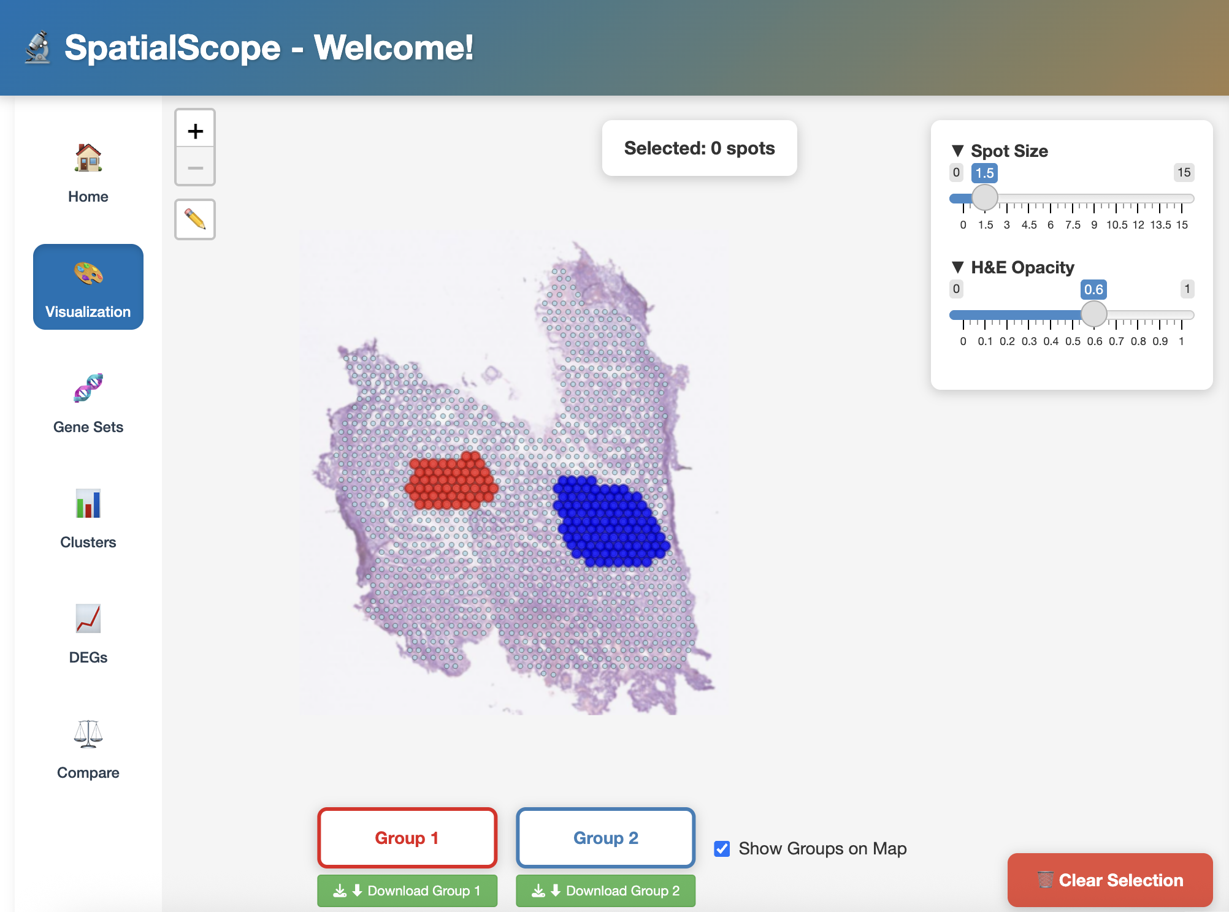
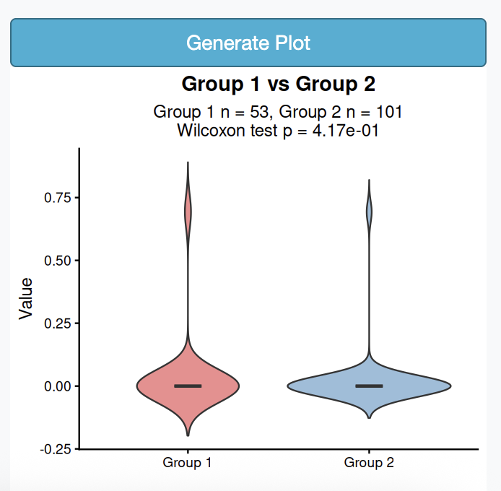
Developing machine learning models to predict the efficacy of chemotherapy and immunotherapy
A microenvironment often consists of heterogeneous spatial domains hosting different cell compositions and thereby distinguishable cell-cell communication networks (CCCNs). In this regard, the spatial transcriptome provides promise in deciphering the complex heterogeneity in the biological system by providing location-indexed gene expression for studying CCCNs.
Each spatial region of interest has its unique cell composition and spatial-domain-specific CCCNs, which may contribute to elucidating the spatial-dependent heterogeneity.
The advantage of our approach compared with contemporary spatial transcriptomic studies include 1) inferring the functional composition instead of traditional cell types in each spatial spot. 2) inferring the CCCNs in an individual spot and then identifying patterns of CCCNs shared by spots in a spatial domain of interest.
We developed an Rshiny API, SpatialScope, an interactive R Shiny platform for spatial transcriptomics analysis that enables researchers to select, visualize, and compare regions of interest on tissue maps with H&E overlays. Our tool integrates comprehensive cell type gene signatures from CellMarker 2.0, performs spatial clustering and differential expression analysis, and allows multi-feature comparisons with statistical testing (https://shiny.crc.pitt.edu/spatial_api/)
The Rshiny API used
Publications:
Qiu, A, Lu, M., Lu, X., Xu, M., and Chen., L. (2025) SpatialScope, an interactive R Shiny platform for spatial transcriptomics analysis that enables researchers to select, visualize, and compare regions of interest on tissue maps with H&E overlays. Preprint in preparation.

Slide 4
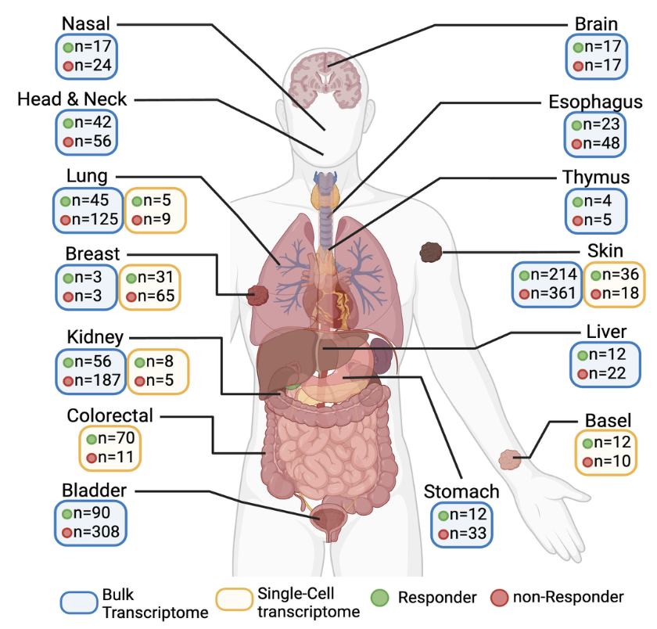
Developing machine learning models to predict the efficacy of chemotherapy and immunotherapy
Immune checkpoint blockade (ICB) has revolutionized the current immuno-oncology and significantly improved clinical outcome for cancer treatment.
We created the largest publicly available transcriptome datasets and biomarker discovery for immunotherapy by immune checkpoint blockage.
We discussed the biomarkers that focused on tumor genome, tumor microenvironment and tumor-host interaction. Then, we compare existing databases for biomarker discovery for ICB response.
We presented IOhub - an interactive web portal that incorporates 36 bulk and 10 single-cell transcriptome datasets for benchmark analysis of the current biomarkers
The Iohub is available for the whole research community to use (https://shiny.crc.pitt.edu/iohub/) .
Publications:
Zhang, H., Lu, B., Lu, X., Saeed, A, Chen, L. (2024) Current transcriptome database and biomarker discovery for immunotherapy by immune checkpoint blockade. Preprint.
Zhang, H., Lu, X., Lu, B. and Chen, L. (2024) Measuring the composition of the tumor microenvironment with transcriptome analysis: past, present and future. Future Oncology.
Zhang, H., Lu, X., Lu, B. and Chen, L. (2023) scGEM: Unveiling the Nested Tree-Structured Gene Co-Expressing Modules in Single Cell Transcriptome Data. Cancers, 15(17), p.4277.

Slide 5
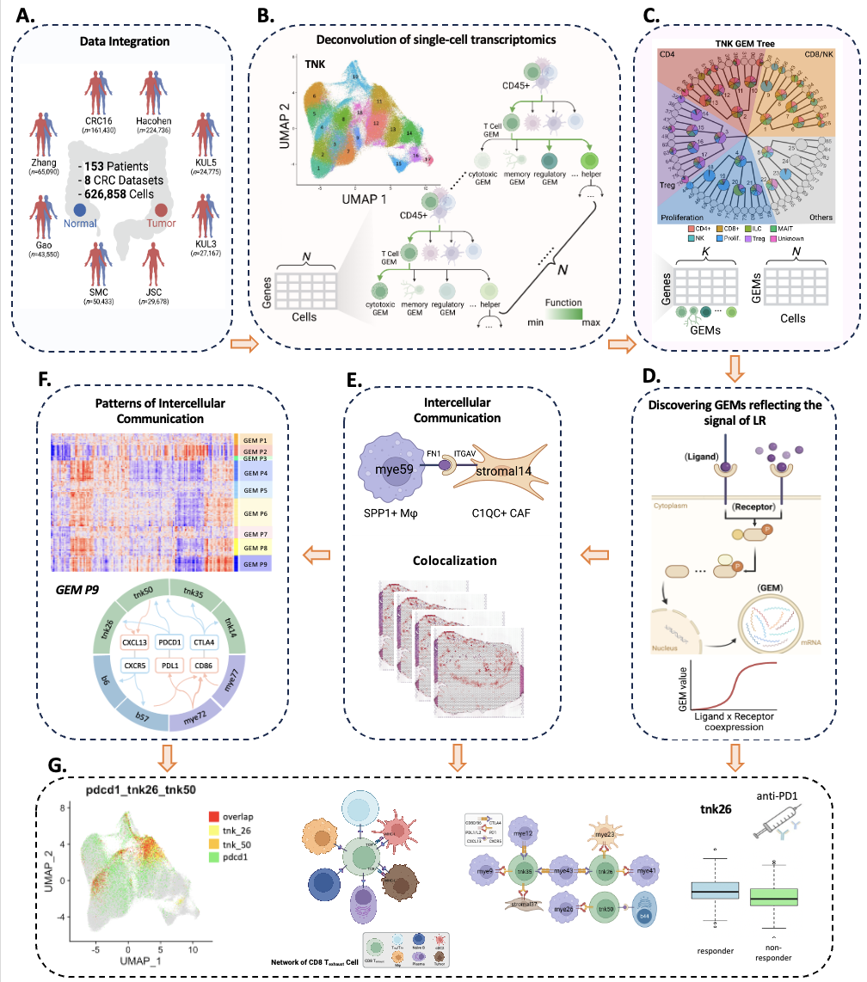
Combination of machine learning models and causal discovery for studying tumor microenvironment
We developed a topic modeling method to learn nested tree-structured gene expression modules (GEMs) that reflect cellular functions and transcriptomic processes of a specific cell type in the tumor microenvironment of colorectal cancer.
GEMs could be used as new representations of cellular states to deconvolute bulk RNA-seq data and spatial transcriptomics.
By incorporating the biological knowledge of ligand-receptor interactions into the causal discovery, our model successfully learnt the intercellular interactions among cell types (T, B, Myeloid, Stromal, and Epithelial cells).
We further validated the inferred cell-cell communication using spatial transcriptomics, which measured all the gene activity in a tissue and mapped where the activity was occurring.
We successfully identified GEMs involved in the ligand-receptor signaling, which could be used as novel biomarker for therapies such as anti-PD-1 immunotherapy.
Publications:
1. Zhang, H., Lu, X., Lu, B. and Chen, L. (2023) scGEM: Unveiling the Nested Tree-Structured Gene Co-Expressing Modules in Single Cell Transcriptome Data. Cancers, 15(17), p.4277.
2. Chen, L., Zhang, H., et al (2023) Deconvoluting single-cell transcriptomics reveals cellular programs regulated by cell-cell communication in colorectal cancer. Under submission.
3. Chen, X.*, Chen, L.*, et al (2022) An individualized causal framework for learning intercellular communication networks that define microenvironments of individual tumors. PLOS Computational Biology, 18(12), p.e1010761.

Slide 6
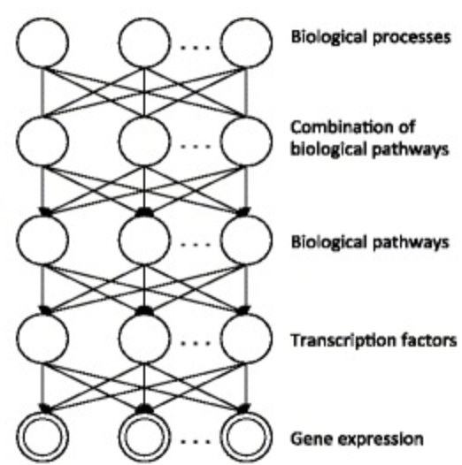
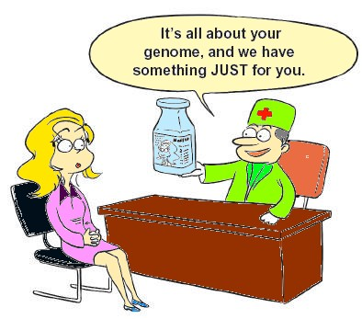
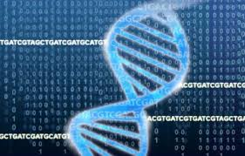
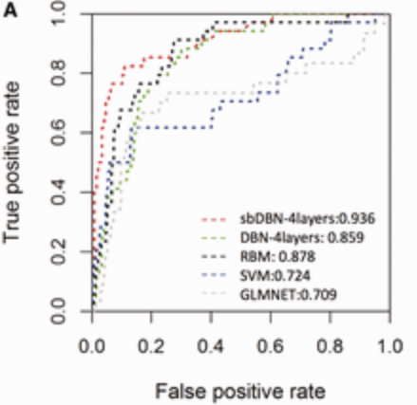

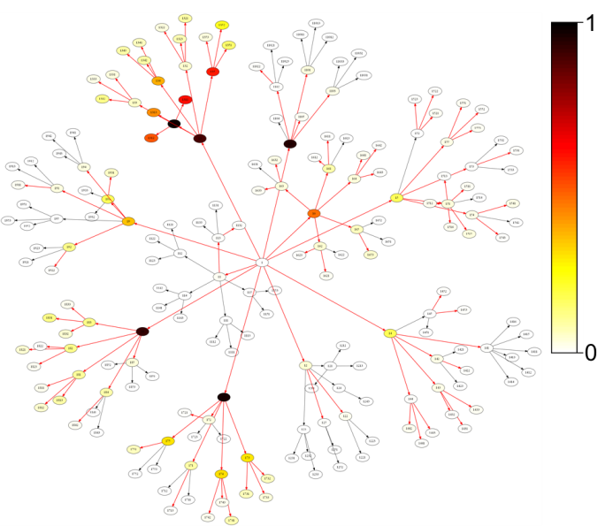
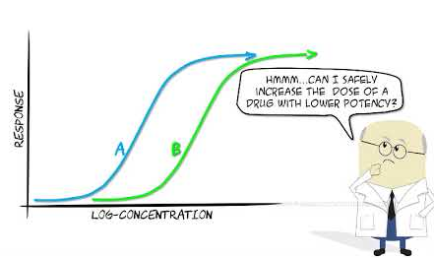

Deep Learning for precision oncology
e.g. Deep Autoencoder
Gene Modules/Pathways
Cancer Subtype Analysis
Personalized
medicine
Genomic Data
(single-cell and bulk-cell)
G1
G2
… …
Gn
T1
Tumors
Deep Learning Model
T2
… …
Tm
Drug prediction
Tumor Representation
Drug Sensitivity Analysis
(machine learning classifiers)
Drug response
e.g. Topic Modeling
Diagonosis
Survival Analysis
Publications:
Chen, L., Wang, Y., et al. (2023) Machine Learning Predicts Oxaliplatin Benefit in Early Colon Cancer. Journal of Clinical Oncology. Formally accepted.
Liu, Z., Cai, C., Ma, X., Liu, J., Chen, L., Lui, V.W.Y., Cooper, G.F. and Lu, X. (2022) A Novel Bayesian Framework Infers Driver Activation States and Reveals Pathway-Oriented Molecular Subtypes in Head and Neck Cancer. Cancers, 14(19), p.4825.
Ding, M.Q., Chen, L., Cooper G.F., Young, J.D., Lu X. (2018) Precision Oncology beyond Targeted Therapy: Combining Omics Data with Machine Learning Matches the Majority of Cancer Cells to Effective Therapeutics, Molecular cancer research : MCR, 16, 269-278.
Chen, L., Cai C., Chen V., Lu X. (2016) Learning a hierarchical representation of the yeast transcriptomic machinery using an autoencoder model, BMC bioinformatics, 17 Suppl 1, 9.
Notes:
https://medchrome.com/patient/the-promise-of-personalized-medicine/
https://www.shutterstock.com/search/drugs+cartoon
https://www.pngwing.com/en/free-png-bkaoc
https://www.niaid.nih.gov/research/genomic-data-sharing

Slide 7
AI in Precision Oncology
Our lab focuses on developing and applying machine learning, especially deep learning models and causal discovery, to systematically identify major signaling pathways and cell-cell communication in the normal/disease microenvironment. Our lab aims to enhance the discovery of patient-specific gene signature biomarkers and guide drug selection to advance the precision medicine .
Collaborators in the following areas:
Artificial Intelligence especially Deep Learning
Cancer biology
Drug discovery
Immunology

