Slide 1

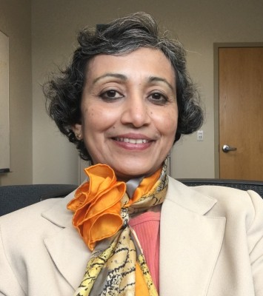
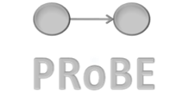
Biomedical Data Science for Precision Medicine
Department of Biomedical Informatics
Vanathi Gopalakrishnan, PhD
Associate Professor of Biomedical Informatics (Primary), Bioengineering, Clinical and Translational Science (Secondary)
Director, PRoBE Laboratory for Pattern Recognition from Biomedical Evidence
Founding Director, Vijayalakshmi Innovation Center in Women’s Health Analytics and Research (VIHAR)
Longitudinal Educator (LE)
School of Medicine, University of Pittsburgh
vanathi@pitt.edu
Room 530, BAUM

Slide 2
Vijayalakshmi Innovation Center in Women’s Health Analytics and Research (VIHAR)
Mission
To conduct world-class research and training that empowers females of all ages across the world to take charge of their own health and well-being in collaboration with health care technology and systems.
Vision
To become the world’s premier innovation center of knowledge and practice in evidence-based girls and women’s integrated health and wellness across the life span.
Philanthropic Support for Named Center
Koita Center for Digital Health (KCDH)
Mumbai, India
Ganesh Ramakrishnan
VIHAR
University of Pittsburgh, USA
Vanathi Gopalakrishnan
Carnegie Mellon University, Africa
Rwanda, Africa
Edith Luhanga
Department of Biomedical Informatics

Slide 3
Pattern Recognition from Biomedical Evidence:
PRoBE Lab
Research Goals: To Accelerate Biomedical Knowledge Discovery by
Developing and Applying novel hybrid Artificial Intelligence Methods
Obtained for
example from:
Literature,
Ontologies,
Past analyses
Obtained for
example from:
Biomedical Assays, Clinical Assessments,
Imaging tests
PRIOR
KNOWLEDGE
DATA
(structured or unstructured)
Integrative Modeling
Examples:
Bayesian Rule Learning (BRL)
Transfer Rule Learner (TRL)
RULE LEARNING METHODOLOGIES
PREDICTIVE MODELS FOR
BIOMEDICINE
EXPLAINABLE
ARTIFICIAL
INTELLIGENCE
Enable predictions about for example: mechanism of action, target selection, useful biomarkers for early detection or monitoring of disease, toxicity risk, and clinical trial outcomes.

Slide 4

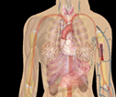
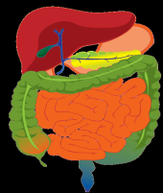

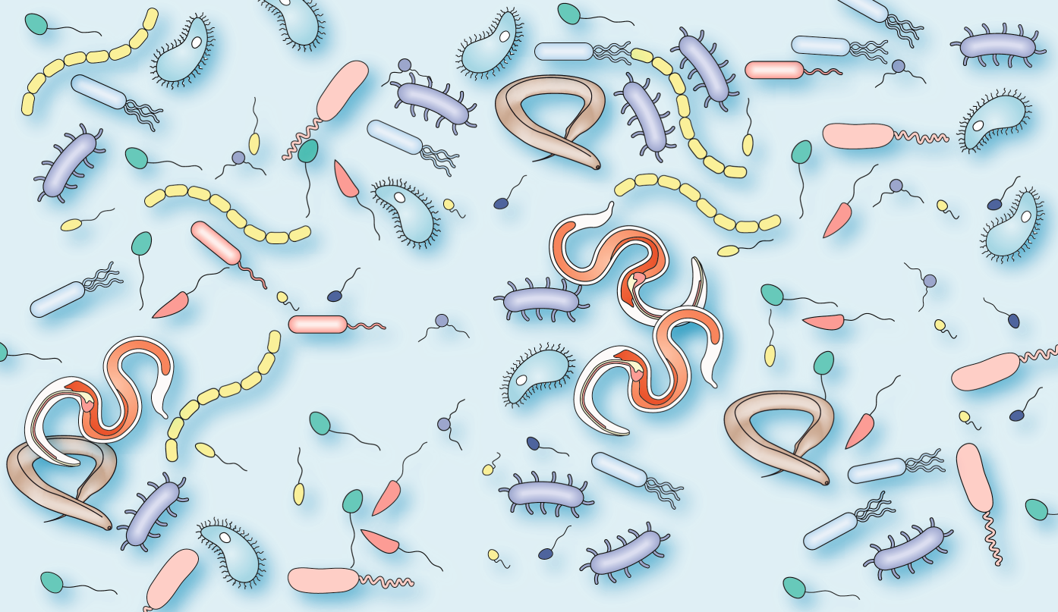
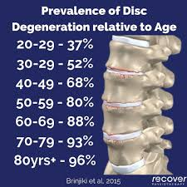
BIOMEDICAL DATA PRoBE LAB HAS ANALYZED
Proteomic
  Mass Spectral (large/wide/deep)
  Immunoassay
Genomic
  GWAS/SNPs(very large)
  DNA Methylation
  Gene Expression
  microRNA
Images
  Cardiac MRI
  Brain fMRI
Microbiome
Metabolome
Exposome
Federated EHR
From biomarker discovery studies for early detection of:
  Amyotrophic Lateral Sclerosis
  Alzheimer’s
  Lung Cancer
  Breast Cancer
  Esophageal Cancer
  Inflammatory Bowel Diseases Ulcerative Colitis, Crohn’s
  Coronary Artery Disease
  Pediatric Cardiomyopathy
  Markers for diagnosis of:
  Helminth’s infections
  Beryllium Exposure
  Type 2 Diabetes
  Cardiovascular Disease
  Intervertebral Aging
https://www.nature.com/articles/s41584-019-0253-3

Slide 5
SELECT PUBLICATIONS LINKS
https://assets-eu.researchsquare.com/files/rs-5041092/v1/922f438a-c12e-430c-942c-1666b17dd246.pdf?c=1727434885
https://crimsonpublishers.com/oabb/pdf/OABB.000573.pdf
https://ojs.aaai.org/aimagazine/index.php/aimagazine/article/view/7375
https://www.sciencedirect.com/science/article/pii/S1532046420300836
https://www.mdpi.com/2306-5729/2/1/8
https://link.springer.com/article/10.1186/s12885-016-2223-3
https://link.springer.com/article/10.1186/1475-925X-14-S2-S7
https://acsjournals.onlinelibrary.wiley.com/doi/full/10.1002/cncr.28963
https://www.sciencedirect.com/science/article/pii/S1556086415329129
https://pmc.ncbi.nlm.nih.gov/articles/PMC2656082/
https://onlinelibrary.wiley.com/doi/abs/10.1002/mus.21683
https://onlinelibrary.wiley.com/doi/abs/10.1111/j.1471-4159.2005.03478.x

