Slide 1
Eric V. Strobl, M.D., Ph.D. Assistant Professor of Biomedical Informatics eric.strobl@pitt.edu 412-624-5100
Causal discovery algorithms that help solve fundamental problems in biomedicine
Lists of publications: https://scholar.google.com/citations?user=aimJiz4AAAAJ&hl=en

Slide 2
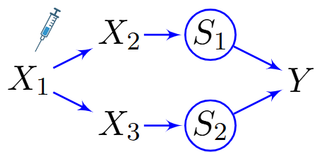
Discovering and Targeting Root Causes of Disease
Definition: Root causes of disease correspond to root vertices that cause a diagnosis and have a large causal effect (i.e., root causal effect) on the diagnosis. Root causes of disease thus initiate the vast majority of pathogenesis and targeting them can alleviate all downstream symptoms.
Problem: Few methods attempt to identify treatment targets that reverse root causal effects.
Approach: Utilize additional experimental (e.g., Perturb-seq³) or instrumental (e.g., genetic variants⁴) data sources to accurately identify personalized treatments that reverse large root causal effects as early as possible.
Status: Root causes of disease have been properly defined² and validated in clinical data¹. We have also developed two methods that estimate root causal effects carried by gene expression^{3,4}.
Representative publications:
Strobl EV, Lasko T. Identifying patient specific root causes with the heteroscedastic noise model. Journal of Computational Science. 2023 Sep 1;72:102099.
Strobl EV. Counterfactual Formulation of Patient-Specific Root Causes of Disease. Journal of Biomedical Informatics, 2024.
Strobl EV, Gamazon ER. Discovering Root Causal Genes with High Throughput Perturbations. eLife, 2024.
Strobl EV, Gamazon ER. Transcriptome-Wide Root Causal Inference. medRXiv, 2024.
Reducing the root causal viral load $X_{1}$ in the common cold $Y$ reduces fever $S_{1}$ and congestion $S_{2}$with one medication.

Slide 3
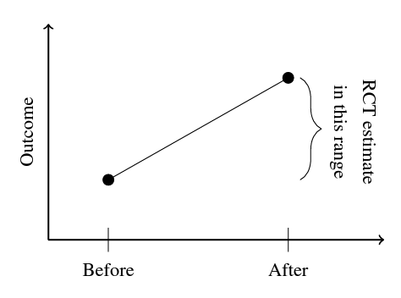
Generalizing Clinical Trials to the Broader Population
Problem: Randomized clinical trials (RCTs) eliminate confounding but typically impose strict exclusion criteria that limit recruitment to a subset of the population. Observational datasets are more inclusive but suffer from confounding
Approach: Combine RCTs and observational data to mitigate confounding and improve generalizability.
Status: We have created two practical approaches^{1,2} for combining RCTs and observational data using time information.
Representative publications:
Strobl EV, Lasko TA. Synthesized difference in differences. 12th ACM Conference on Bioinformatics, Computational Biology, and Health Informatics. 2021 Aug 1;1-10.
Strobl EV, Lasko TA. Generalizing clinical trials with convex hulls. Conference on Causal Learning and Reasoning. 2023 Aug 10: 197-221. (PMLR).
Physicians are like reinforcement learning agents; they identify sub-populations of patients that appear to respond well to a given treatment over time, and then prescribe that treatment more often to those patients. The improvement in patient outcomes from before to after treatment assignment is therefore confounded in observational data and usually too large. The RCT estimate lies in-between the observational estimates seen before and after treatment administration, which our developed algorithm exploits. ²

Slide 4
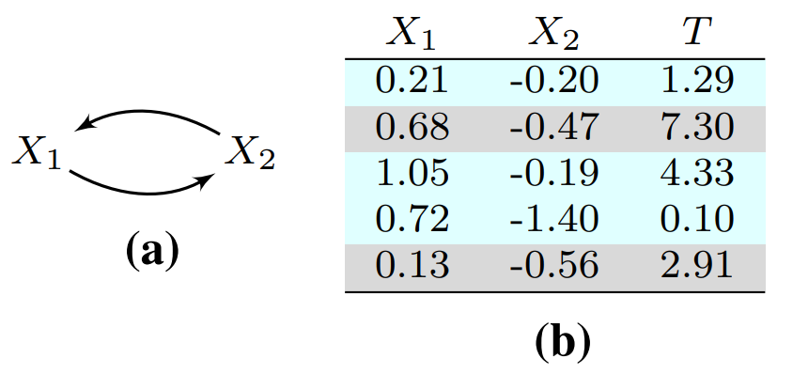
Causal Discovery with Cycles
Problem: Real causal processes often contain cycles, but most causal discovery algorithms assume that no cycles exist. Cycles in biology also tend to occur sequentially and rarely reach an equilibrium state.
Approach: We consider alternative definitions of cycles and create algorithms that identify causal relations even when those cycles exist.
Status: We created an algorithm that can handle cycles, selection bias and latent confounders simultaneously¹. We also modeled cycles using a mixture of directed acyclic graphs, rather than a single equilibriated structural equation model².
Representative publications:
Strobl EV. A constraint-based algorithm for causal discovery with cycles, latent variables and selection bias. International Journal of Data Science and Analytics. 2019 Jul;8(1):33-56.
Strobl EV. Causal Discovery with a mixture of DAGs. Machine Learning. 2022 Mar;112(11):4201-4225.
We can decompose the cycle in (a) into two DAGs: $X_{1}→X_{2}$ and $X_{2}→X_{1}.$The blue samples in (b) refer to samples arising from the first DAG and the grey ones to the second. ²

