Slide 1
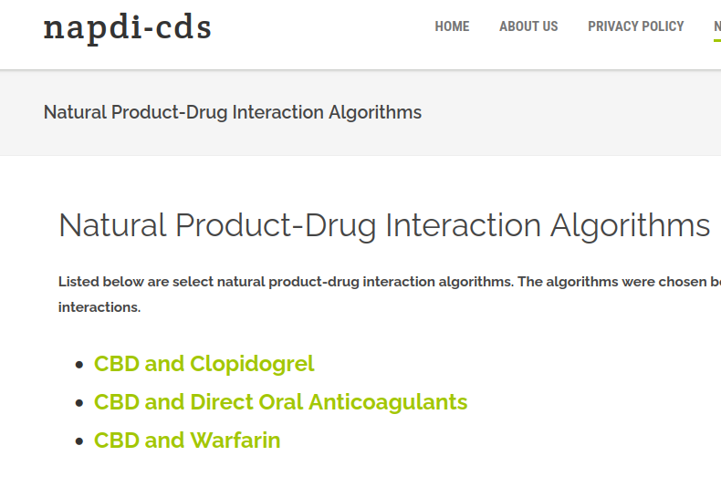
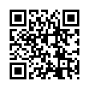
Designing Clinical Decision Support for Natural Product-Drug Interactions
Develop a detailed description of natural product-drug interaction (NPDI) evidence
Implement the logic of the NPDI “trigger” in an app
Standards
Fast Healthcare Interoperability Resources (FHIR)
Substitutable Medical Applications, Reusable Technologies (SMART)
Clinical Quality Language (CQL)
User studies (ongoing)
Determine most effective workflow for CDS
Useability and cognitive load
Abanyie K, Boyce R, Kravchenko O. Validation of Potential Natural Product Drug Interaction Rules Written in HL7 Clinical Quality Language. Poster presentation at: AMIA 2023 Annual Symposium; 2023 Nov 11-15; New Orleans, Louisiana.

