Slide 1
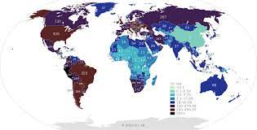
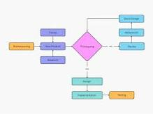
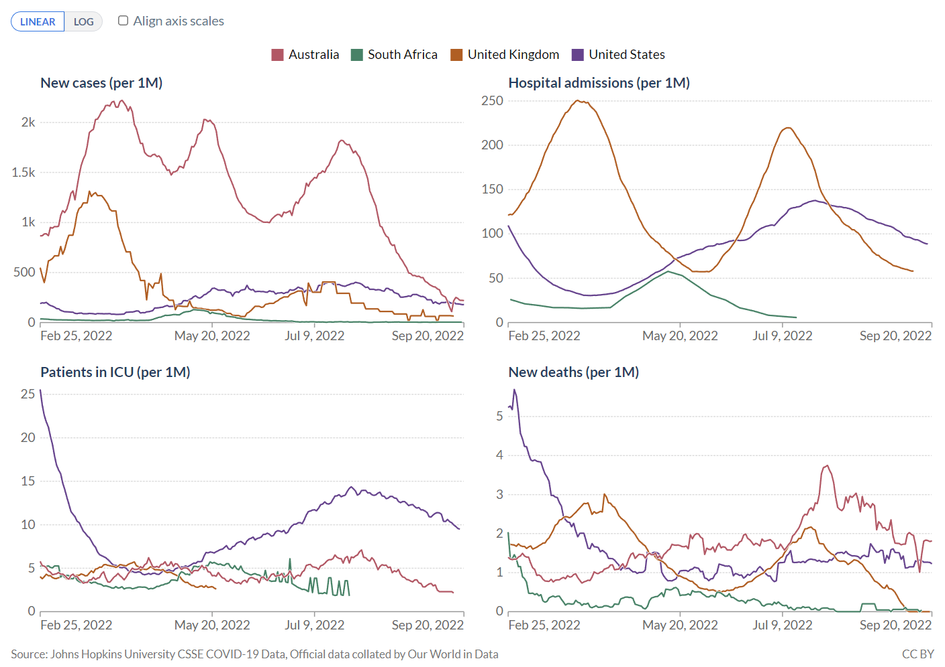
Going viral: New Approaches for Informatics in Emergency Response
Yalini Senathirajah, PhD
PH & frontline - Dx and Tx algorithms
→searches and protocols, local care processes
→sent to others, online
each EHR system different
Usual process speeded up for pandemic, rules changed
But technical process still requires specialty programming
Staff shortages, outages; dependency on heroic staff
Platform approach can create new things in minutes
Can be built with our current technologies
e.g., openEHR, SMART/FHIR
Human nature: stop planning/thinking once emergency is past
Needed: will, true attitude of preparation even if no current emergency
True recognition of ignorance, unpredictable data needs
Platform use in normal times –
fit to task, new Tx, burnout, efficiency, time savings, cognitive support…
AI implementation
Senathirajah, Y. Going Viral: New approache for Infomatics in Emergency Respone. Prehospital and Disaster Medicine, World Association for Disaster and Emergency Medicine. May 2023
1

