Slide 1
ResGitDR Transforming genome-informed precision oncology
A deep learning framework for genome-informed precision oncology
Transform genomic alteration data into latent variables
Represent the state of cellular signaling systems
Use cellular state to predict drug responses

Slide 2
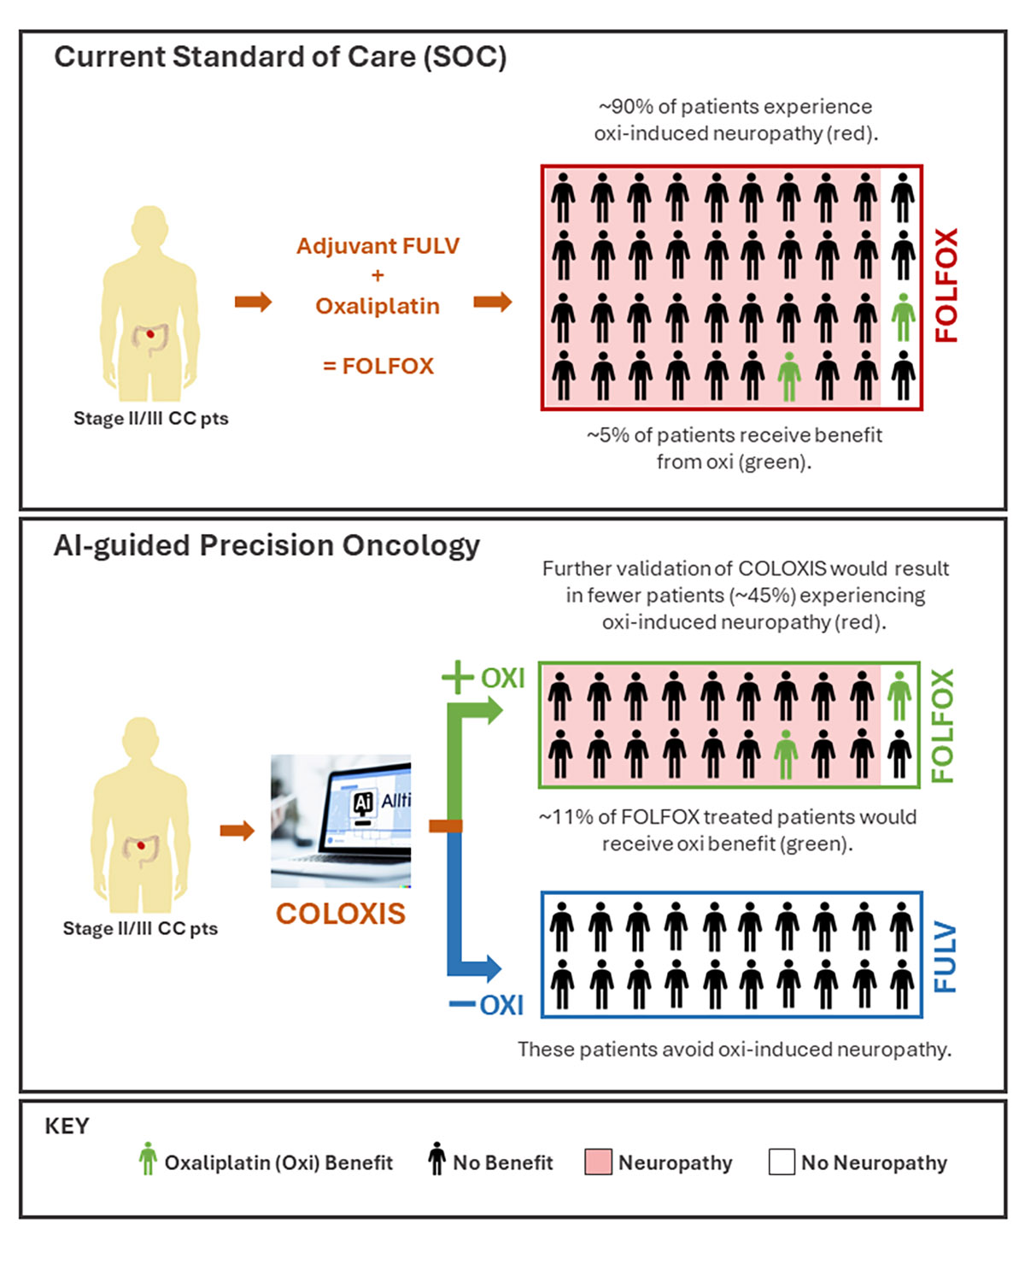
COLOXIS as a practice-change AI model
An AI model can save half colon cancer adjuvant patients from unnecessary adverse effects

Slide 3
COLOXIS as a practice-change AI model
An AI model can save half colon cancer adjuvant patients from unnecessary adverse effects

