Slide 1
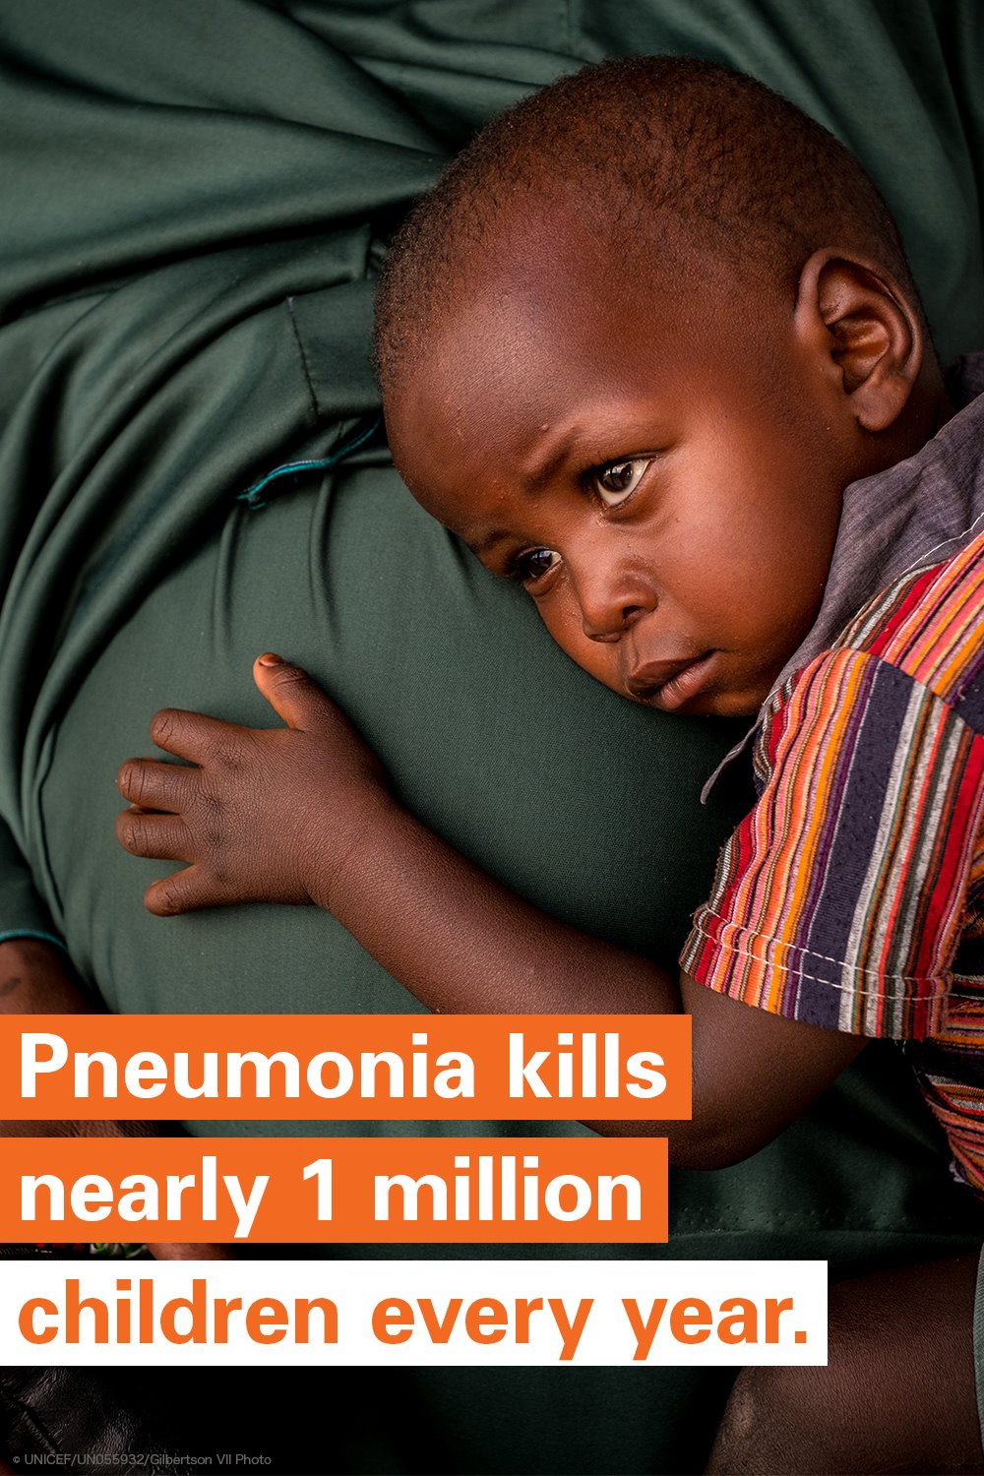
CHEST-180°
Child Health Essential Systems & Technologies
Turning Around Child Mortality
in Low- and Middle-Income Countries
Gerry Douglas, PhD
Assistant Professor of Biomedical Informatics,
University of Pittsburgh, USA
Founder,
Global Health Informatics Institute, Malawi
gdouglas@pitt.edu

Slide 2
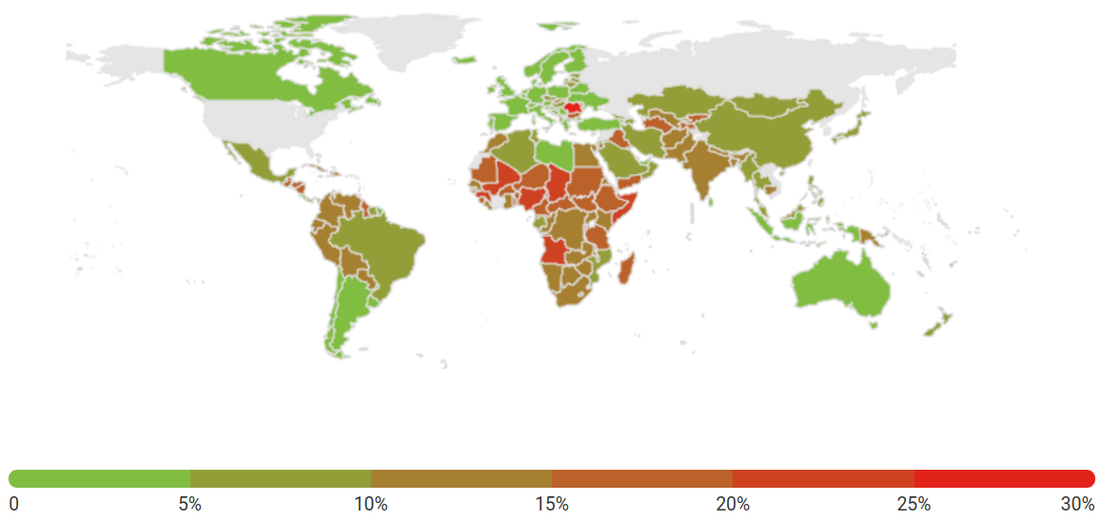
A Child Dies of Pneumonia Every 39 Seconds
Sustainable Development Goals
Pneumonia kills more children than any other infectious disease, and the majority of these deaths are preventable.
The proposed SDG target for child mortality aims to end, by 2030, preventable deaths of newborns and children under 5 years of age, with all countries aiming to reduce under-5 mortality to at least as low as 25 deaths per 1,000 live births (currently ~46 in Malawi).
https://data.unicef.org/topic/child-health/pneumonia/
Percentage of deaths caused by pneumonia in children under 5 years of age (2021)

Slide 3
Child Health Essential Systems and Technologies (CHEST)
Working at the intersection of biomedical informatics and biomedical engineering, CHEST will address each of the pillars necessary to impact childhood pneumonia …
Diagnosis: Pulse oximetry and AI (building on our prior work on Bayesian models for Malaria)
Treatment: Supporting supply chain for antibiotics (building on the electronic drug inventory management work)
Supportive Therapy: Making oxygen available in rural/semi-urban primary care facilities and in ambulances during transport (building on the OpenO2 work)
Data: Robustly collecting routine data on signs and symptoms to improved monitoring and evaluation and build better models for treatment (building on our EMR work)

Slide 4
2024 Targets / Scope of Work
Submit funding applications (TBD - NIH/NSF route or foundations?)
Collect data with which to learn a pneumonia model, do preliminary modeling and evaluate the accuracy of the model (TBD - do we model just pneumonia or the five most common diseases?)
Evaluate affordable options for pulse oximetry(TBD - is there space for innovation?)
Identify clinical sites for a pilot in Malawi and estimate the demand of oxygen for childhood pneumonia (TBD - should we consider a second country?)
Identify solution for fit-for-purpose 1 lpm oxygen concentrator (TBD - Collaboration with existing manufacturer (e.g. DeVilbiss, Somerset, PA) vs. custom solution?)
Determine optimal data collection platform (TBD - classic touches screen POS terminal approach vs. mobile app?)
Develop impact evaluation of complete package (including baseline data collection)

