Slide 1
From Big Data to Bedside (BD2B): Translating genomic big data to better clinical care through artificial intelligence
Xinghua Lu, MD, PhD
Dept. Biomedical Informatics
University of Pittsburgh
Email: xinghua@pitt.edu
Tel: 412-624-3303
https://www.dbmi.pitt.edu/person/xinghua-lu-md-phd-ms

Slide 2
Address key questions of AI in medicine
Causality
Understand disease mechanisms through a lens of causality
Pattern recognition
Deep learning
Active learning
Decision support

Slide 3
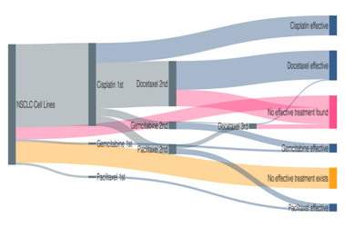
My Moonshot
DeepRx: A comprehensive AI-driven Precision Oncology Decision Support System
Integrating multi-omics data (genomic, transcriptomic, and pharmacogenomics)
Advanced AI methodologies: Deep learning, tumor-specific Bayesian causal networks, …
02
Detect patterns in the disease states of tumors
Recommend
Patient-specific regimen
Omics + EMR
Predict drug sensitivity of individual patients based on the activation states of
Drug-targeted pathway
Circumventing pathways
Immune evasion mechanism of individual tumors
Notes:
Our unique perspective of perceiving disease state of each tumor

Slide 4
COLOXIS as a practice-change AI model
An AI model can save half colon cancer adjuvant patients from unnecessary adverse effects
Chen, L et al (224) JCO to appear

Slide 5
ResGitDR Transforming genome-informed precision oncology
A deep learning framework for genome-informed precision oncology
Transform genomic alteration data into latent variables
Represent the state of cellular signaling systems
Use cellular state to predict drug responses
https://www.biorxiv.org/content/10.1101/2023.07.11.548534v1

Slide 6
Research Themes
Cancer Pathway Discovery
Decision support system for personalized medicine
Machine learning
Deep learning
Single-cell omics
Text mining and knowledge representation
Current grant support as PI:
R01 LM012011
Collaborative funding
R01 CA229431 R01
1R01 CA254274-01
R01 CA215481-01

