Slide 1
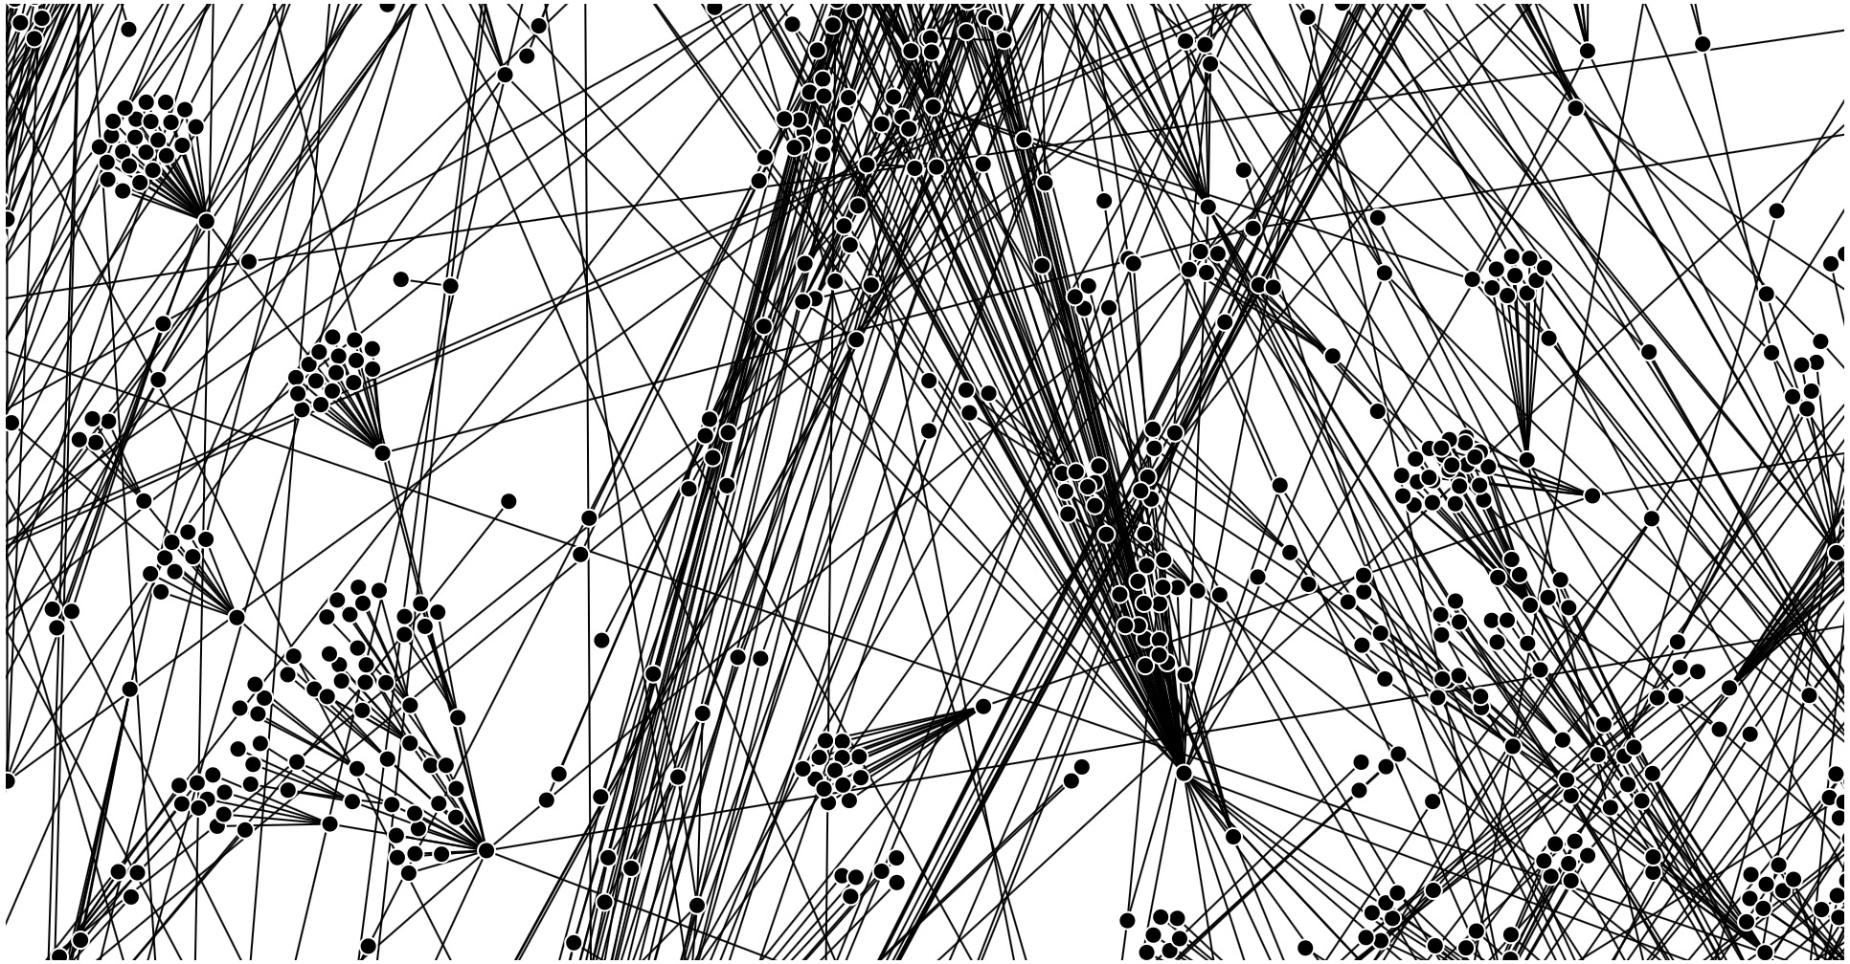
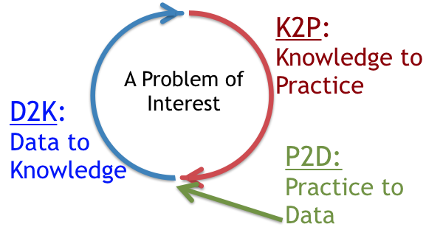
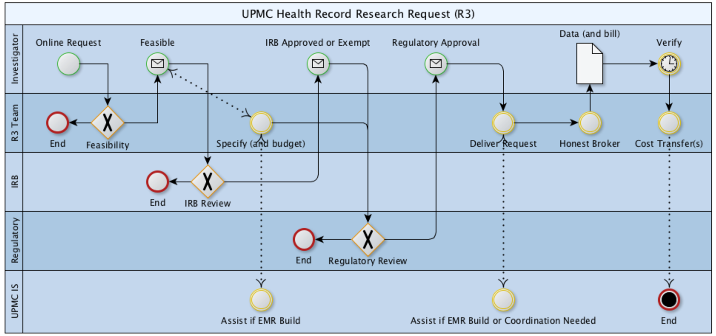
Jonathan C. Silverstein, MD, MS, FACS, FACMI
Chief Research Informatics Officer
Health Sciences and Institute for Precision Medicine
Professor, Department of Biomedical Informatics
Affiliate Scholar, Pitt Cyber
Board Member
Areas of Discovery/Innovation
1. Biomedical Informatics Infrastructures (SaaS, vocab, viz)
2. Learning Health Systems
3. Secure Data Liquidity, Collaborative Networks
PEER-REVIEWED PUBLICATIONS: Curated bibliography at NCBI/PubMed. Curated citations at Google Scholar.

Slide 2
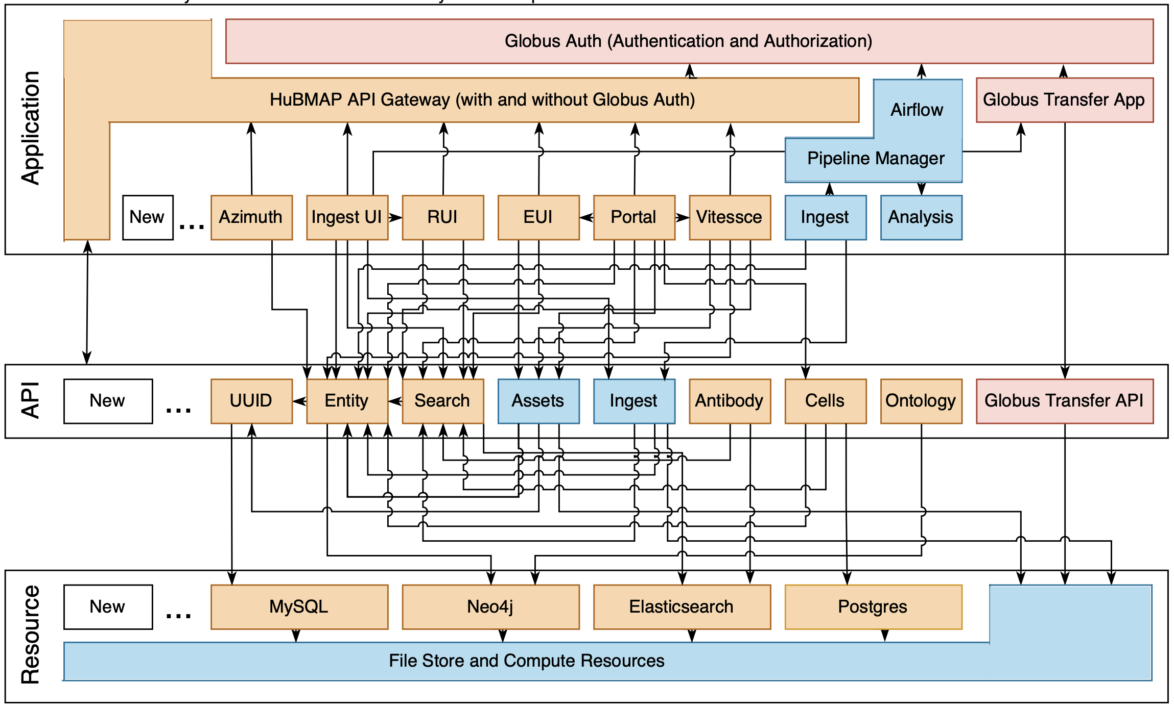
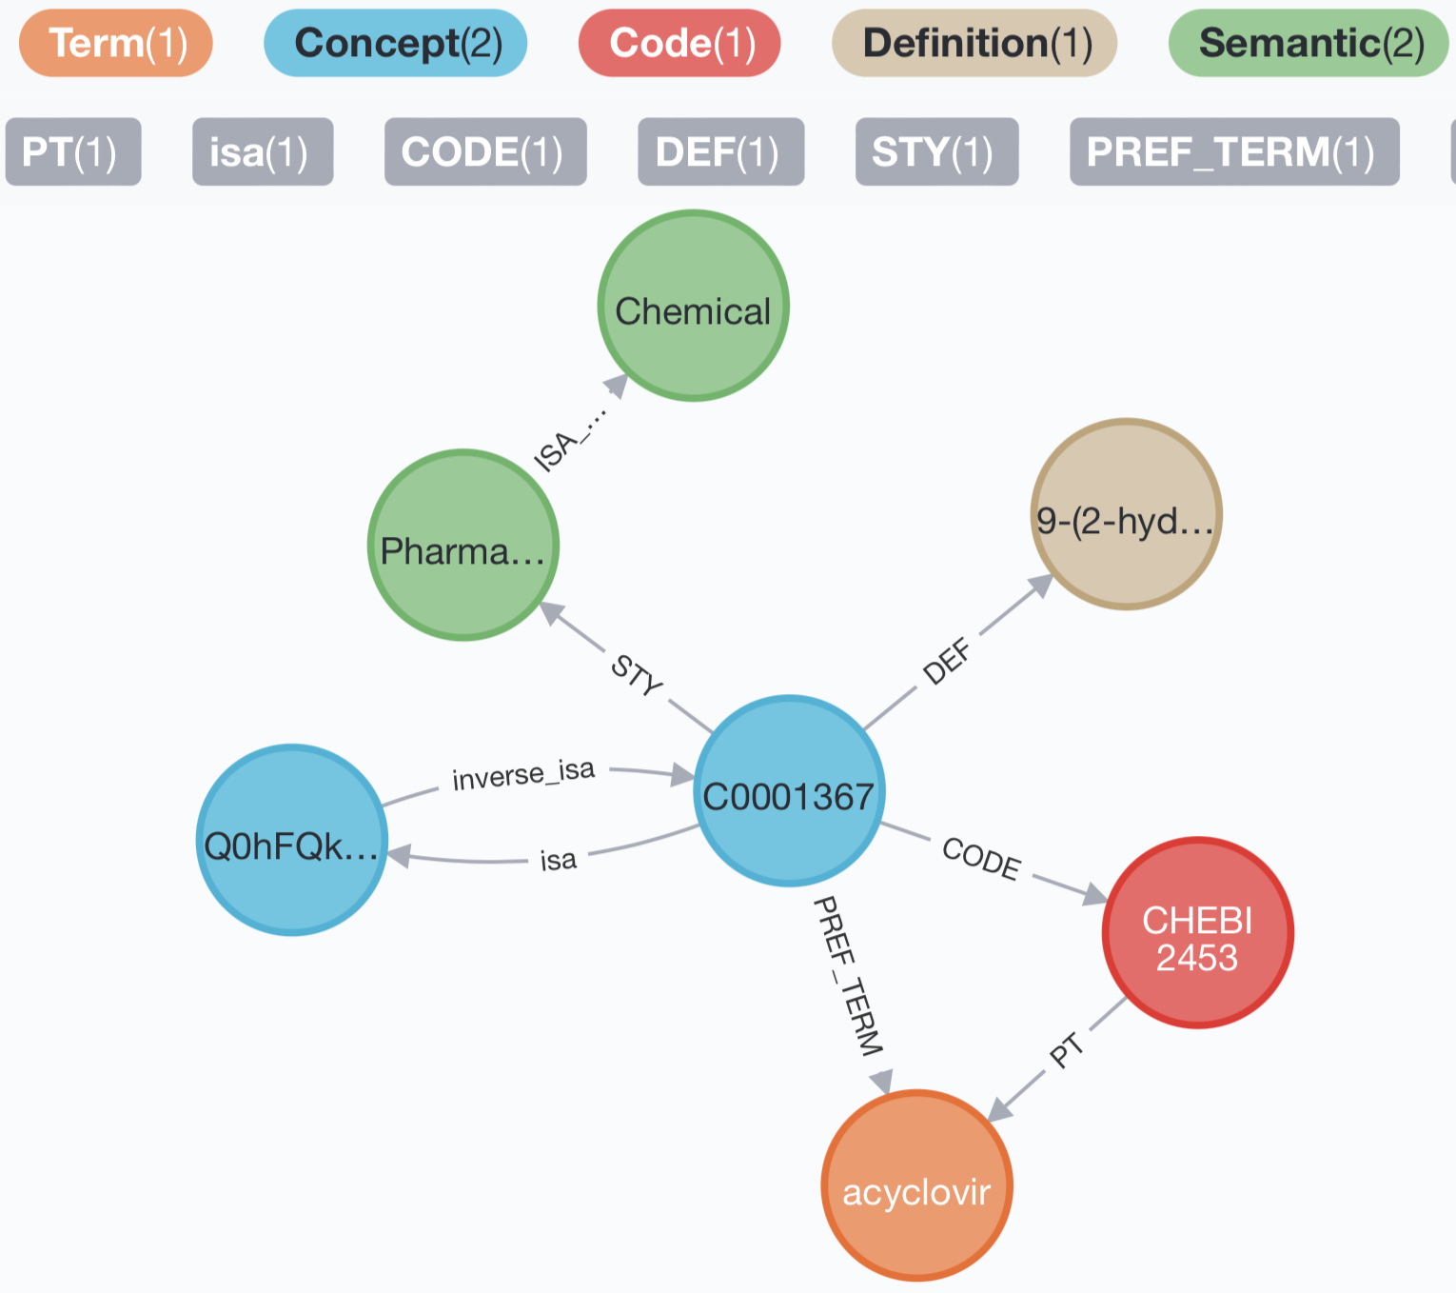
Biomedical Infrastructures (service architectures, vocabularies, interactive viz)
HuBMAP
Hybrid Cloud
Microservices
Architecture
https://software.docs.hubmapconsortium.org
Grayscale + Realistic Color = Perceptual
Knowledge Graph ‘Schema’

Slide 3
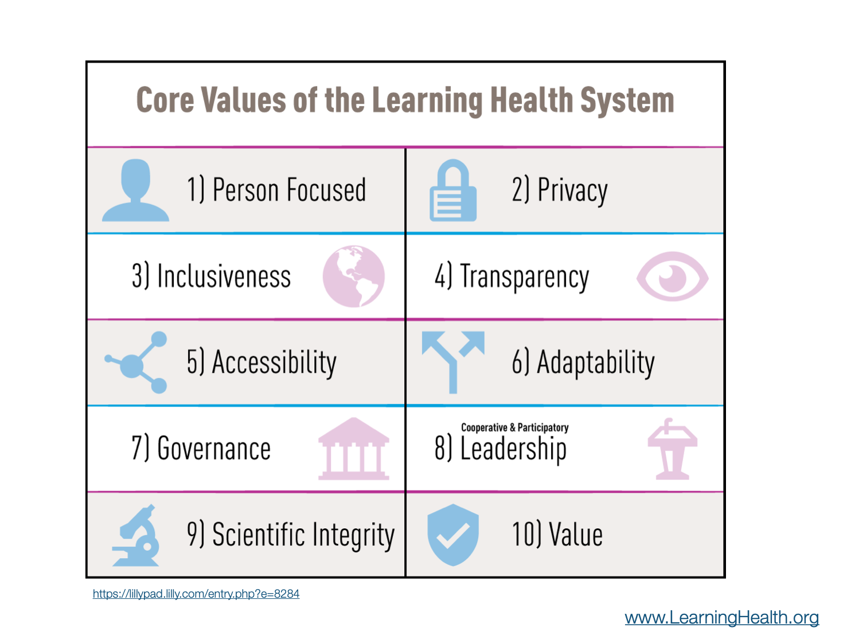
Learning Health Systems

Slide 4
Secure Data Liquidity, Collaborative Networks
R3
Health Record Research Request
Cellular Senescence Network

Slide 5
Active Research Networks as of Jan 2024
U24OH009077 (Becich) CDC/NIH/NIOSH 0.6 calendar
Sustaining the Expansion of the National Mesothelioma Virtual Bank (NMVB)
RI-CRN-2020-006 (McTigue; Becich) PCORI 0.6 calendar
Advancement of PCORnet Infrastructure: Clinical Research Network Project
OT2OD026554 (Reis) NIH/NCATS 0.6 calendar
All of Us Pennsylvania
UL1TR001857 (Reis) NIH/NCATS 1.8 calendar
Biomedical Informatics Core, Clinical and Translational Science Institute
OT2OD026675 (Blood; Silverstein) NIH/Office of the Director 2.4 calendar
Flexible Hybrid Cloud Infrastructure for Seamless Management of HuBMAP Resources
U24CA268108 (Silverstein; Blood; Bar-Joseph) NIH/NCI 2.4 calendar
Cellular Senescence Network (SenNet) Consortium Organization and Data Coordinating Center (CODCC)
SPEC-20-009 (Silverstein) BCRF 1.2 calendar
Breast Cancer Research Foundation Data Coordination Center
OT2OD030545 (Blood; Silverstein; Borner) NIH/CF Data Ecosystem 1.2 calendar
Amplifying the Value of HuBMAP Data Through Data Interoperability and Collaboration

Slide 6
Some 2023 Peer-Reviewed Publications
Schmidt S, Kim J, Jacobs MA, Hall DE, Stitzenberg KB, Kao LS, Brimhall BB, Wang CP, Manuel LS, Su HD, Silverstein JC, Shireman PK. Independent Associations of Neighborhood Deprivation and Patient-level Social Determinants of Health with Textbook Outcomes after Inpatient Surgery. Ann Surg Open [Internet]. 2023 Mar [cited 2023 Mar 19];4(1):e237. Available from: http://dx.doi.org/10.1097/as9.0000000000000237 PMCID: PMC10427124
Quardokus EM, Saunders DC, McDonough E, Hickey JW, Werlein C, Surrette C, Rajbhandari P, Casals AM, Tian H, Lowery L, Neumann EK, Björklund F, Neelakantan TV, Croteau J, Wiblin AE, Fisher J, Livengood AJ, Dowell KG, Silverstein JC, Spraggins JM, Pryhuber GS, Deutsch G, Ginty F, Nolan GP, Melov S, Jonigk D, Caldwell MA, Vlachos IS, Muller W, Gehlenborg N, Stockwell BR, Lundberg E, Snyder MP, Germain RN, Camarillo JM, Kelleher NL, Börner K, Radtke AJ. Organ Mapping Antibody Panels: a community resource for standardized multiplexed tissue imaging. Nat Methods [Internet]. 2023 Jul 19; Available from: http://dx.doi.org/10.1038/s41592-023-01846-7 PMCID: 10335836
Jain S, Pei L, Spraggins JM, Angelo M, Carson JP, Gehlenborg N, Ginty F, Gonçalves JP, Hagood JS, Hickey JW, Kelleher NL, Laurent LC, Lin S, Lin Y, Liu H, Naba A, Nakayasu ES, Qian WJ, Radtke A, Robson P, Stockwell BR, Van de Plas R, Vlachos IS, Zhou M, HuBMAP Consortium, Börner K, Snyder MP. Advances and prospects for the Human BioMolecular Atlas Program (HuBMAP). Nat Cell Biol [Internet]. 2023 Aug;25(8):1089–1100. Available from: http://dx.doi.org/10.1038/s41556-023-01194-w PMCID: 8238499
Oniani D, Parmanto B, Saptono A, Bove A, Freburger J, Visweswaran S, Cappella N, McLay B, Silverstein JC, Becich MJ, Delitto A, Skidmore E, Wang Y. ReDWINE: A clinical datamart with text analytical capabilities to facilitate rehabilitation research. Int J Med Inform [Internet]. 2023 Sep;177:105144. Available from: http://dx.doi.org/10.1016/j.ijmedinf.2023.105144 PMCID: PMC10528160
Rashid R, Copelli S, Silverstein JC, Becich MJ. REDCap and the National Mesothelioma Virtual Bank-a scalable and sustainable model for rare disease biorepositories. J Am Med Inform Assoc [Internet]. 2023 Sep 25;30(10):1634–1644. Available from: http://dx.doi.org/10.1093/jamia/ocad132 PMCID: PMC10531116
Schmidt S, Jacobs MA, Kim J, Hall DE, Stitzenberg KB, Kao LS, Brimhall BB, Wang CP, Manuel LS, Su HD, Silverstein JC, Shireman PK. Presentation Acuity and Surgical Outcomes for Patients With Health Insurance Living in Highly Deprived Neighborhoods. JAMA Surg [Internet]. 2024 Feb 7; Available from: http://dx.doi.org/10.1001/jamasurg.2023.7468 PMCID: PMC10851138

