Slide 1
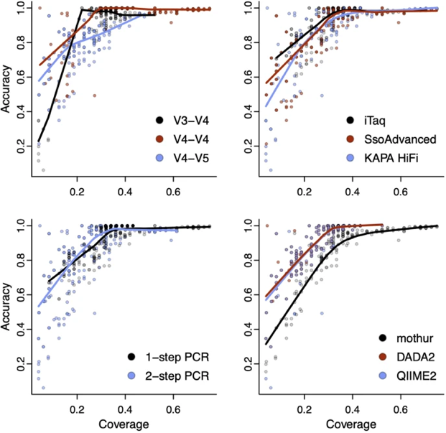
Department of Biomedical Informatics
Comparison of microbiome workflows reveals critical experimental and bioinformatics factors
De Wolfe, T. & Wright, E. Multi-factorial examination of amplicon sequencing workflows from sample preparation to bioinformatic analysis. BMC Microbiology. 2023.

