Slide 1
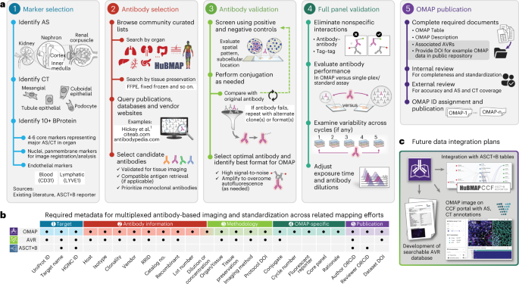
Organ Mapping Antibody Panels: a community resource for standardized multiplexed tissue imaging
Jonathan C. Silverstein, MD and staff leads: Kay Métis, MS and Bill Shirey, MS
Multiplexed antibody-based imaging enables the detailed characterization of molecular and cellular organization in tissues. Advances in the field now allow high-parameter data collection (>60 targets); however, considerable expertise and capital are needed to construct the antibody panels employed by these methods. Organ mapping antibody panels are community-validated resources that save time and money, increase reproducibility, accelerate discovery and support the construction of a Human Reference Atlas.
Process, required metadata, and future data integration plans for OMAP effort.
Funding Source: NIH
U24CA268108 SenNet
OT2OD026675 HuBMAP
a, Main milestones in constructing an OMAP, outlined via steps 1–5. Nephron and renal corpuscle illustrations were adapted from the HuBMAP CCF 2D Reference Object Library²¹. b, Metadata table illustrates the common fields shared across HuBMAP entities (OMAP, AVR and ASCT+B) to enhance search capabilities and promote community adoption of controlled vocabularies. Visit the Human Reference Atlas Portal (https://humanatlas.io/) for more details. c, In the future, OMAPs will be linked directly to the AVR searchable database, such that users can easily query information about BProtein markers for a specific OMAP. The ARWG is also collaborating with the Vitessce¹⁹ software team to create a user interface with grouped image channels by BProtein and CT that additionally displays annotations by subject matter experts.
Quardokus E, Saunders D, McDonough E,… Silverstein JC… Organ Mapping Antibody Panels: a community resource for standardized multiplexed tissue imaging. Nature Methods 20, 1174-1178 (2023) https://doi.org/10.1038/s41592-023-01846-7

