Slide 1
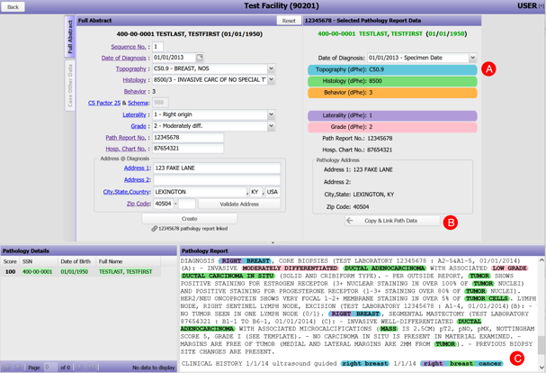
DeepPhe-CR: Natural Language Processing Software Services for Cancer Registrar Case Abstraction
Harry Hochheiser, Associate Professor, University of Pittsburgh
Hochheiser H, Finan S, Yuan Z, Durbin EB, Jeong JC, Hands I, Rust D, Kavuluru, R, Wu, XC, Warner JL, Savova G.
JCO Clinical Care Informatics 7(7). https://doi.org/10.1200/CCI.23.00156
Manual extraction of case details from patient records for cancer surveillance is a resource-intensive task. Natural Language Processing (NLP) techniques have been proposed for automating the identification of key details in clinical notes. We used cancer registry manual abstraction processes to guide the design of DeepPhe-CR, a web-based NLP service API. The coding of key variables was performed through NLP methods validated using established workflows. A container-based implementation of the NLP methods and the supporting infrastructure was developed. An initial usability study with data registrars provided early validation of the feasibility of the DeepPhe-CR tools. Funding: UH3CA243120 Natural Language Processing Platform for Cancer Surveillance (MPI)

