Slide 1
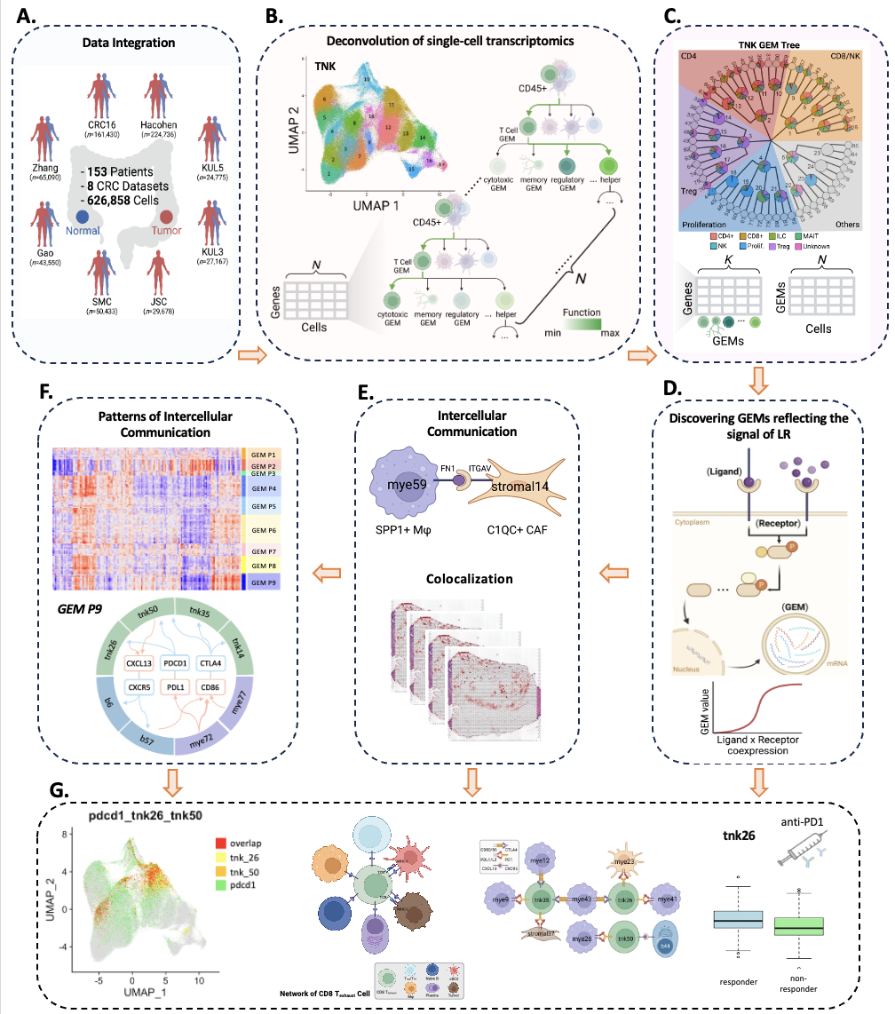
Department of Biomedical Informatics
We developed a topic modeling method to learn nested tree-structured gene expression modules (GEMs) that reflect cellular functions and transcriptomic processes of a specific cell type in the tumor microenvironment of colorectal cancer.
GEMs could be used as new representations of cellular states to deconvolute bulk RNA-seq data and spatial transcriptomics.
By incorporating the biological knowledge of ligand-receptor interactions into the causal discovery, our model successfully learnt the intercellular interactions among cell types (T, B, Myeloid, Stromal, and Epithelial cells).
We further validated the inferred cell-cell communication using spatial transcriptomics, which measured all the gene activity in a tissue and mapped where the activity was occurring.
We successfully identified GEMs involved in the ligand-receptor signaling, which could be used as novel biomarker for therapies such as anti-PD-1 immunotherapy.
1. Zhang, H., Lu, X., Lu, B. and Chen, L. (2023) scGEM: Unveiling the Nested Tree-Structured Gene Co-Expressing Modules in Single Cell Transcriptome Data. Cancers, 15(17), p.4277.
2. Chen, L., Zhang, H., et al (2023) Deconvoluting single-cell transcriptomics reveals cellular programs regulated by cell-cell communication in colorectal cancer. Under submission.
3. Chen, X.*, Chen, L.*, et al (2022) An individualized causal framework for learning intercellular communication networks that define microenvironments of individual tumors. PLOS Computational Biology, 18(12), p.e1010761.

