Slide 1



Developing deep learning models for precision oncology
Lujia Chen
Assistant Professor
Department of Biomedical Informatics, School of Medicine, University of Pittsburgh
Contact: luc17@pitt.edu
Phone: 412-736-7952
Google scholar profile: https://scholar.google.com/citations?user=L7f-43gAAAAJ&hl=en

Slide 2
Major goals of current research
Uses machine learning, especially deep learning models, to simulate the hierarchical organization of cellular signaling systems and to systematically identify major cancer signaling pathways.
Detect tumor-specific aberrations in signaling pathways, and predict cancer cells’ sensitivity to anti-cancer drugs, which help guide the personalized treatment based on patients’ individual genomic status.
Use individual patient’s genomic data (e.g. bulk RNA-seq, single-cell RNA-seq and spatial transcriptomics) to select candidate drugs (single drug/drug combination) and predict drug response rate.
Use the combination of deep learning and causal discovery to study the intercellular communication in the tumor microenvironment.
Provide insights on gene signatures and representation of transcriptomic processes that are most sensitive to drug response.
Publications:
1. Zhang, H., Lu, X., Lu, B. and Chen, L. (2023) scGEM: Unveiling the Nested Tree-Structured Gene Co-Expressing Modules in Single Cell Transcriptome Data. Cancers, 15(17), p.4277.
2. Chen, L., Zhang, H., et al (2023) Deconvoluting single-cell transcriptomics reveals cellular programs regulated by cell-cell communication in colorectal cancer. Under submission.
3. Chen, X.*, Chen, L.*, et al (2022) An individualized causal framework for learning intercellular communication networks that define microenvironments of individual tumors. PLOS Computational Biology, 18(12), p.e1010761.
4. Ding, M.Q., Chen, L., Cooper G.F., Young, J.D., Lu X. (2018) Precision Oncology beyond Targeted Therapy: Combining Omics Data with Machine Learning Matches the Majority of Cancer Cells to Effective Therapeutics, Molecular cancer research : MCR, 16, 269-278.
Funding Support:
Developing deep learning models for precision oncology (PI, NIH R00, 4R00LM013089, Feb 2022 – Feb 2025)
Notes:
3. Chen, L., Cai C., Chen V., Lu X. (2016) Learning a hierarchical representation of the yeast transcriptomic machinery using an autoencoder model, BMC bioinformatics, 17 Suppl 1, 9.

Slide 3
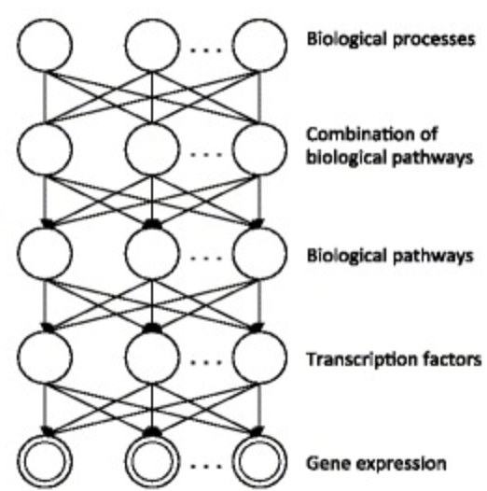
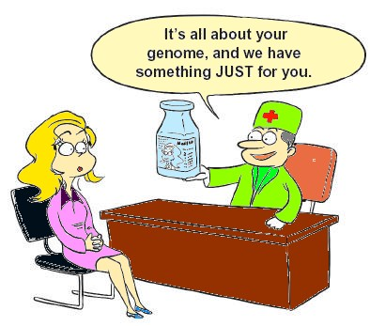
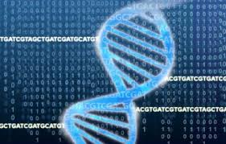
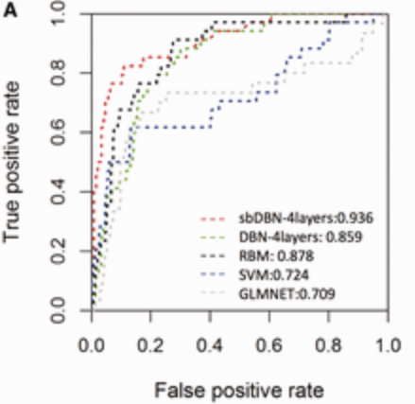

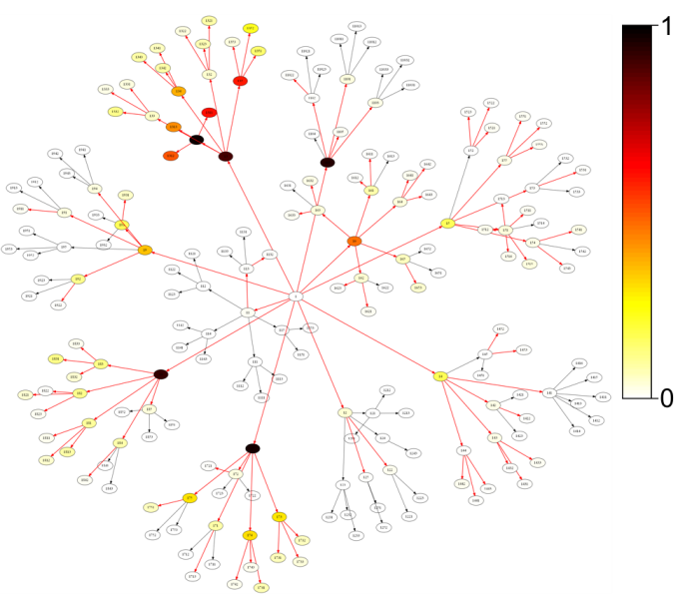
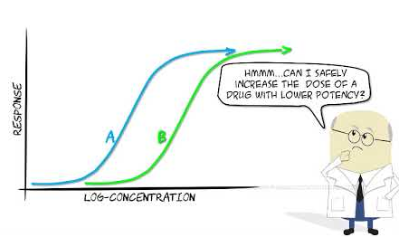

Deep Learning for precision oncology
e.g. Deep Autoencoder
Gene Modules/Pathways
Cancer Subtype Analysis
Personalized
medicine
Genomic Data
(single-cell and bulk-cell)
G1
G2
… …
Gn
T1
Tumors
Deep Learning Model
T2
… …
Tm
Drug prediction
Tumor Representation
Drug Sensitivity Analysis
(machine learning classifiers)
Drug response
e.g. Topic Modeling
Diagonosis
Survival Analysis
Publications:
Chen, L., Wang, Y., et al. (2023) Machine Learning Predicts Oxaliplatin Benefit in Early Colon Cancer. Journal of Clinical Oncology. Formally accepted.
Liu, Z., Cai, C., Ma, X., Liu, J., Chen, L., Lui, V.W.Y., Cooper, G.F. and Lu, X. (2022) A Novel Bayesian Framework Infers Driver Activation States and Reveals Pathway-Oriented Molecular Subtypes in Head and Neck Cancer. Cancers, 14(19), p.4825.
Ding, M.Q., Chen, L., Cooper G.F., Young, J.D., Lu X. (2018) Precision Oncology beyond Targeted Therapy: Combining Omics Data with Machine Learning Matches the Majority of Cancer Cells to Effective Therapeutics, Molecular cancer research : MCR, 16, 269-278.
Chen, L., Cai C., Chen V., Lu X. (2016) Learning a hierarchical representation of the yeast transcriptomic machinery using an autoencoder model, BMC bioinformatics, 17 Suppl 1, 9.
Notes:
https://medchrome.com/patient/the-promise-of-personalized-medicine/
https://www.shutterstock.com/search/drugs+cartoon
https://www.pngwing.com/en/free-png-bkaoc
https://www.niaid.nih.gov/research/genomic-data-sharing

Slide 4
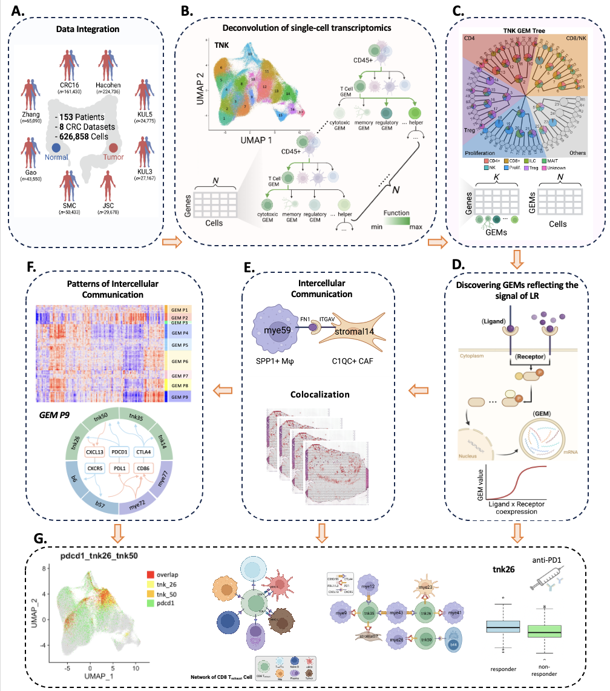
Combination of machine learning models and causal discovery for studying tumor microenvironment
We developed a topic modeling method to learn nested tree-structured gene expression modules (GEMs) that reflect cellular functions and transcriptomic processes of a specific cell type in the tumor microenvironment of colorectal cancer.
GEMs could be used as new representations of cellular states to deconvolute bulk RNA-seq data and spatial transcriptomics.
By incorporating the biological knowledge of ligand-receptor interactions into the causal discovery, our model successfully learnt the intercellular interactions among cell types (T, B, Myeloid, Stromal, and Epithelial cells).
We further validated the inferred cell-cell communication using spatial transcriptomics, which measured all the gene activity in a tissue and mapped where the activity was occurring.
We successfully identified GEMs involved in the ligand-receptor signaling, which could be used as novel biomarker for therapies such as anti-PD-1 immunotherapy.
1. Zhang, H., Lu, X., Lu, B. and Chen, L. (2023) scGEM: Unveiling the Nested Tree-Structured Gene Co-Expressing Modules in Single Cell Transcriptome Data. Cancers, 15(17), p.4277.
2. Chen, L., Zhang, H., et al (2023) Deconvoluting single-cell transcriptomics reveals cellular programs regulated by cell-cell communication in colorectal cancer. Under submission.
3. Chen, X.*, Chen, L.*, et al (2022) An individualized causal framework for learning intercellular communication networks that define microenvironments of individual tumors. PLOS Computational Biology, 18(12), p.e1010761.

Slide 5
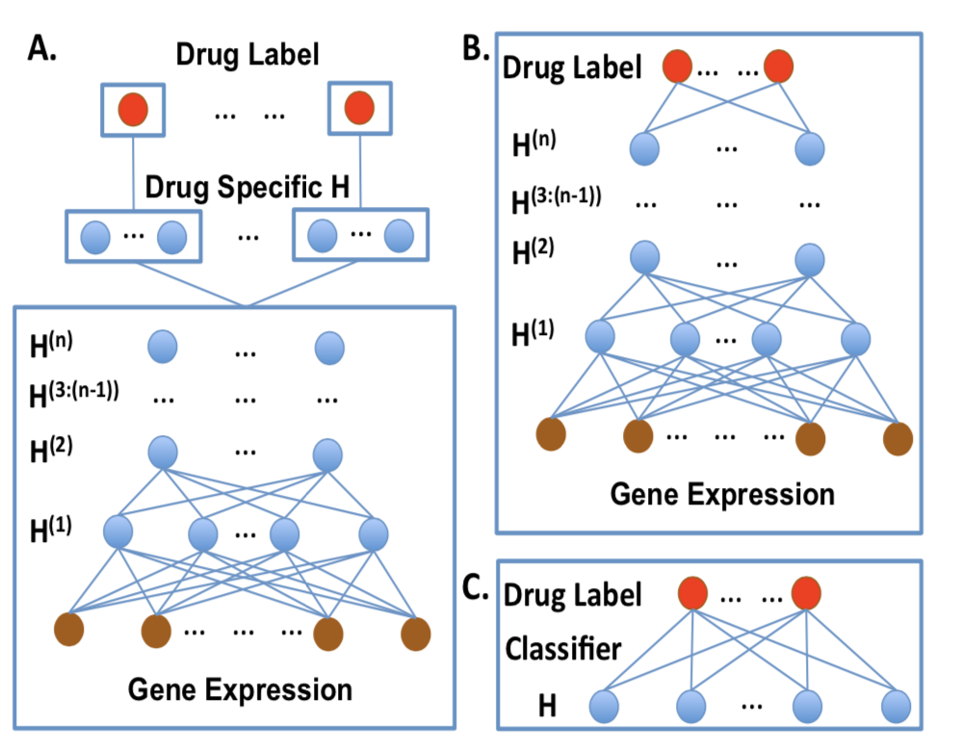
Develop Deep Learning Models (DLMs) for drug prediction
Develop DLMs to simulate the hierarchical organization of cellular signaling systems and to systematically identify major cancer signaling pathways.
Use the representations of cancer signaling pathways to improve the drug response prediction.
Example of three DLM multi-task learning models
(A) Supervised DLM with intermediate shared deep hidden layers and drug specific hidden layer on top.
(B) Supervised DLM with multi-task classifier;
(C) Semi-supervised DLM using hidden representation learned from unsupervised DLM with multi- task classifier.
Publications:
1. Chen, L., Lu, X. (2018) Discovering functional impacts of miRNAs in cancers using a causal deep learning model, BMC medical genomics, 11, 116.
2. Lu, S., Fan, X., Chen, L., Lu, X. (2018) A novel method of using Deep Belief Networks and genetic perturbation data to search for yeast signaling pathways, Plos One, 13, 9.
3. Chen, L., Cai C., Chen V., Lu X. (2016) Learning a hierarchical representation of the yeast transcriptomic machinery using an autoencoder model, BMC bioinformatics, 17 Suppl 1, 9.
4. Chen, L., Cai C., Chen V., Lu X. (2015) Trans-species learning of cellular signaling systems with bimodal deep belief networks, Bioinformatics, 31, 3008-3015.

Slide 6
Deep Learning in Precision Oncology
Develop and apply machine learning, especially deep learning models and causal discovery, to systematically identify major cancer signaling pathways and cell-cell communication in the tumor microenvironment of cancer patients. This aims to enhance the discovery of patient-specific gene signature biomarkers and guide drug selection.
Collaborators in the following areas:
  Artificial Intelligence especially Deep Learning
  Cancer biology
  Drug discovery
  Immunology
Notes:
Develop and apply machine learning, especially deep learning models and causal discovery, to systematically identify major cancer signaling pathways and cell-cell communication in the tumor microenvironment of cancer patients. This aims to enhance the discovery of patient-specific gene signature biomarkers and guide drug selection

Slide 7
Recent publications

