Slide 1
A Survey of Heterogeneous Transfer Learning
Ye Ye, Assistant Professor, University of Pittsburgh
Bao R, Sun Y, Gao Y, Wang J, Yang Q, Chen H, Mao Z, Ye Y*. 2023. https://arxiv.org/abs/2310.08459 (Corresponding author) Under Review by IEEE Transactions on Neural Networks and Learning Systems.
We present a survey of recent developments in heterogeneous transfer learning methods, offering a systematic guide for future research. Our paper reviews methodologies for diverse learning scenarios, discusses the limitations of current studies, and covers various application contexts, including Natural Language Processing, Computer Vision, Multimodality, and Biomedicine, to foster a deeper understanding and spur future research.
Funding: R00LM013383 Transfer Learning to Improve the Re-usability of Computable Biomedical Knowledge (PI)

Slide 2
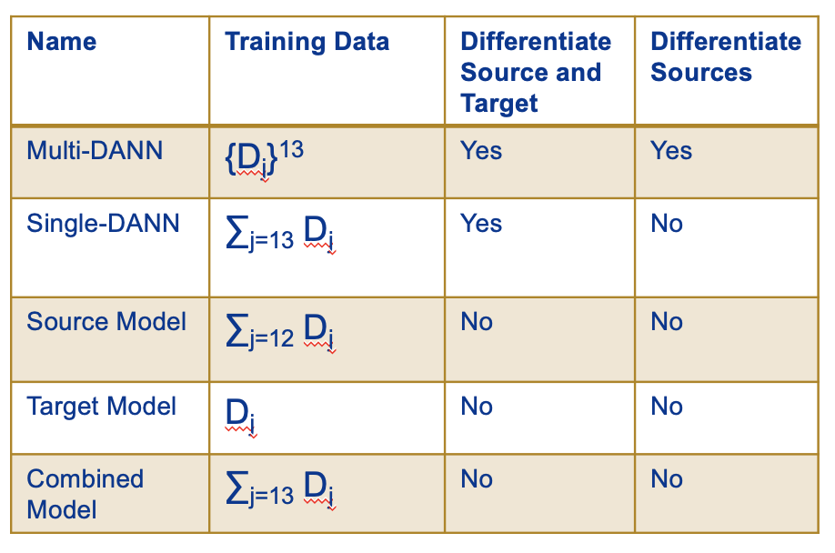
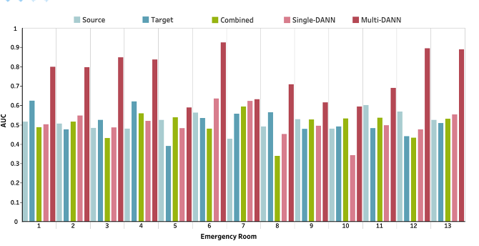
Prediction of COVID-19 Patients' Emergency Room Revisit using Multi-Source Transfer Learning.
Ye Ye, Assistant Professor, University of Pittsburgh
Yuelyu Ji, Yuhe Gao, Runxue Bao, Qi Li, Disheng Liu, Yiming Sun, and Ye Ye*. Prediction of COVID-19 Patients' Emergency Room Revisit using Multi-Source Transfer Learning. In 2023 IEEE 11th International Conference on Healthcare Informatics (ICHI) 2023 Jun 26 (pp. 138-144).
The study analyzed Electronic Health Records from 3,210 COVID-19 ER visits at the University of Pittsburgh Medical Center to predict 7-day revisits. It used ScispaCy for data extraction and the Domain Adversarial Neural Network (DANN) to address data variability, evaluating multiple modeling strategies for effectiveness.
Funding: R00LM013383 Transfer Learning to Improve the Re-usability of Computable Biomedical Knowledge (PI)
Multi-DANN models outperformed the Single-DANN models and baseline models in predicting revisits of COVID-19 patients to the ER within 7 days after discharge. Notably, the Multi-DANN strategy effectively addressed the heterogeneity among multiple source domains and improved the adaptation of source data to the target domain. Moreover, the high performance of Multi-DANN models indicates that EHRs are informative for developing a prediction model to identify COVID-19 patients who are very likely to revisit an ER within 7 days after discharge.

