Slide 1
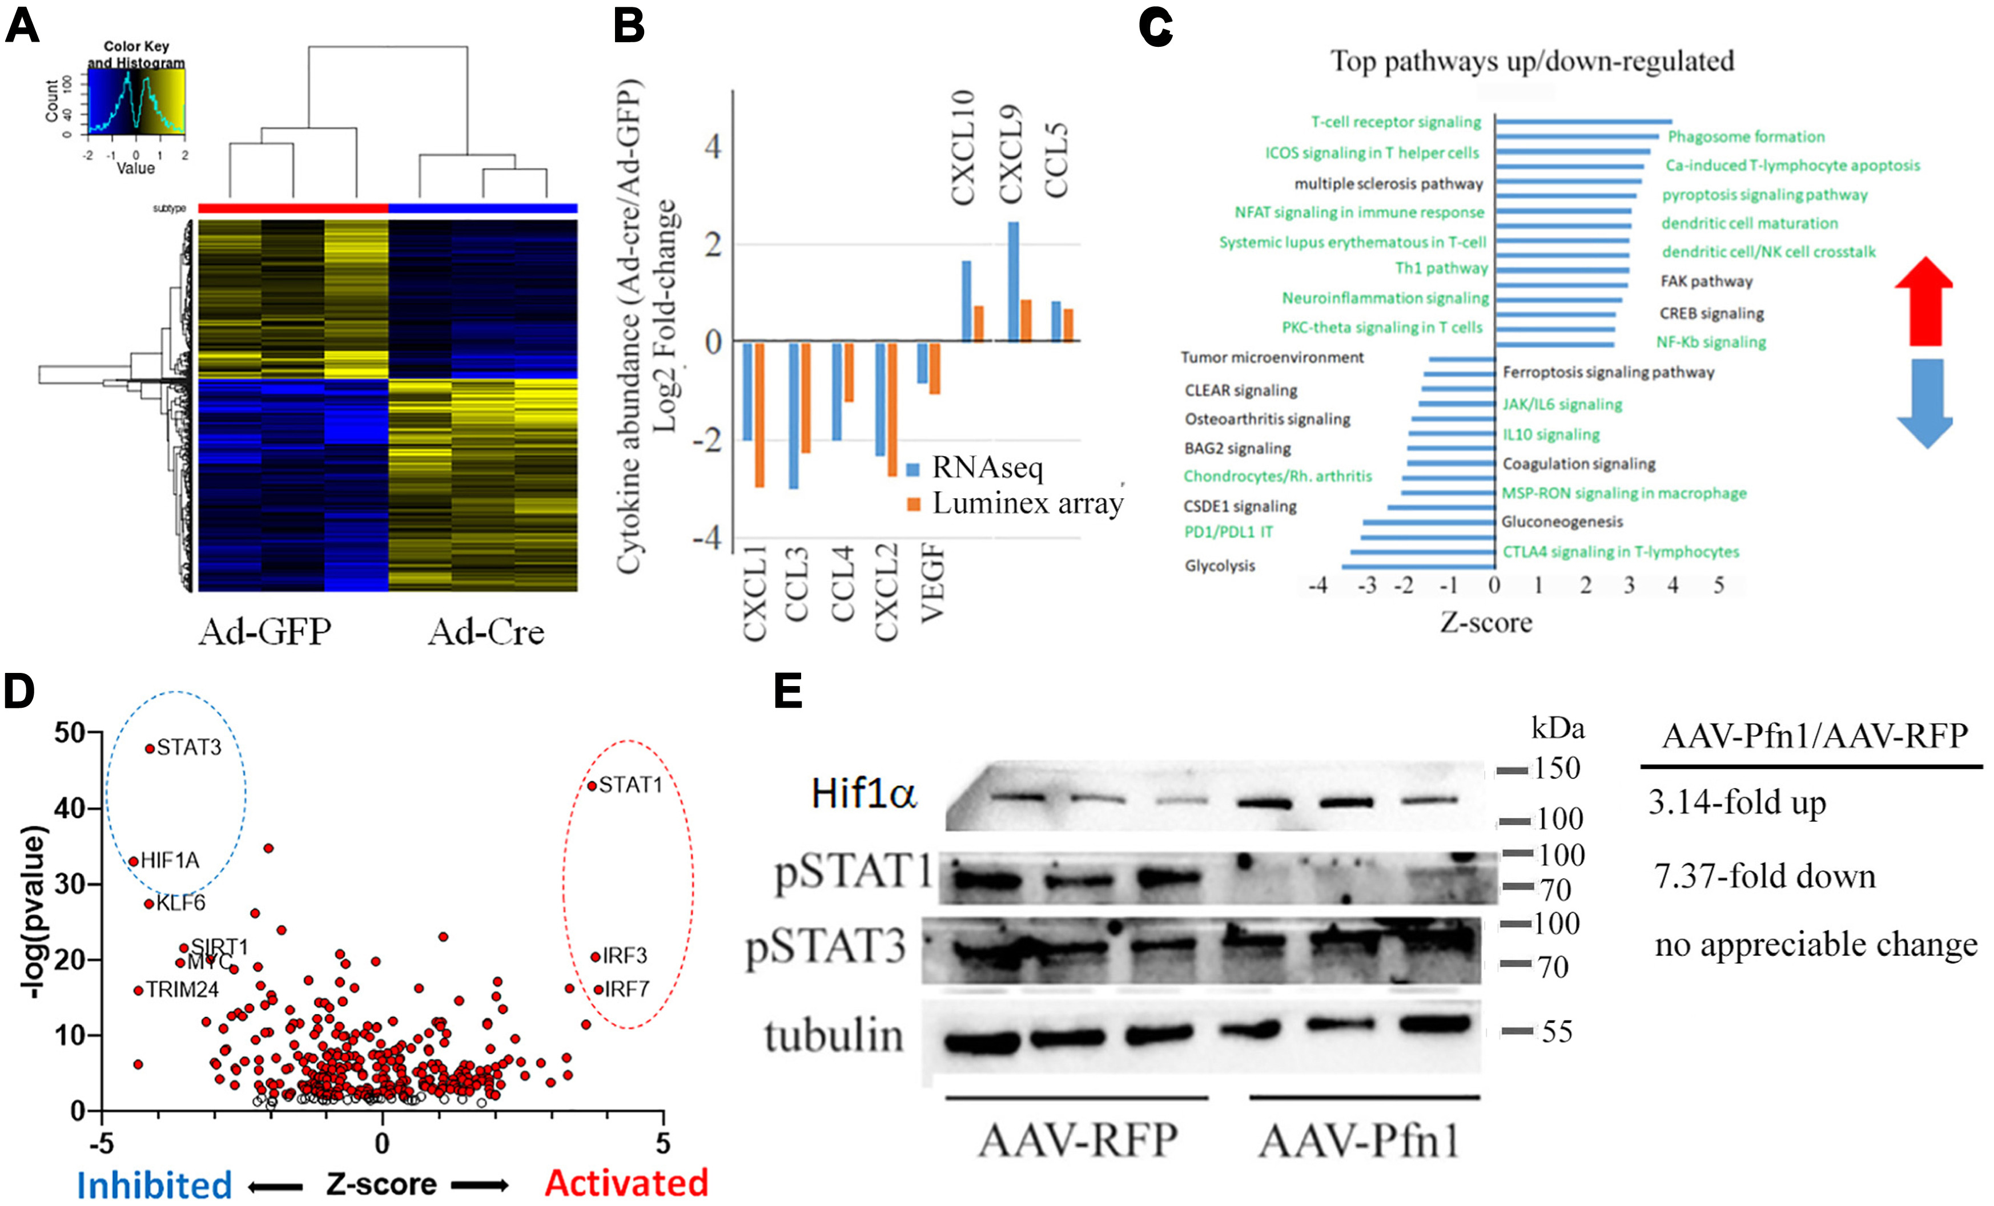
Vascular endothelial profilin-1 drives protumorigenic tumor microenvironment and tumor progression in renal cancer.
David Gau, Andrew Daoud, Abigail Allen, Marion Joy, April Sagan, Sanghoon Lee, Peter Lucas, Stefan Duensing, David Boone,
Hatice Osmanbeyoglu, and Partha Roy. JBC. 2023.

