Slide 1

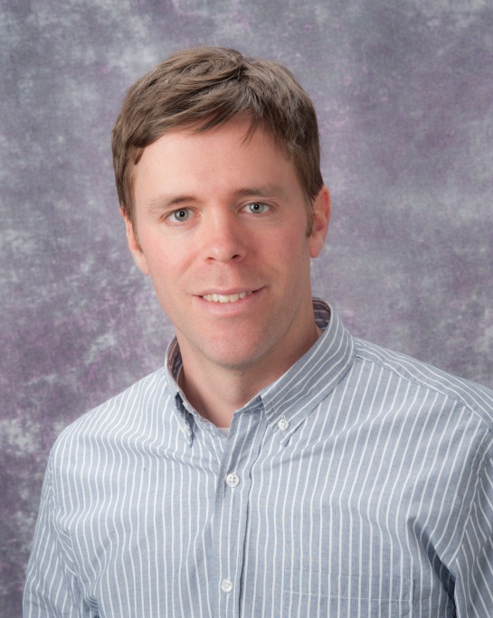







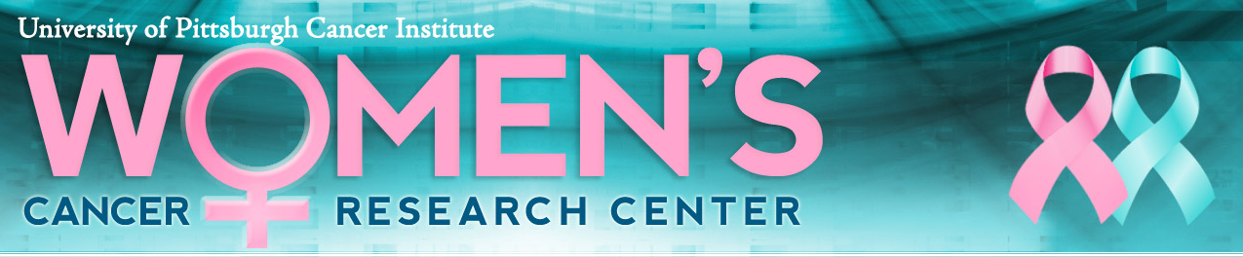


David Boone
Assistant Professor
Department of Biomedical Informatics
University of Pittsburgh
Director of Hillman Academy
Director of CoSBBI/iBRIC
dnb14@pitt.edu; 7243226668
https://hillmanacademy.upmc.com/
https://www.stempushnetwork.org/
https://www.youtube.com/channel/UCC_n1kISicItwgeo64LcDSg/videos
https://be-stem.pitt.edu/
Major interests:
STEM Outreach/Pathway programs
Cancer Genomics

Slide 2

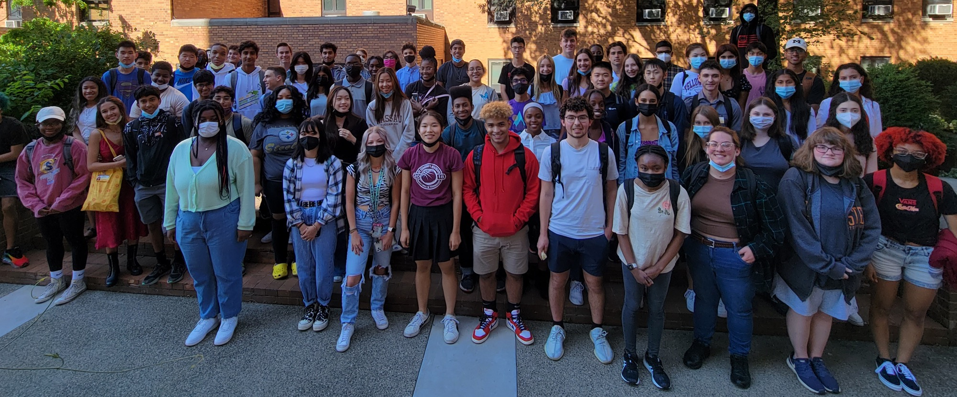



Hillman Cancer Center Academy
Top 100 Global Education Innovations
Ends March 2026
~500k/annual
Ends Dec 2023
~135k/annual
June 20 – Aug 5*
David Boone, PhD
Solomon Livshits
Our Mission
The Hillman Academy strives to provide mentorship and authentic research and career preparatory experiences to a diverse group of motivated high school students who are interested in pursuing higher education and careers in STEM fields, especially research and medicine.
Ayoob…Boone. JSO. 2022
Delale-Oconnor. CSL. 2021
Fung…Boone. JSO. 2021
Allen. CSL. 2020

Slide 3
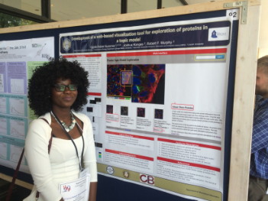
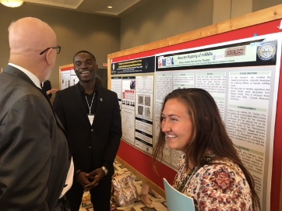
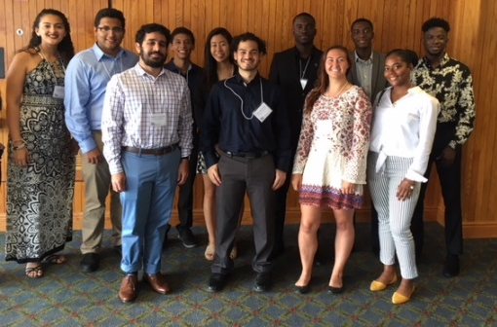
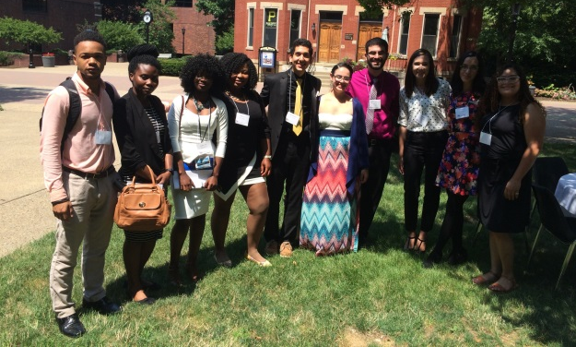
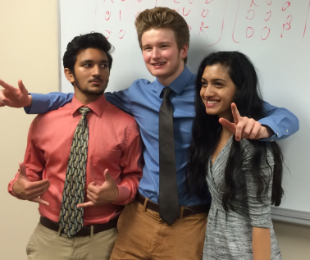





Internship in Biomedical Research, Informatics, and Computer Science (iBRIC) now Accessible and Inclusive Biomedical Informatics and Data Science (AIBIDS)
Mission
Build a foundation for a career in biomedical data science for undergraduates from underrepresented backgrounds through immersive, challenging, authentic, and mentored research and training experiences in the emerging fields of big data, computer science, computational and systems biology, and biomedical informatics
CoSBBI/Hillman Academy
Current Funding both new :
NLM R25 – Boyce
NHGRI R25 (students only) - Garcia
Details
10-week authentic research project
Mentorship
Academic preparatory experiences
Presentations
Internship
Career
iBRIC

Slide 4

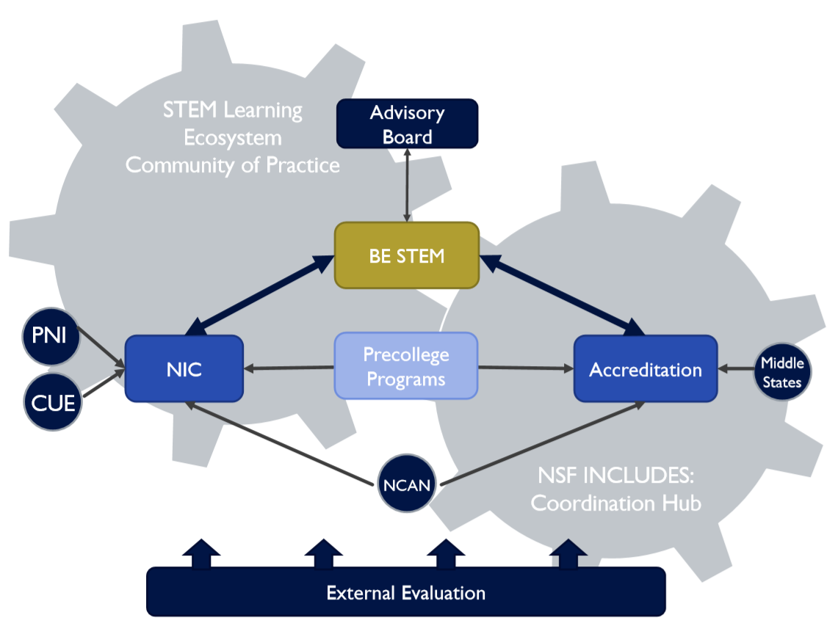
STEM PUSH
https://www.stempushnetwork.org/
Currently 9 cities
40+ PCSPs and partners
https://www.stempushnetwork.org/network-directory/
https://be-stem.pitt.edu/
Funding - $2 million annual
Delale-Oconnor. CSL. 2021
Allen. CSL. 2020

Slide 5
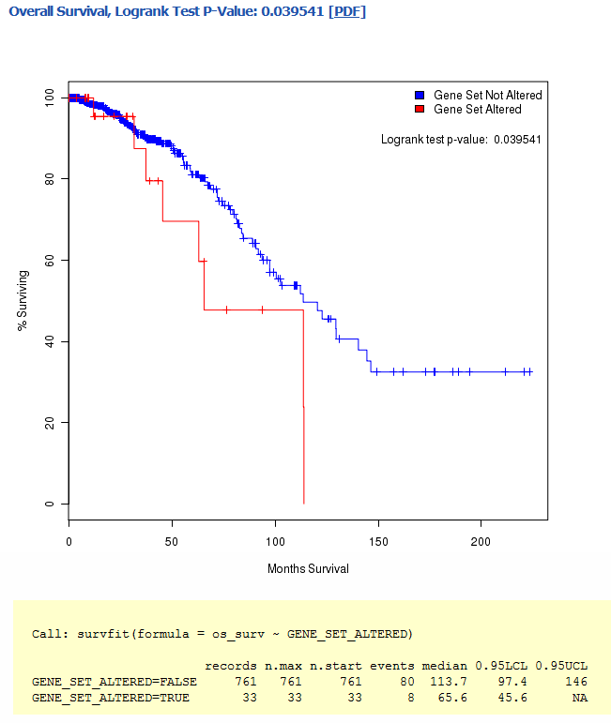
Cancer Genomics
IGF1
Basal
Normal-like
Her2
LumA
LumB
Boone et al. Scientific Reports 2020
Warburton and Boone. Curr Pathobiol Rep. 2017
Sreekumar. Endocrinology. 2020
Gau. JBC. 2020
Funding: GAC and Roy
IGF1R
PI3K
AKT
mTOR
MAPK
-2.0
2.0
Logrank test p-value: 0.0395
100
Unaltered SNHG7
Growth
Survival
80
Proliferation
% Surviving
60
Upregulated SNHG7
40
20
0
0
50
100
150
200
Months Survival

Slide 6
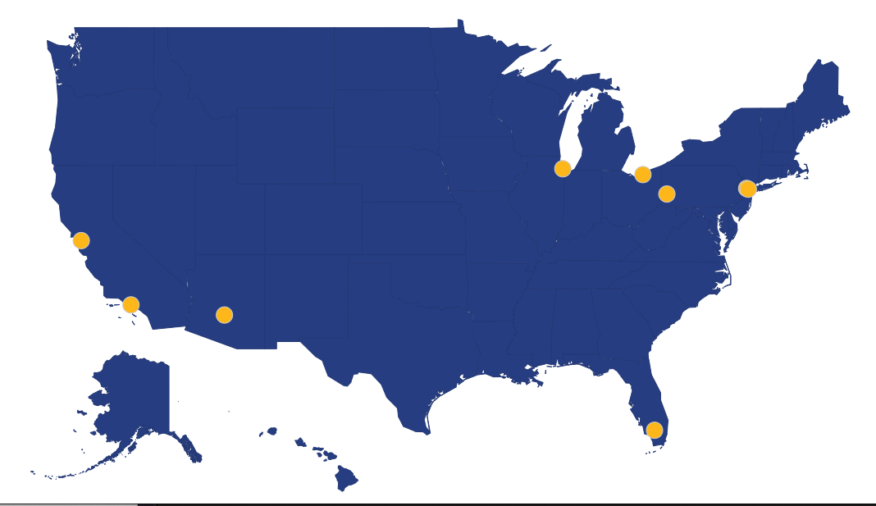
Moonshot – Improve, sustain, and grow Hillman Academy and iBRIC/AIBIDS through R25 renewal and philanthropy and participation/leadership in STEM PUSH and local community-based organizations
CoSBBI/Hillman Academy
Internship
Career
iBRIC/AIBIDS

