Slide 1
AI in Population Health
Multidisciplinary Background :
Preventive Medicine (BMED, MD Equivalent), Epidemiology and Health Statistics (MS), Public Health Informatics (MS), and Artificial Intelligence (PhD)
Research Interests:
Developing artificial intelligence techniques (e.g., transfer learning, machine learning, natural language processing) and statistical methods (e.g., Bayesian statistics, linear models, survival analysis) to analyze large-scale healthcare data (e.g., electronic medical records, administrative data, questionnaire surveys) and social media data (e.g., tweets) for
Infectious Disease Surveillance
Cancer Surveillance
Healthcare Management (Quality and Cost)
Ye, Ye
Assistant Professor
Faculty Mentors: Drs. Michael Becich (primary), Gregory Cooper
Department of Biomedical Informatics, University of Pittsburgh
Contact: yey5@pitt.edu Phone: 412-925-2746
LinkedIn: https://www.linkedin.com/in/ye-ye-88815731/
Google scholar profile: https://scholar.google.com/citations?hl=en&authuser=3&user=DSkE5P0AAAAJ

Slide 2
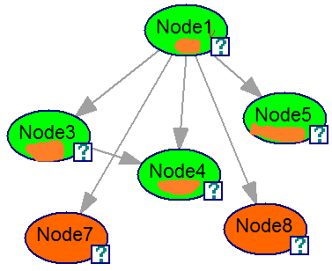
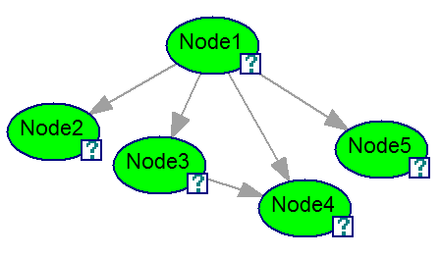
Bayesian Network Transfer Learning
target domain and task (e.g., influenza detection in Emergency Departments at Intermountain Healthcare (IH), Utah)
I developed an innovative transfer learning framework to share both data and models between two different settings (e.g., hospitals). To the best of my knowledge, this research is the first investigation of model-based transfer learning in biomedicine under heterogeneous scenarios.
Publications:
Ye Y. Transfer Learning for Bayesian Case Detection Systems. Doctoral dissertation, University of Pittsburgh. 2018. *American Medical Informatics Association Doctoral Dissertation Award Finalist (Top 5) in 2019.
Ye Y, Wagner MM, Cooper GF, et al. Bayesian network transfer learning to improve re-usability of computable biomedical knowledge for public health. Poster abstract accepted by Mobilizing Computable Biomedical Knowledge 2nd Annual Meeting in National Institutes of Health - Bethesda, MD, July 18-19, 2019.
Ye Y, Wagner MM, Cooper GF, et al. A study of the transferability of influenza case detection systems between two large healthcare systems. PLoS One. 2017 Apr 5;12(4):e0174970.
Ferraro JP, Ye Y, Gesteland PH, et al. The effects of natural language processing on cross-institutional portability of influenza case detection for disease surveillance. Applied Clinical Informatics. 2017 Feb;8(02):560-80.
Funding Supports:
Arts and Sciences Fellowship, U Pittsburgh, Sep 2016 – May 2017
Andrew Mellon Fellowship, U Pittsburgh, Sep 2017 – May 2018
K99, NLM, May 2020 – April 2022
R00, NLM, May 2022 – April 2025
source domain and task
(e.g., influenza detection in Emergency Departments at University of Pittsburgh Medical Center (UPMC), Pennsylvania)
IH model
UPMC Data / UPMC Model
UPMC model

Slide 3
Deep Transfer Learning
Models
DANN
Model-based Transfer Learning
Baseline
Topaz NLP system
Naïve Bayes network
Synthetic dataset
Objective
Whether, when and how deep transfer learning may be useful for infectious disease case detection in emergency department visits
Target
Concept Unique
Identifiers code
IHC’s EHR
Features
Source
Set of Naïve Bayes network, with different KL divergence
Funding:
R00LM013383 Transfer Learning to Improve the Re-usability of Computable Biomedical Knowledge
Software and synthetic data: https://github.com/AI-In-Population-Health-Lab/Deep-Transfer-Learning-Package-Release-V1
Model-based Transfer Learning
Result & Conclusion
Transfer learning is useful to facilitate healthcare data or model sharing to enhance infectious disease case detection. Our experimental results show that model-based transfer learning attains a performance similar to that of classic data-based transfer learning, indicating that sharing models can be useful and sufficient.
Domain Adversarial Neural Networks

Slide 4
A Survey of Heterogeneous Transfer Learning
Bao R, Sun Y, Gao Y, Wang J, Yang Q, Chen H, Mao Z, Ye Y*. 2023. https://arxiv.org/abs/2310.08459 (Corresponding author) Under Review by IEEE Transactions on Neural Networks and Learning Systems.
We present a survey of recent developments in heterogeneous transfer learning methods, offering a systematic guide for future research. Our paper reviews methodologies for diverse learning scenarios, discusses the limitations of current studies, and covers various application contexts, including Natural Language Processing, Computer Vision, Multimodality, and Biomedicine, to foster a deeper understanding and spur future research.
Funding: R00LM013383 Transfer Learning to Improve the Re-usability of Computable Biomedical Knowledge (PI)

Slide 5
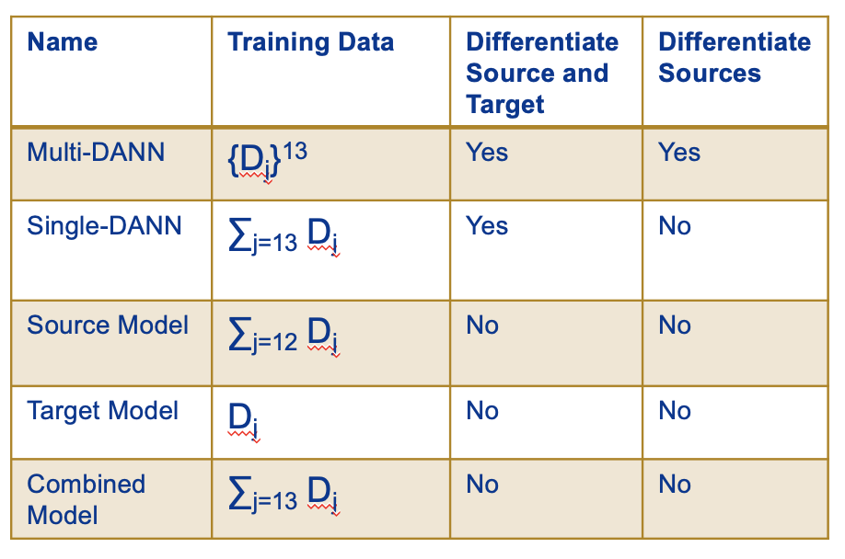
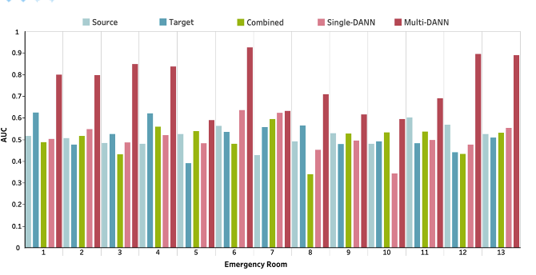
Prediction of COVID-19 Patients' Emergency Room Revisit using Multi-Source Transfer Learning.
Ji Y, Gao Y, Bao R, Li Q, Liu D, Sun Y, Ye Y*. Prediction of COVID-19 Patients' Emergency Room Revisit using Multi-Source Transfer Learning. https://arxiv.org/abs/2306.17257. 2023 Jun 29. (Accepted and presented in IEEE ICHI) (Corresponding author)
The study analyzed Electronic Health Records from 3,210 COVID-19 ER visits at the University of Pittsburgh Medical Center to predict 7-day revisits. It used ScispaCy for data extraction and the Domain Adversarial Neural Network (DANN) to address data variability, evaluating multiple modeling strategies for effectiveness.
Funding: R00LM013383 Transfer Learning to Improve the Re-usability of Computable Biomedical Knowledge (PI)
Multi-DANN models outperformed the Single-DANN models and baseline models in predicting revisits of COVID-19 patients to the ER within 7 days after discharge. Notably, the Multi-DANN strategy effectively addressed the heterogeneity among multiple source domains and improved the adaptation of source data to the target domain. Moreover, the high performance of Multi-DANN models indicates that EHRs are informative for developing a prediction model to identify COVID-19 patients who are very likely to revisit an ER within 7 days after discharge.

Slide 6
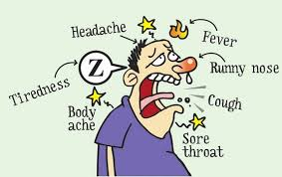
Infectious Disease Surveillance
We developed a near real-time, active surveillance approach that uses machine-learned case detection systems to automatically capture cases from electronic medical records. We established an efficient and effective communication channel between public health and clinical practice.
Publications:
Ye Y, Tsui F, Wagner M, et al. Influenza detection from emergency department reports using natural language processing and Bayesian network classifiers. Journal of the American Medical Informatics Association. 2014 Jan 9;21(5):815-23.
Pineda AL, Ye Y, Visweswaran S, et al. Comparison of machine learning classifiers for influenza detection from emergency department free-text reports. Journal of Biomedical Informatics. 2015 Dec 1;58:60-9.
Tsui F, Ye Y, Ruiz V, et al. Automated influenza case detection for public health surveillance and clinical diagnosis using dynamic influenza prevalence method. Journal of Public Health. 2017 Oct 20:1-8.
Aronis JM, Millett NE, Wagner MM, Tsui F, Ye Y, et al. A Bayesian system to detect and characterize overlapping outbreaks. Journal of Biomedical Informatics. 2017 Sep 1;73:171-81.
Ruhsary R, Tsui F, Espino J, Chrysanthis P, Wesaratchakit S, Ye Y. An analytics appliance for identifying (near) optimal over-the-counter medicine products as health indicators for influenza surveillance. Information Systems 48 (2015): 151-163.
Ruhsary R, Tsui F, Espino J, Wesaratchakit S, Ye Y, et al. Using a distributed search engine to identify optimal product sets for use in an outbreak detection system. In Collaborative Computing: Networking, Applications and Worksharing (CollaborateCom), 2012 8th International Conference on, pp. 560-566. IEEE, 2012.
Funding supports: NLM R01 LM011370 (PI: Dr. Mike Wagner; served as a Graduate Student Researcher) Aug 2013 to Aug 2016; May 2017 to Aug 2017
Identify cases from suspected visits (for treatment and isolation purpose)
Identify cases from general ED visits (for population monitoring purpose)

Slide 7
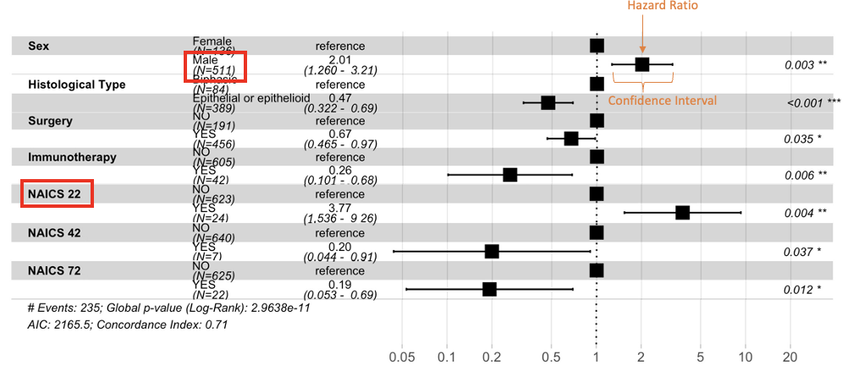
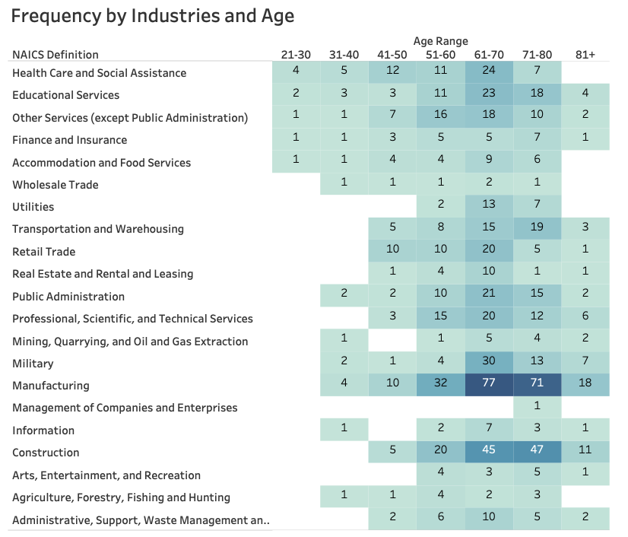
Cancer Surveillance
Survival Analysis
Funding: U24OH009077 National Mesothelioma Virtual Bank (PI: Dr. Michael Becich)
748 patients
693 patients
This study aims to examine work histories of mesothelioma patients and their survival time.
NMVB Heath Assessment Questionnaire
Statistic Analysis
NIOSH Industry and Occupation Computerized Coding System
NAICS 22: Utilities
1023 industry records (NAICS) 924 occupation records (SOC)
1. Female and young (aged 20-40) mesothelioma patients are more likely to report work experience not traditionally associated with mesothelioma risk.
2. Significant prognostic factors associated with decreased survival in mesothelioma cases are sex (male) and work experience in utility-related industry.
3. The NMVB has the potential of serving as a sentinel surveillance mechanism for identifying industries and occupations not traditionally associated with mesothelioma.
Publication: Gao Y, Mazurek JM, Li Y, Blackley D, Weissman DN, Burton SV, Amin W, Landsittel D, Becich MJ, Ye Y*. Industry, occupation, and exposure history of mesothelioma patients in the U.S. National Mesothelioma Virtual Bank, 2006-2022. (Accepted for publication in Environmental Research. Corresponding author)

Slide 8
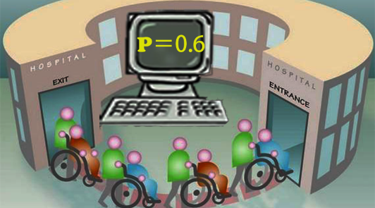
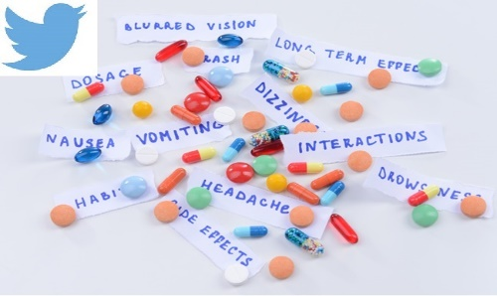
Automated Predictive Modeling
Input: EMR (e.g., Clinical Notes,, Laboratory Results, Medication Orders, Healthcare Utilities) and Twitter messages
Natural Language Processing Free-text notes
Output: Posterior Probabilities and likelihoods
Predictive Models (built with feature selection + machine learning techniques)
Automated Readmission Risk Profiling Using Electronic Medical Records
Publications:
Lu S, Ye Y, Tsui R, et al. Feature selection for 30-day heart failure readmission prediction using clinical drug data. NIPS Workshop on Machine Learning for Clinical Data Analysis and Healthcare, Harrahs and Harveys, Lake Tahoe, 2013.
Lu S, Ye Y, Tsui R, et al. Domain ontology-based feature reduction for high dimensional drug data and its application to 30-day heart failure readmission prediction. In Collaborative Computing: Networking, Applications and Worksharing (Collaboratecom), 2013 9th International Conference on 2013 Oct 20 (pp. 478-484). IEEE.
Awards:
2013 Finalist in Michael G. Wells Student Health Care Entrepreneurship Competition, University of Pittsburgh
Distinguished Poster Award (2nd author), American Medical Informatics Association Annual Symposium
Distinguished Poster Award (3rd author), American Medical Informatics Association Annual Symposium
Innovator Award, University of Pittsburgh
Detection of Adverse Drug Reaction from Twitter Data
Publication:
Tsui F, Shi L, Ruiz V, Barda A, Ye Y, et al. SMM4H: 2nd Social Media Mining for Health Applications Workshop & Shared Task, Washington, DC, Nov. 4, 2017. http://ceur-ws.org/Vol-1996/paper12.pdf

