Slide 1
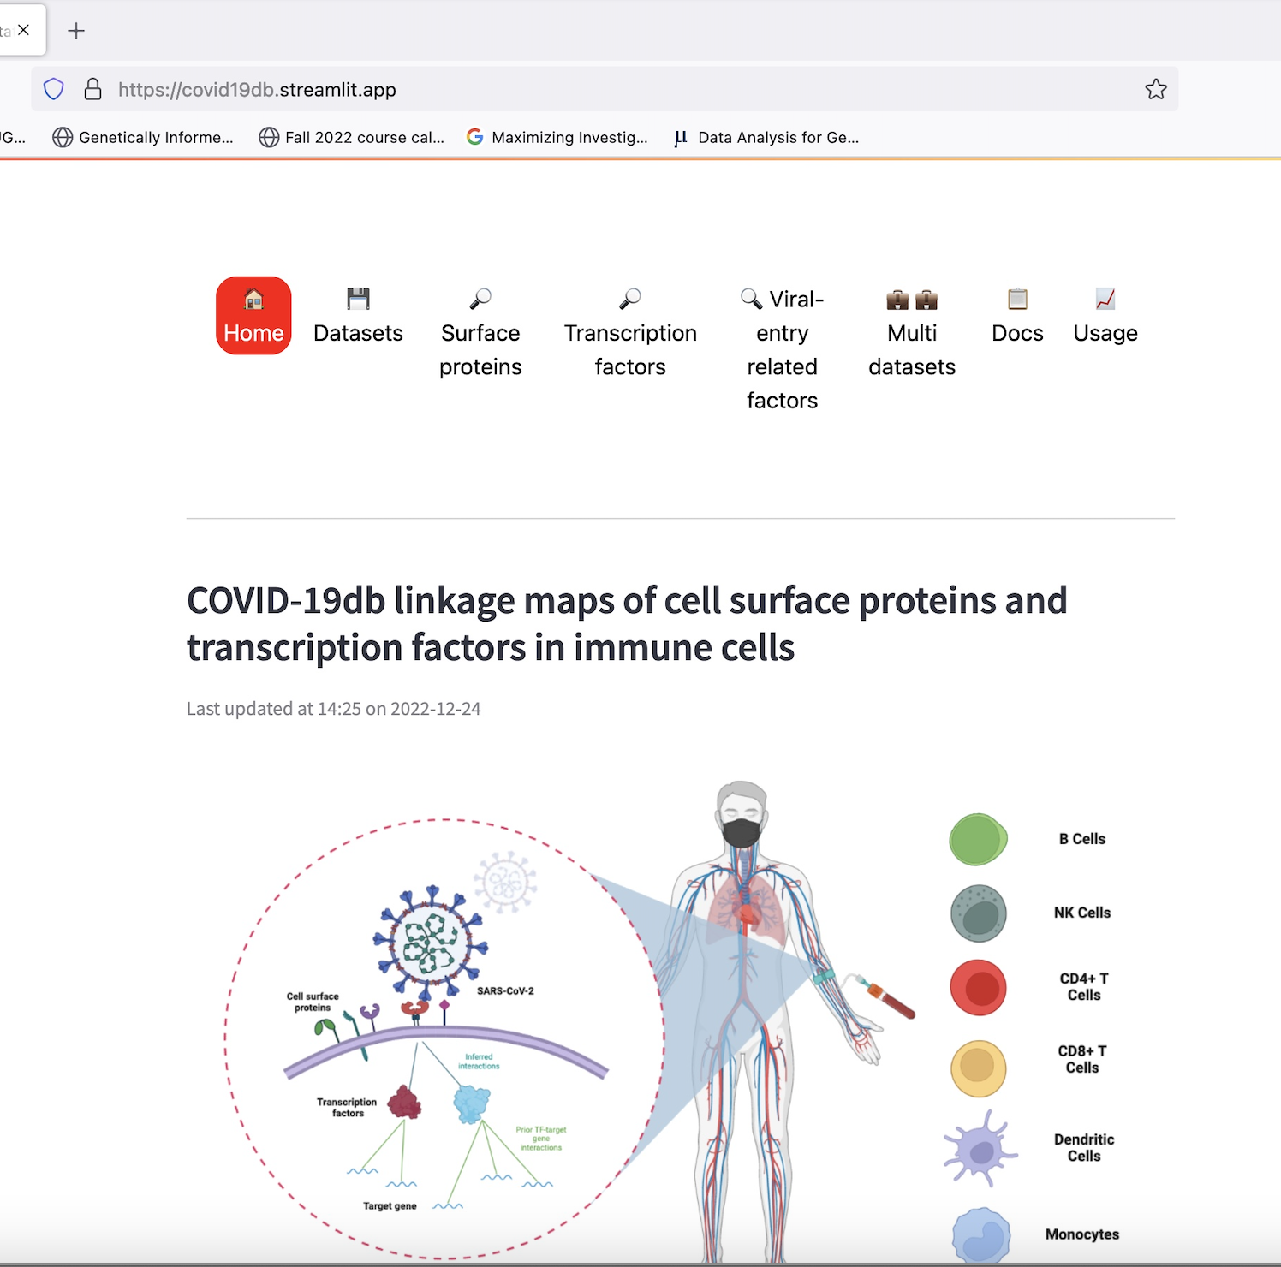

Department of Biomedical Informatics –
Hatice Osmanbeyoglu
Interactive surface protein and TF visualizations across major immune cell types for each dataset, allowing comparison between various patient severity groups for the discovery of potential therapeutic targets and diagnostic biomarkers (Ramjattun*, Ma* et al., Journal of Medical Virology, 2023)
Collaborators: SJ Gao and Harinder Singh (UPITT
https://covid19db.streamlit.app/
Ramjattun K*, Ma X*, Singh H, Gao SJ, Osmanbeyoglu HU. COVID-19db linkage maps of cell surface proteins and transcription factors in immune cells. J Med Virol. 2023;95(6):e28887. Epub 2023/06/21. doi: 10.1002/jmv.28887. PubMed PMID: 37341527. (IF 20.693)
Funding: NIH/NIGMS R35 GM146989 — PI: Osmanbeyoglu (Computational methods for delineating cell context-specific regulatory programs)
Department of Biomedical Informatics

