Slide 1
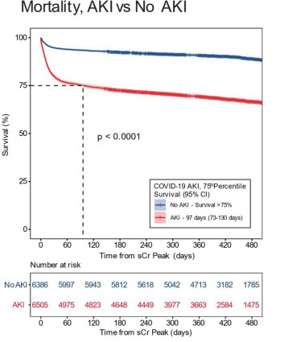
Sequelae of COVID-19-associated acute kidney injury Shyam Visweswaran MD PhD and DBMI team members
While acute kidney injury (AKI) is prevalent in COVID-19 patients, the long-term kidney function recovery outcomes of COVID-19-associated AKI remained poorly understood
EHR data from 12,891 hospitalized patients with COVID-19 across five countries and15 tertiary care institutions worldwide
COVID-19-associated AKI was prevalent in 49.5% in the study cohort, and it was associated with higher mortality
Severe COVID-19-associated AKI was associated with worse long-term post-AKI kidney function recovery
Tan BWL, Tan BWQ, …, Morris M, Visweswaran S, …, Samayamuthu MJ, …, Consortium for Clinical Characterization of COVID-19 by EHR (4CE), ..., Holmes JH, Kee Ngiam KY. Long-term kidney function recovery and mortality after COVID-19-associated acute kidney injury: An international multi-centre observational cohort study. eClinicalMedicine. 2022 Nov 7; 55:101724. PMID: 36381999; PMCID: PMC9640184 (impact factor 15.1)
Funding: NIH/NCATS UL1 TR001857 (PI Reis) and NIH/NCATS U24 TR004111 ENACT (PI: Reis, Visweswaran)
Department of Biomedical Informatics

