Slide 1
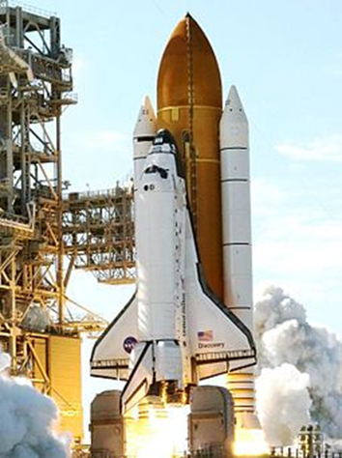



Yalini Senathirajah, PhD yalini@pitt.edu 347-619-4021
Moonshot
Revolutionize the design & use of healthcare software, making it safe, easy to use, fit to task, and adaptive to change.
Perhaps by giving control to the user, via a modular/composable platform
http://www.ehrlab.org
Not for decoration.
NASA uses a similar approach in their
mission control software.
https://scholar.google.com/citations?hl=en&user=j3lK3ygAAAAJ

Slide 2
MedWISER* – model for healthcare systems
Modular and user-composable architecture → clinician control and sharing
Several potential advantages at individual HCI and macro system level:
  fit to task, clinician cognitive support
  Communication/collaboration, influence transmission
  HCI – address display fragmentation problem, others, specific safety/interaction design
  Visualization, incorporation of multiple data sources
  Rapid changeability, creation of new tools (e.g. during epidemics, new Tx)
  New mode of software creation; implications for reliability, security
  Clinician acceptance
Built and tested system; (AHRQ-funded, R01HS023708)
Work on hold pending external collaborations due to UPMC Epic install
*Medical Widget-based Information Sharing Environment
Navigation in the electronic health record: a review of the safety and usability literature. LC Roman, JS Ancker, SB Johnson, Y Senathirajah. Journal of biomedical informatics 67, 69-79 54 2017
The clinician in the driver’s seat: part 1–a drag/drop user-composable electronic health record platform. Y Senathirajah, S Bakken, D Kaufman. Journal of biomedical informatics 52, 165-176
Safer design - Composable EHRs and Mechanisms for Safety. Senathirajah Y. (2015). Borycki EM, et al., eds., IOS Press. Stud Health Technol Inform 2015:218:40602. PMID:26262532

Slide 3
RECOVER – understanding ‘long Covid’
Computable phenotypes for several conditions
Representativeness of data – are our definitions accurate?
Possible work comparing RECOVER phenotypes with frequencies in non-RECOVER populations
Policy implications

Slide 4
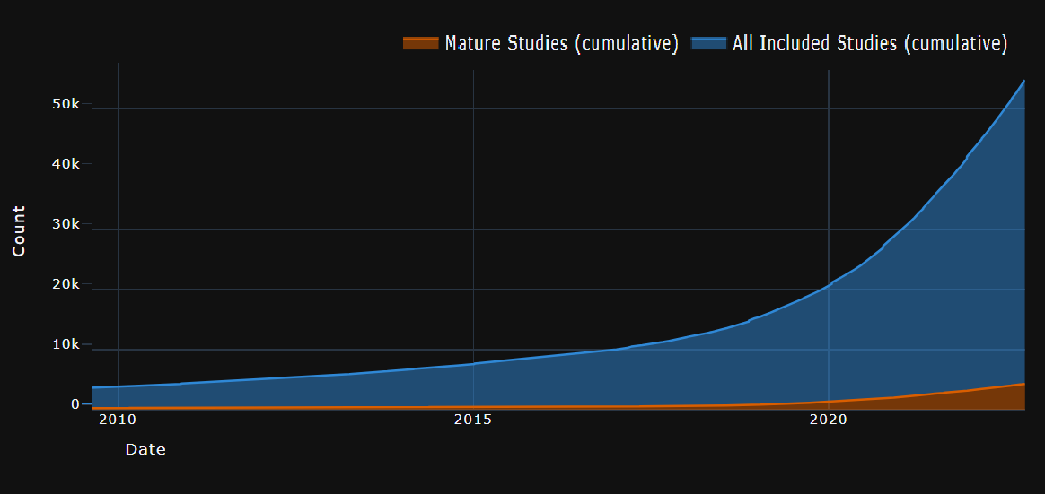
‘Efferent informatics’* - getting advances into care
Most current informatics analyzes data, makes algorithms, then → ?
Can take $100K + years to get into use, if ever
$4.2B spent on health AI devt algorithms, little in deployment
‘learning health system’ – the ‘efferent arm’

Slide 5
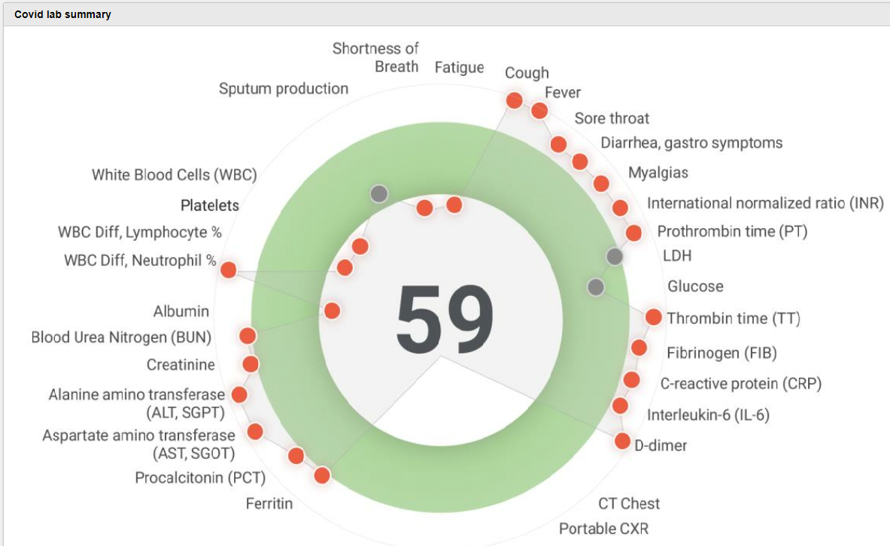
Complex clinical data visualization for clinicians – NAFLD, primary care, Covid, ED
NAFLD clinic (Jay Behari) – 5 related comorbidities, complex data must be visualized for
  Clinician understanding
  Patient communication
?Emergency medicine
  MedWISER + process mining → improved
  ED workflow + Hx → Dx safety?
Specialized user-configurable visualizations permit at-a-glance data appraisal of complex conditions

Slide 6
Tools for ‘the rest of us’
Worked in both high resource academic medical centers (Columbia, Northwell, UPMC) and low-resource (Downstate, Harlem)
Government ignores challenges within low-resource settings with respect to tech demands (e.g. interoperability mandate)
COVID-19: underserved areas hit particularly hard, and health systems could benefit from various HIT innovations
R01 (AHRQ) - new techniques to meet pandemic needs of underserved/low resource institutions + policy changes
MedWISER plays a role in
  Fast change for pandemics
  Data aggregation + vis. from multiple source →decisions

Slide 7
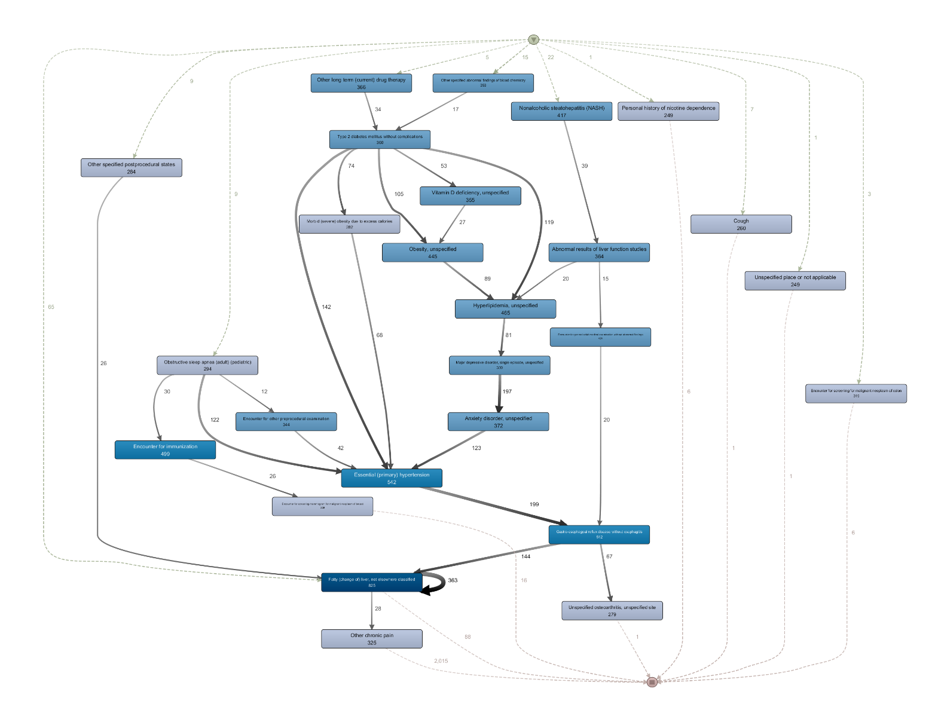
Process mining of clinical/administrative data
to understand causes of diagnostic and treatment delay and pinpoint possible locations of disparate treatment/system bias
Applicable at both individual patient and system levels
‘Diagnose’ health systems to pinpoint place in processes where disparities or delays occur
Create alternate decision support to shorten pathways where delays (individual patient) occur

Slide 8
Equity in AI and clinical algorithms
Understand sources of sex-based bias in clinical algorithms
Understand and prevent future bias in AI-based tools
Use AI to de-bias current workflows?

