Slide 1


Biomedical Data Science for Precision Medicine
vanathi@pitt.edu
Room 530, BAUM
Vanathi Gopalakrishnan, PhD
Associate Professor of Biomedical Informatics,
Computational & Systems Biology,
Bioengineering, Clinical and Translational Science
Director, PRoBE Laboratory for Pattern Recognition from Biomedical Evidence
University of Pittsburgh

Slide 2
Pattern Recognition from Biomedical Evidence:
PRoBE Lab
Research Goals: To Accelerate Biomedical Knowledge Discovery by
Developing and Applying novel hybrid Artificial Intelligence Methods
Obtained for
example from:
Literature,
Ontologies,
Past analyses
Obtained for
example from:
Biomedical Assays, Clinical Assessments,
Imaging tests
PRIOR
KNOWLEDGE
DATA
Integrative Modeling
Examples:
Bayesian Rule Learner (BRL)
Transfer Rule Learning (TRL)
RULE LEARNING METHODOLOGIES
PREDICTIVE MODELS FOR
BIOMEDICINE
Enable predictions about for example: mechanism of action, target selection, useful biomarkers for early detection or monitoring of disease, toxicity risk, and clinical trial outcomes.

Slide 3

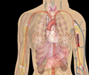
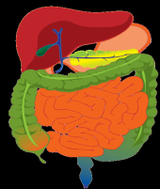

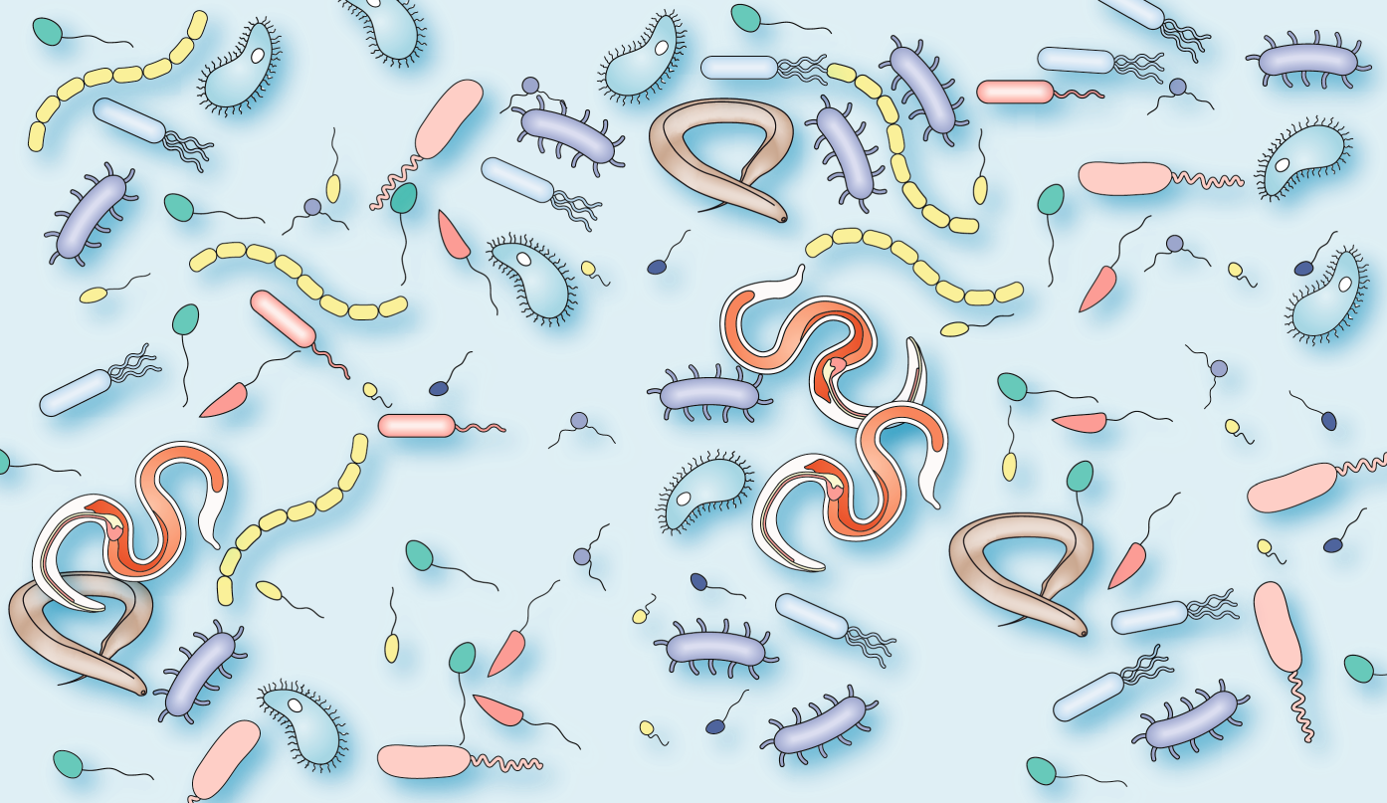
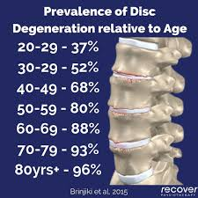
BIOMEDICAL DATA PRoBE LAB HAS ANALYZED
Proteomic
  Mass Spectral (large/wide/deep)
  Immunoassay
Genomic
  GWAS/SNPs(very large)
  DNA Methylation
  Gene Expression
  microRNA
Images
  Cardiac MRI
  Brain fMRI
Microbiome
Metabolome
Exposome
Federated EHR
From biomarker discovery studies for early detection of:
  Amyotrophic Lateral Sclerosis
  Alzheimer’s
  Lung Cancer
  Breast Cancer
  Esophageal Cancer
  Inflammatory Bowel Diseases Ulcerative Colitis, Crohn’s
  Coronary Artery Disease
  Pediatric Cardiomyopathy
  Markers for diagnosis of:
  Helminth’s infections
  Beryllium Exposure
  Type 2 Diabetes
  Cardiovascular Disease
  Intervertebral Aging
https://www.nature.com/articles/s41584-019-0253-3

Slide 4
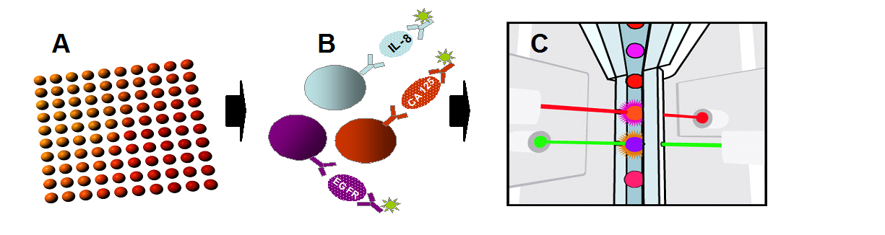
Example: Lung Cancer Early Detection
Clinical
History
RISK
PREDICTION
MODEL
?
Accuracy of early detection
# Unnecessary biopsies
CT screen
Results
Blood
Test
Multiplexed serologic
Quantitative immunoassays
Luminex xMAP® technology
  Bigbee, W. L*., Gopalakrishnan, V.*, Weissfeld J, L., Wilson, D. O., Dacic, S. Lokshin, A. E., Siegfried, J. M. A Multiplexed Serum Biomarker Immunoassay Panel Discriminates Clinical Lung Cancer Patients from High-Risk Individuals Found to be Cancer-Free by CT Screening. J Thorac Oncol. 2012 Apr;7(4):698-708. (*These authors contributed equally to the study).

Slide 5
Current Projects/Publications
(1) Biomarker discovery for Intervertebral Disc Degeneration (IDD) (Co-I)
Collaborators: Gwen Sowa and Nam Vo (Orthopaedic Surgery) – PI
(2) Predicting postpartum hemorrhage in Tanzania through automated
sensing and machine learning (Co-I). Collaborators: Edith Luhanga (CMU Africa)
(3) ENACT: Translating Health Informatics Tools to Research and Clinical Decision Making (Co-I)
Collaborators: Steve Reis and Shyam Visweswaran – PI
Key Publications:
Proteomic profiling of cerebrospinal fluid identifies biomarkers for amyotrophic lateral sclerosis. S Ranganathan, E Williams, P Ganchev, V Gopalakrishnan, D Lacomis, ... Journal of neurochemistry 95 (5), 1461-1471
A multiplexed serum biomarker immunoassay panel discriminates clinical lung cancer patients from high-risk individuals found to be cancer-free by CT screening. WL Bigbee, V Gopalakrishnan, JL Weissfeld, DO Wilson, S Dacic, ... Journal of thoracic oncology 7 (4), 698-708
Bayesian rule learning for biomedical data mining. Gopalakrishnan, V., Lustgarten, J. L., Visweswaran, S., and Cooper, G. F. (2010). Bioinformatics 26, 668–675. doi: 10.1093/bioinformatics/btq005
Opinion: Global Chronic Disease Burden Can Be Reduced by Taking Care of Our Mitochondria. V Gopalakrishnan – 2023 (Preprints)
LinkedIn Profile: https://www.linkedin.com/in/vanathi-gopalakrishnan-33b4087/

