Slide 1
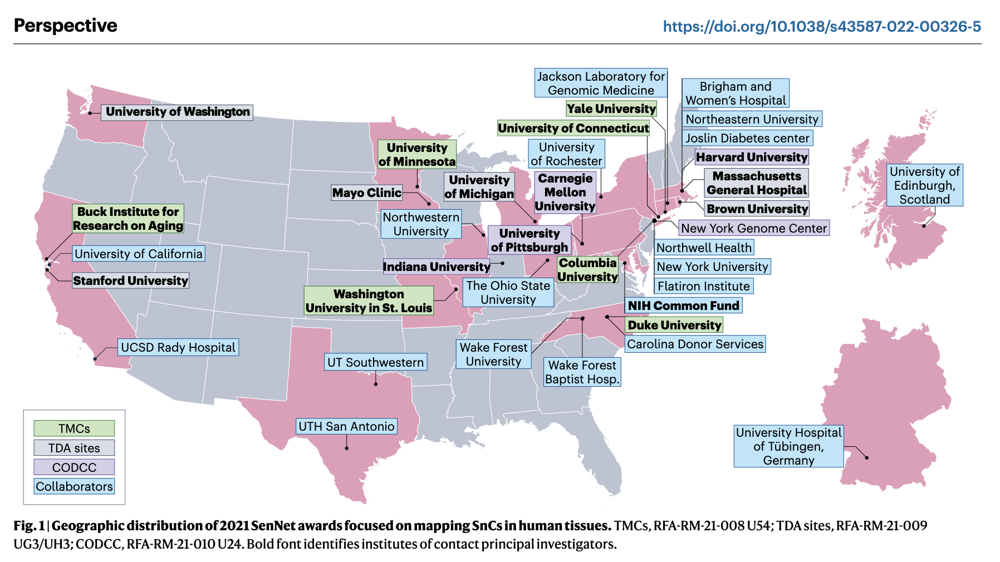
SenNet Consortium Jonathan C. Silverstein, MD and staff leads: Kay Métis, MS and Bill Shirey
The NIH Common Fund Cellular Senescence Network (SenNet) will map senescent cells throughout the human lifespan and throughout the body.
This network will extend the work of the Human BioMolecular Atlas Program (HuBMAP) to include detailed muti-omic and experimental single-cell maps focused upon senescent cells.
The current plan includes mapping 18 organs among 60 participating sites. We serve as the consortium organizating and data coordination center (CODCC). We have supplement to support summer under-represented undergraduates.
SenNet Consortium. NIH SenNet Consortium to map senescent cells throughout the human lifespan to understand physiological health. Nature Aging. 2022 Dec 20;2(12):1090–100. https://doi.org/10.1038/s43587-022-00326-5
Funding: NIH Common Fund / National Cancer Institute
PIs: Jonathan C. Silverstein, Phil Blood (PSC), Ziv Bar-Joseph (CMU)
Department of Biomedical Informatics

