Slide 1
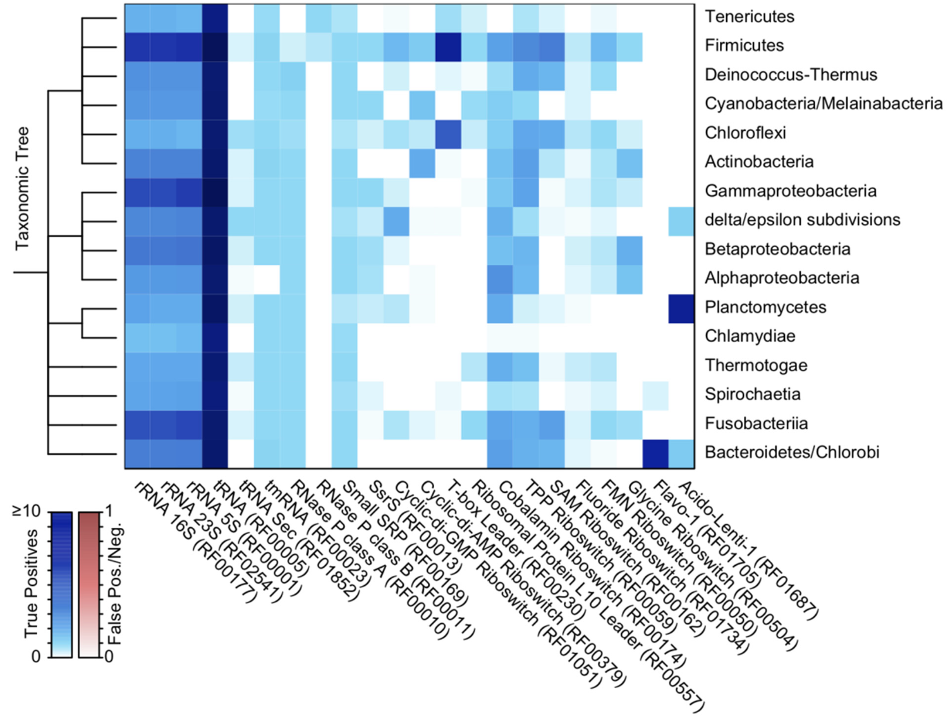
Department of Biomedical Informatics
Finding non-coding RNAs in genomes is complicated
FindNoncoding is a new approach:
Ultra-fast and accurate
Very simple and user friendly
Finds all standard non-coding RNAs
Extensible to new RNAs
Wright, E. FindNonCoding: rapid and simple detection of non-coding RNAs in genomes. Bioinformatics. 2022.

