Slide 1
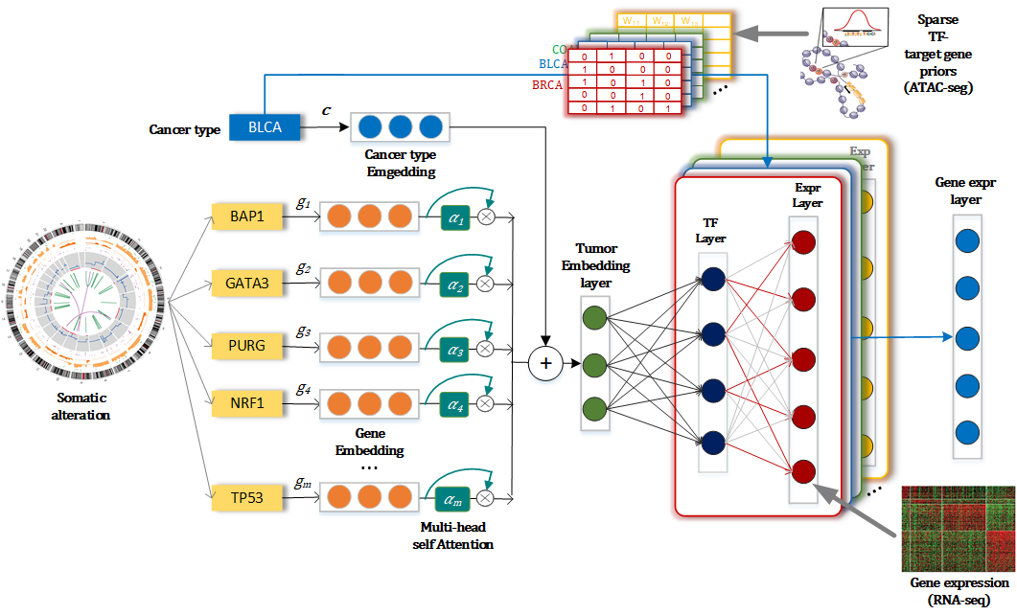
Department of Biomedical Informatics – Hatice Osmanbeyoglu
We developed a partially interpretable neural network model CITRUS (Chromatin-informed Inference of Transcriptional Regulators Using Self-attention mechanism) with encoder-decoder architecture to model the effects of somatic alterations on cellular states and downstream gene expression programs
We are now incorporating curated pathway and protein-protein interaction data into CITRUS (Ramjattun et al., unpublished).
Collaborators: Xinghua Lu (UPITT), Russell Schwartz (CMU)
Tao Y*, Ma X*, Palmer D, Schwartz R, Lu X, Osmanbeyoglu HU. Interpretable deep learning for chromatin-informed inference of transcriptional programs driven by somatic alterations across cancers. Nucleic Acids Res. 2022. Epub 2022/10/17. doi: 10.1093/nar/gkac881. PubMed PMID: 36243974. (IF 19.160 / 3 citations)
Funding: NIH/NCI K99/R00 CA207871— PI: Osmanbeyoglu (Algorithms to link signaling pathways with transcriptional programs for precision medicine)
Department of Biomedical Informatics
Notes:
TITLE of Slide Your Name & Title and DBMI team members

