Slide 1
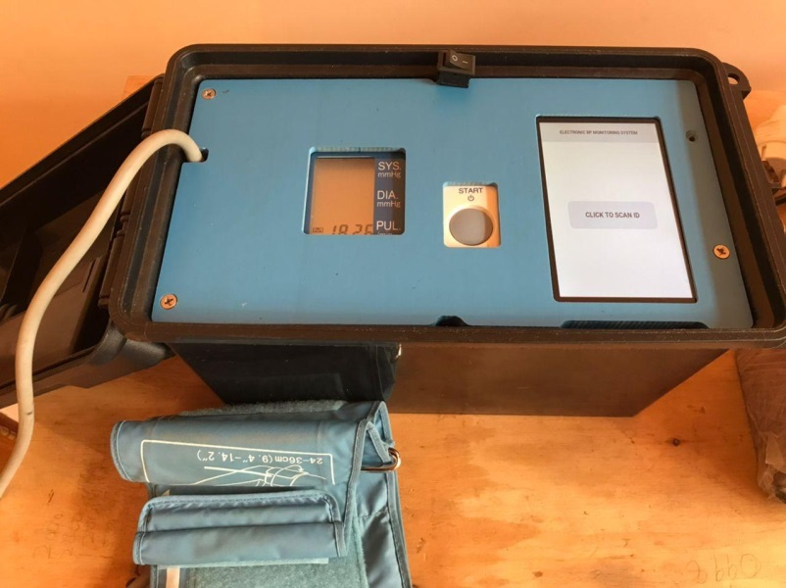
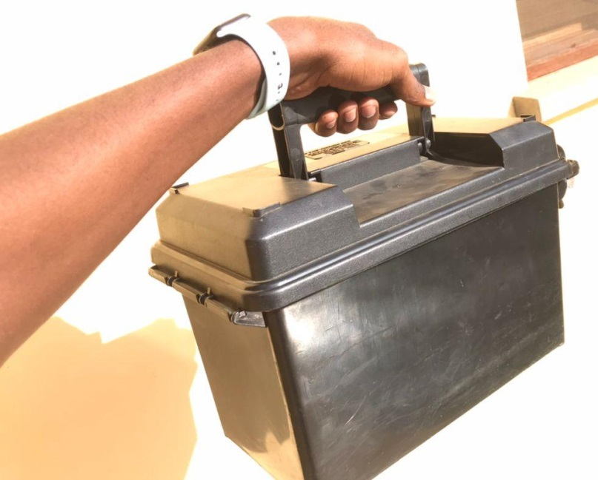
Identifying and Managing Hypertension for Rural Patient Populations in Low- and Middle-Income Countries
Background: Elevated blood pressure, often as a result of undiagnosed or uncontrolled hypertension, is a leading global risk for mortality especially in LMICs, which account for 80% of all global deaths from cardiovascular disease.
Peer Support can be an effective resource in countries with weak health systems.
In Malawi, Peer support Groups established to BP in the community already exists, however continuity of care depends on proper data management.
Impactful Innovation: We have developed a touchscreen-based, battery operated field unit that captures BP readings , stores them in the cloud and provides clinical decision support.
Next Steps: Pilot the unit in 4 peer support groups and evaluate.

