Slide 1
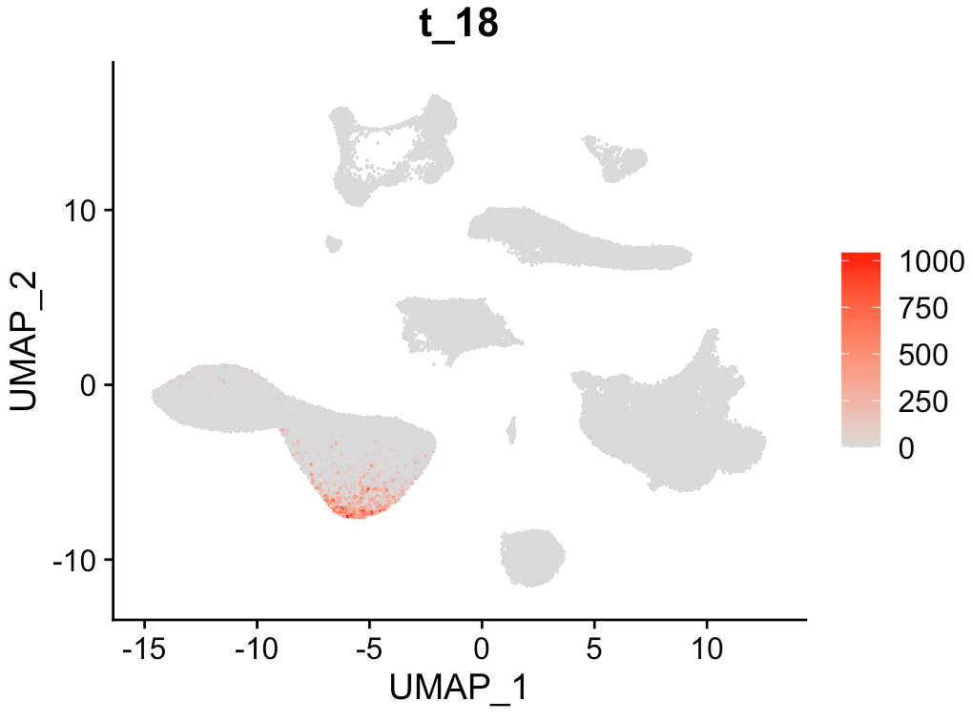
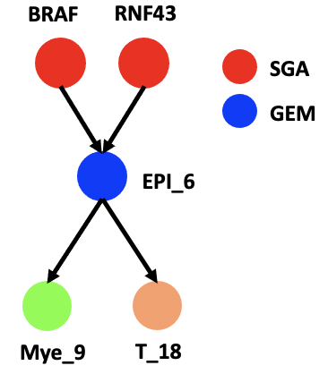
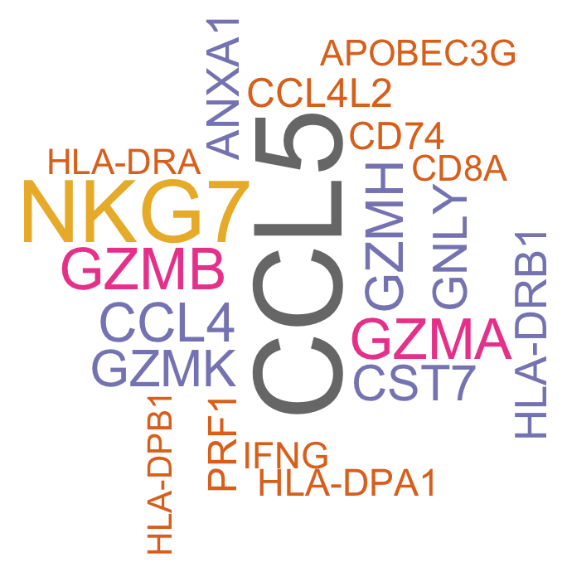
Department of Biomedical Informatics
We developed a topic modeling & causal discovery framework to learn gene expression modules (GEMs) which reflect cellular signals/functions of a particular cell type in the tumor microenvironment in colorectal cancer.
Our model successfully learnt the intercellular interactions among cell types (T, B, Myeloid, Epithelial).
We developed new machine learning methods to validate the intercellular interactions using biological knowledge including well-known ligand-receptor pairs.
We built the signaling network from SGA to immune cells and indicated the possible influence of somatic mutation/alteration on epithelial cells and more complex communication among immune cells.
1. Chen, L., Zhang, H., et al (2022) Discovering the cell-cell communication involved in the tumor microenvironment in colorectal cancer.
2. Chen, X., Chen, L., et al (2021). An individualized causal framework for learning intercellular communication networks that define microenvironments of individual tumors, bioRxiv.

