Slide 1
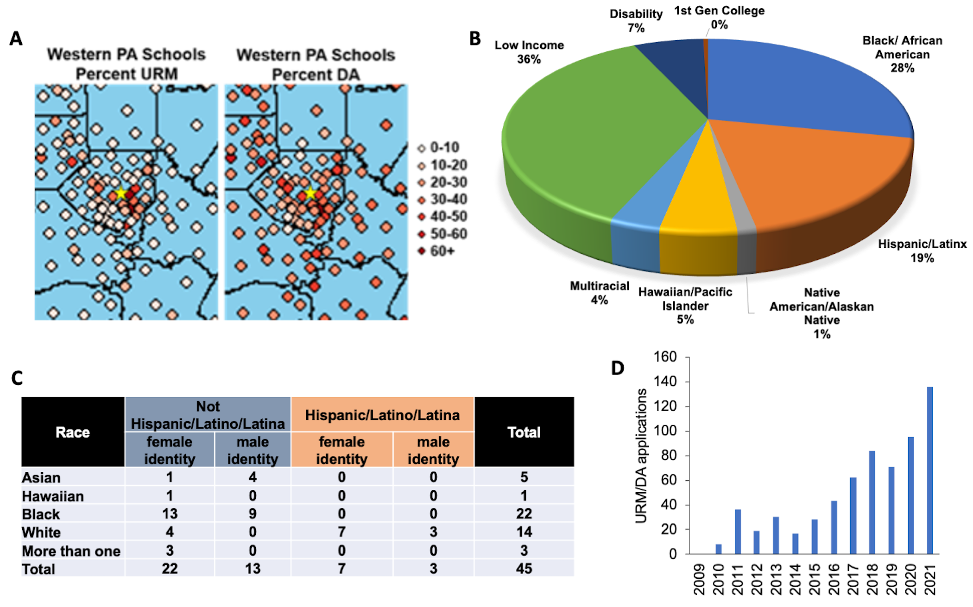
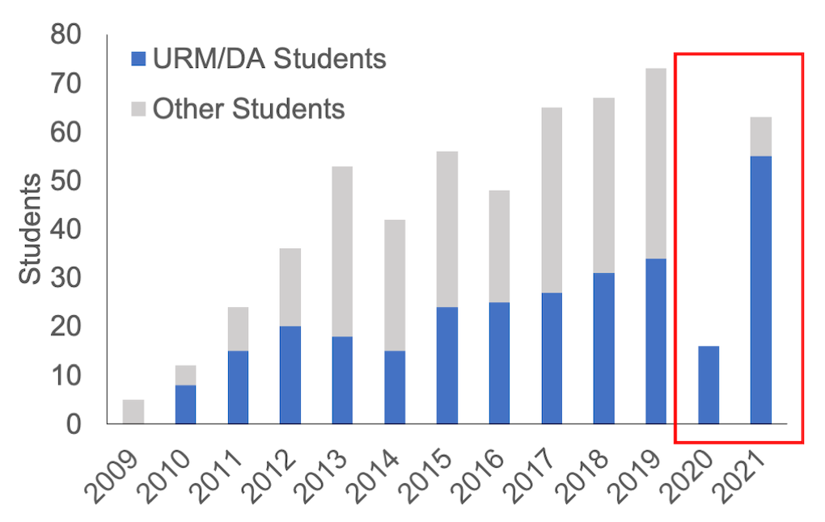
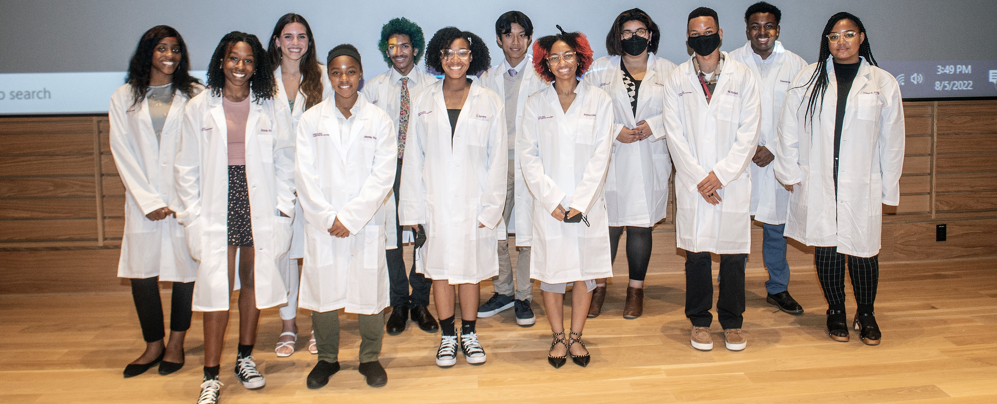
Hillman Academy – YES Program – Growth and Diversity
Ayoob, J. C., Boyce, R. D., Livshits, S., Bruno, T. C., Delgoffe, G. M., Galson, D. L., ... & Boone, D. N. (2022). Getting to YES: The Evolution of the University of Pittsburgh Medical Center Hillman Cancer Center Youth Enjoy Science (YES) Academy. Journal of STEM Outreach, 5(2), 1-15.

