Slide 1
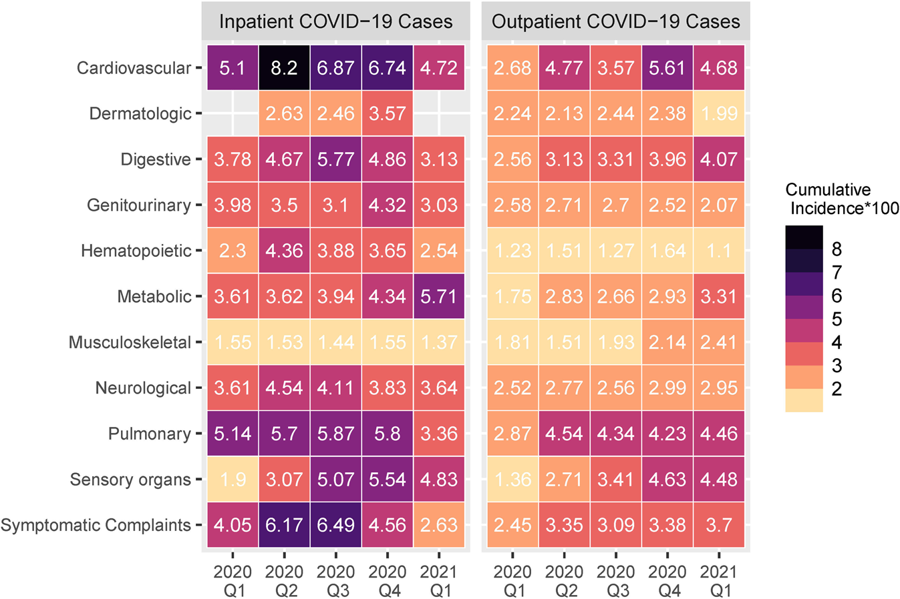
Risk profiles of post-acute sequelae of COVID-19 Shyam Visweswaran MD PhD and DBMI team members
Characterization of risk profiles of post-acute sequelae of COVID-19 (PASC) using large scale electronic health record (EHR) data analyses
EHR data from 277 international hospitals representing 414,602 patients with COVID-19 and 2.3 million control patients without COVID-19
Compared to inpatient controls, inpatient COVID-19 patients were at risk for angina pectoris, heart, cognitive dysfunctions and fatigue
Relative to outpatient controls, outpatient COVID-19 patients were at risk for pulmonary embolism, venous embolism, atrial fibrillation, type 2 diabetes, and vitamin D deficiency
Zhang HG, …, Morris M, Visweswaran S, …, Samayamuthu MJ, …, Consortium for Clinical Characterization of COVID-19 by EHR (4CE), ..., Kohane IS, Weber GM. International electronic health record-derived post-acute sequelae profiles of COVID-19 patients. NPJ Digital Medicine. 2022 Jun 29;5(1):81. PMID: 35768548 PMCID: PMC9242995 (impact factor 15.4)
Funding: NIH/NCATS UL1 TR001857 CTSI (PI Reis) and
NIH/NCATS U24 TR004111 ENACT (PI: Reis, Visweswaran)

