Slide 1






Shyam Visweswaran, MD, PhD
Associate Professor of Biomedical Informatics
Director of Clinical Informatics
Director, Center for Clinical Research Informatics (CCRI)
Director of Biomedical Informatics Core, Clinical and Translational Science Institute (CTSI)
www.thevislab.com
shv3@pitt.edu

Slide 2
Research focuses on different aspects of the Learning Health System
Molecular and Research Data
Mobile Health Data
3. Data Mining & Causal Discovery
4. Reuse of EMR Data
Extract, transform, and assemble
Electronic Medical Records
The Learning Health System
Integrated Research Data
Clinical Decision Support
Apply best evidence for each patient
1. Learning Electronic Medical Record System
2. Personalized Modeling & Precision Medicine
Patient Decision Support

Slide 3
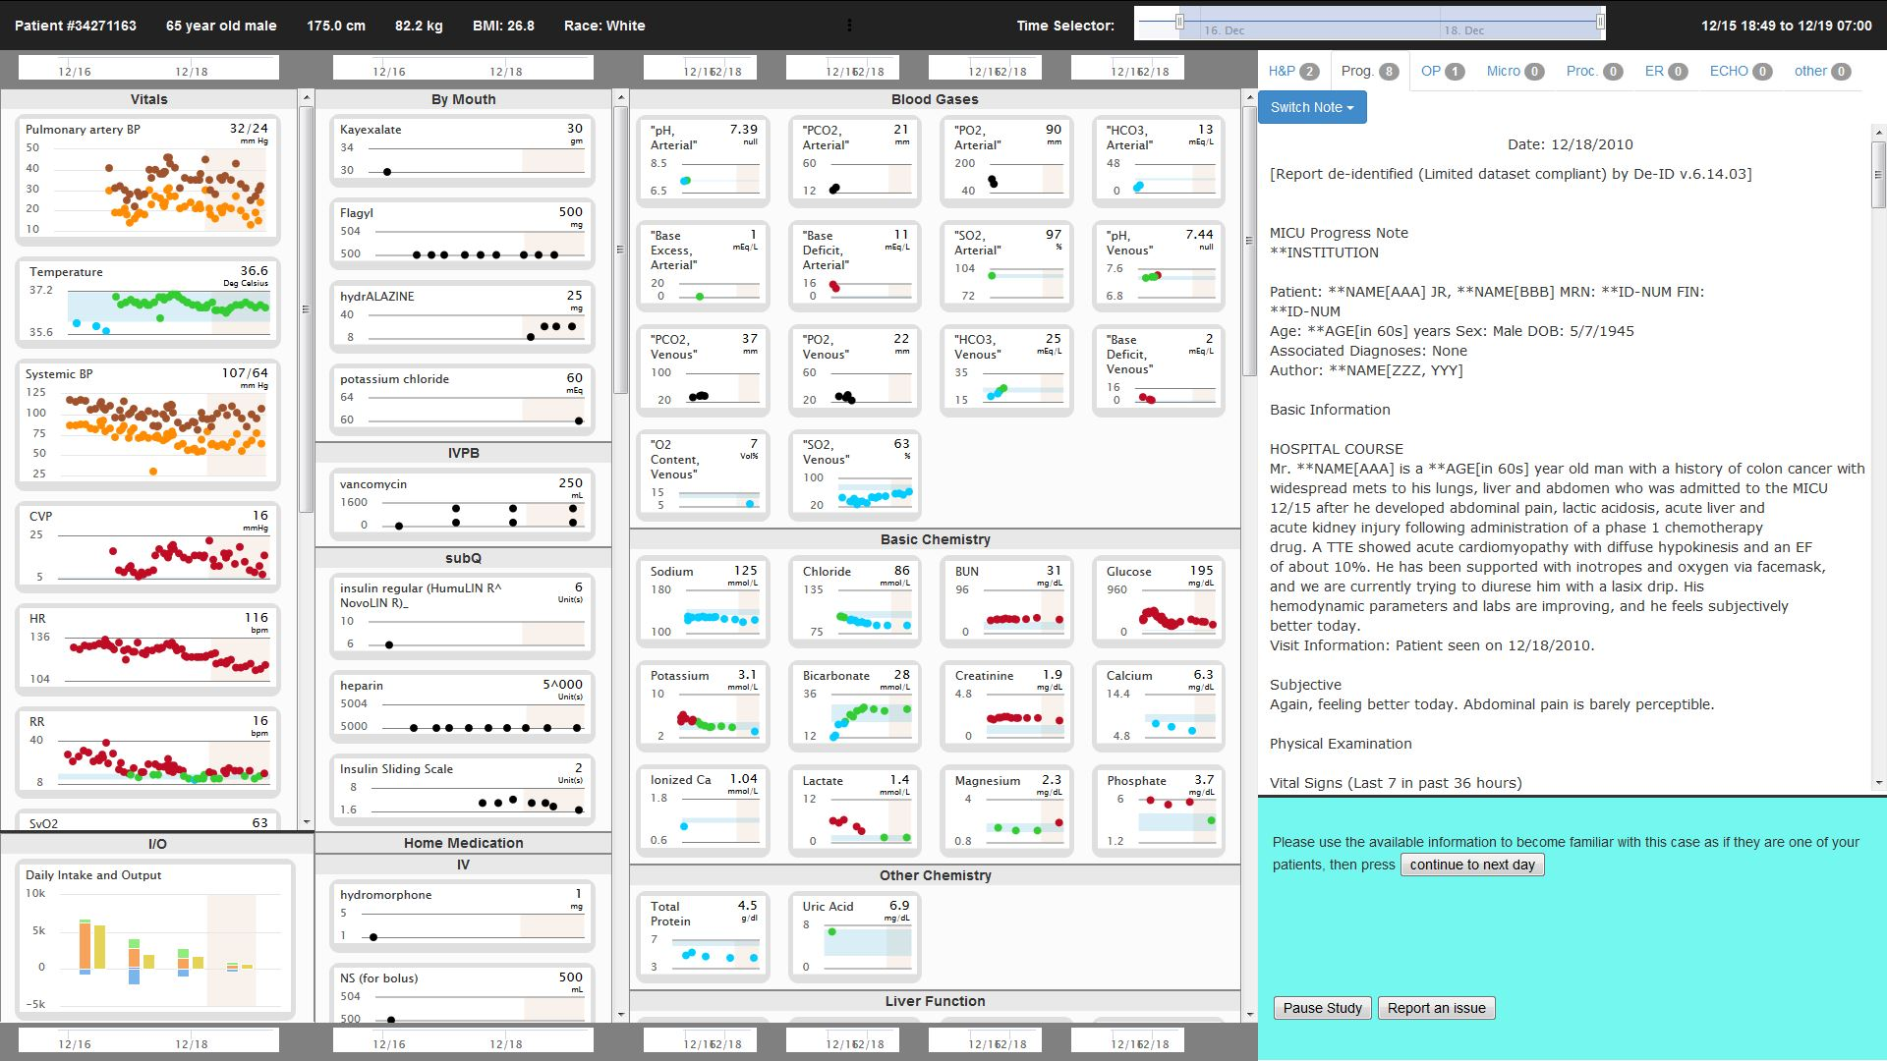
1. Learning Electronic Medical Record System
Improve EMRs to intelligently display the right data,
at the right time using learning components that adapt both to the physician and the patient’s condition.
Funding:
NLM R01 LM012095
Collaborators:
Gregory F. Cooper, Harry Hochheiser, Milos Hauskrecht (Computer Science),
Gilles Clermont (Critical Care Medicine) and Dean Sittig (University of Texas)

Slide 4
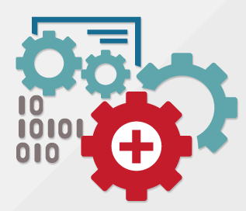

2. Personalized Modeling & Precision Medicine
Personalized modeling facilitates precision medicine by enabling:
more accurate prediction of clinical outcomes,
discovery of disease subtypes, and
identification of factors that are specific to the current individual.
Collaborators:
Gregory F. Cooper, David Whitcomb (Gastroenterology & Hepatology), Adriana Johnson (MSTP trainee), Lorne Walker (Pediatrics Infectious Diseases), Patrick O'Halloran (Staff)

Slide 5

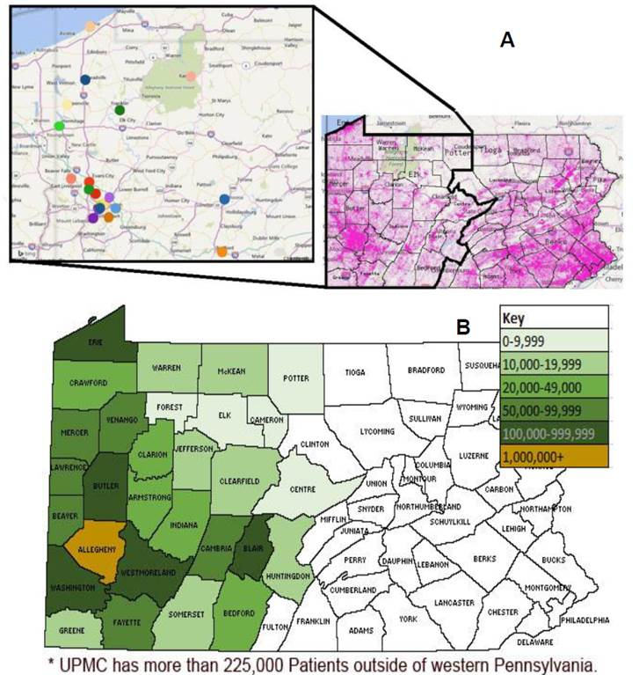

2. Personalized Modeling & Precision Medicine
The All of Us Pennsylvania Research Program will enroll 120,000 participants for the All of Us Research Program and will collect EHR data and bio specimens.
Funding:
UG3 OD023153
Collaborators:
Steven E. Reis (CTSI) and Oscar Marroquin (Medicine)

Slide 6
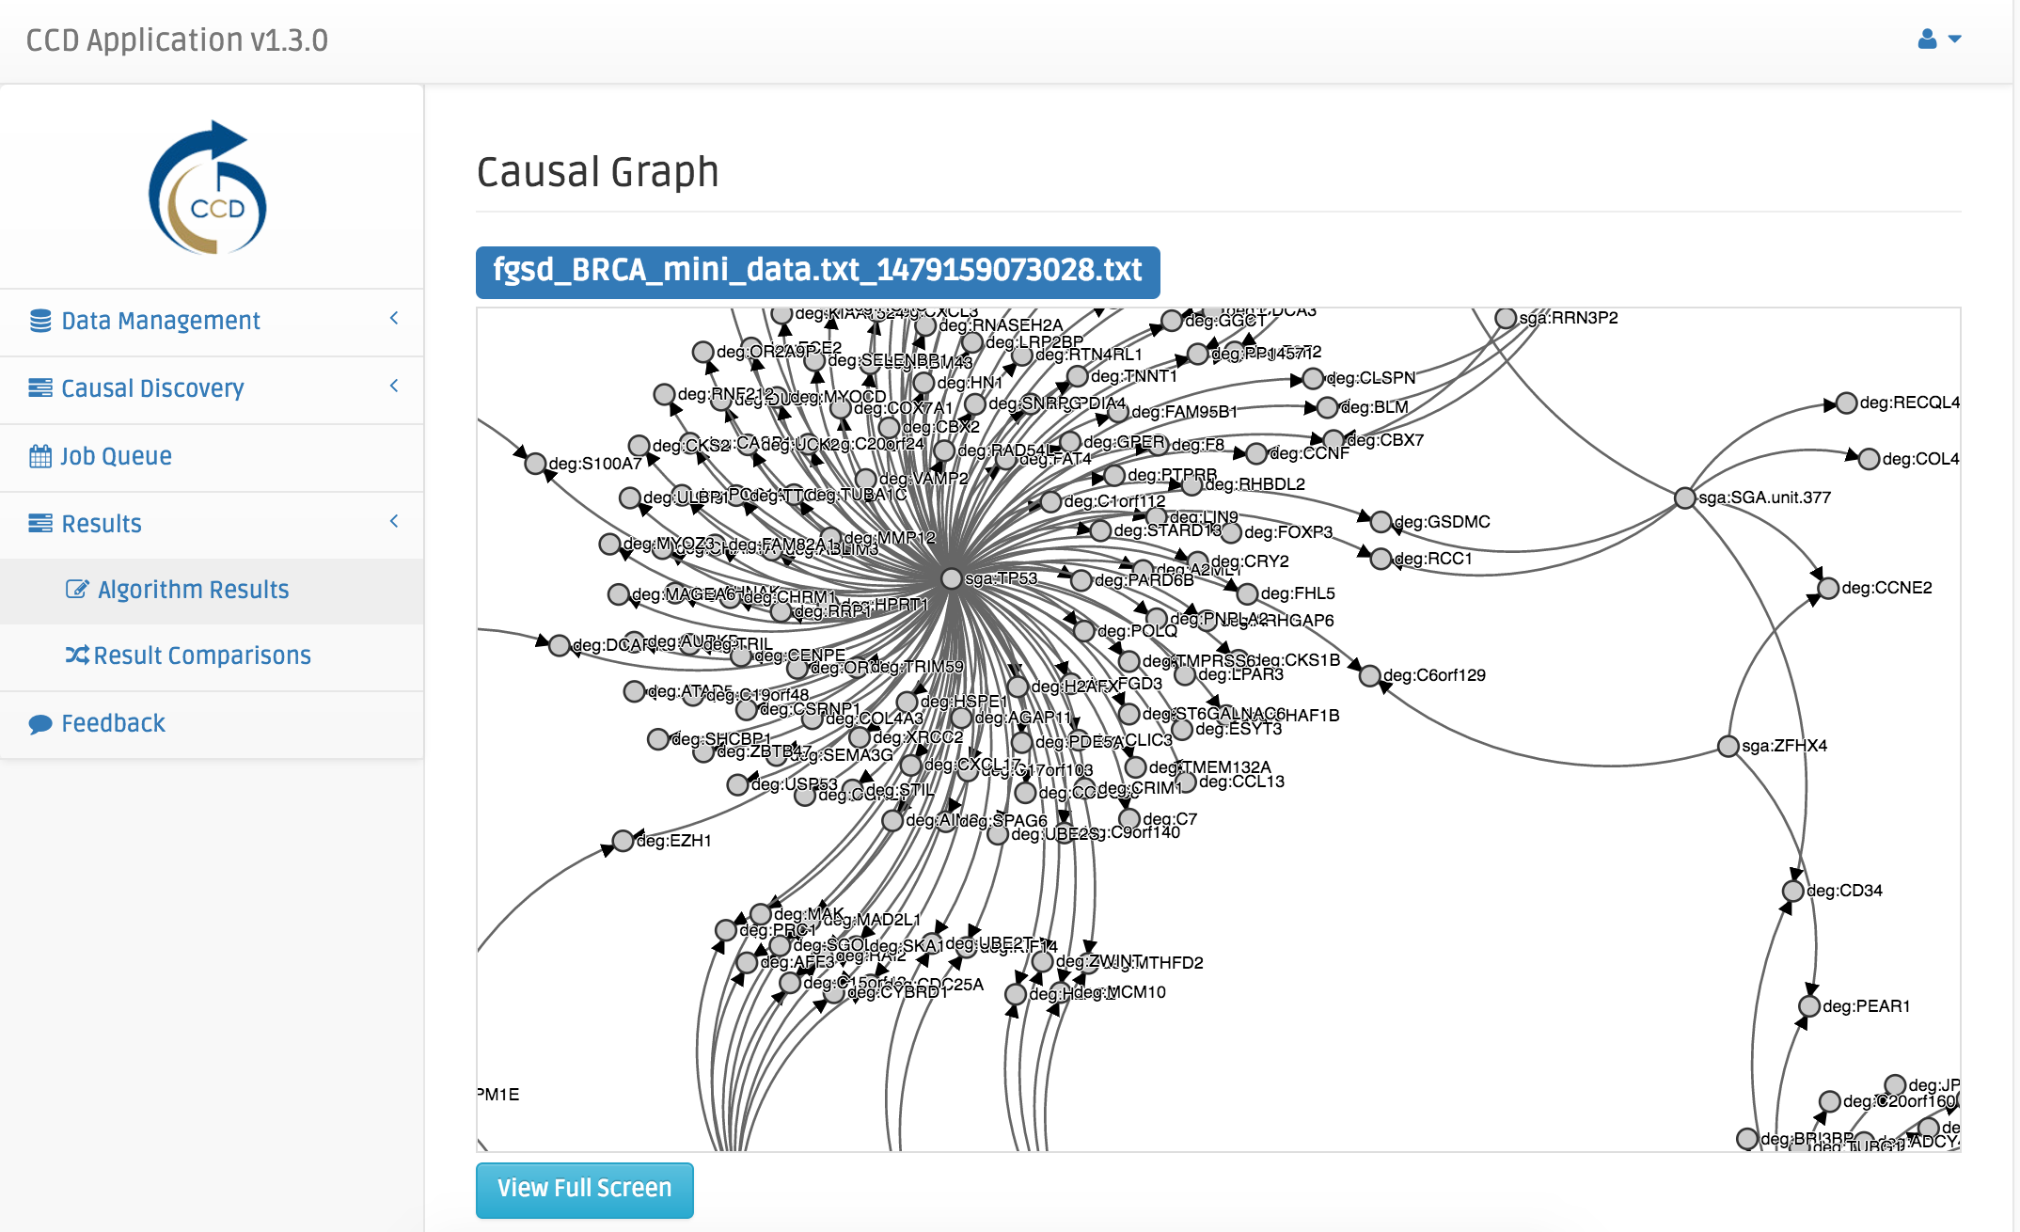
3. Data Mining & Causal Discovery
Develop algorithms to analyze biomedical data to find causal relationships that are novel, significant and valid.
www.ccd.pitt.edu
Funding:
U54 HG008540
Collaborators:
Gregory F. Cooper and Jeremy Espino

Slide 7



4. Reuse of EMR Data
Enable reuse of Electronic Medical Record (EMR) data for clinical, translational, and informatics research.
Pitt EMR data warehouse (Neptune)
NCATS-funded i2b2 data repository for Accrual of patients to Clinical Trials (ACT) network
PCORI-funded PaTH clinical data research network (CDRN)
Funding:
NCATS (NIH) UL1 TR000005
CATS (NIH) UL1 TR000005-09S1
PCORI CDRN 1306-04912
Collaborators:
Steven E. Reis (CTSI), Michael J. Becich and Jonathan Silverstein (CRIO)

