Slide 1
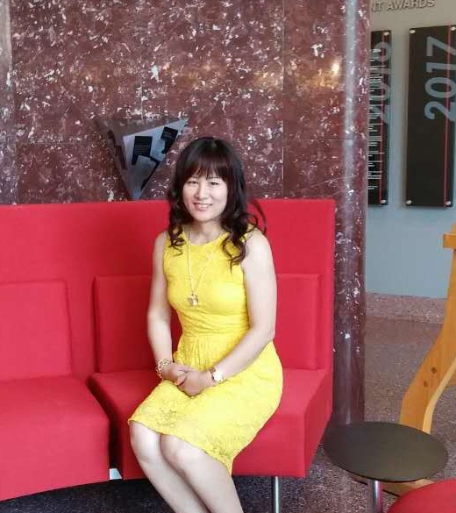



1. Big data science: Efficient probabilistic and deep learning; New algorithms development.
2. Bayesian epistasis; Interaction and causal modeling and discovery in cancer omics
Areas of Research
3. Precision and personalized medicine via AI-based methods
Xia Jiang
Associate Professor of
Biomedical Informatics, of
Intelligent Systems Program, and of
Join CMU-Pitt Computational Biology Ph.D. Program
Notes:
1

Slide 2
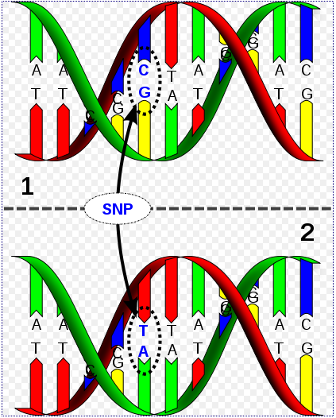
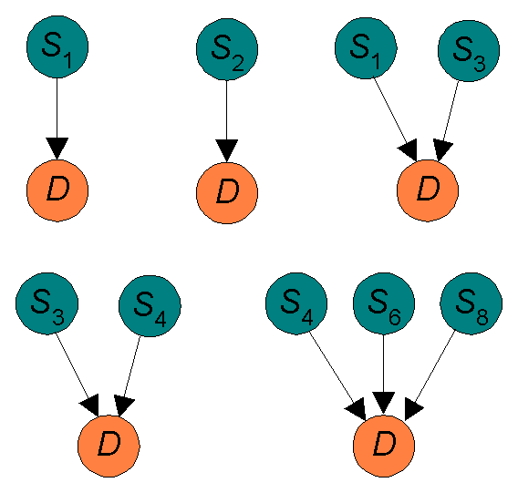
Detecting Genome Wide Epistasis with Efficient Bayesian Network Learning
NIH R00, Role: PI. Grant Number:R00LM010822
Major Contribution
We found that SNP rs6094514, which is mapped to the EYA2 gene on chromosome 20, often appeared along with GAB2 in Late Onset Alzheimer’s patients.
Jiang et al. BMC Bioinformatics (2011) ;12: 89
Jiang et al. Genetic Epidemiology 2010 34(6) : 578-81
1. BN-Based model representation and definition
3. Novel efficient learning algorithms: MBS, REGAL, LEAP, and IGAIN
http://en.wikipedia.org/wiki/File:Dna-SNP.svg
2. Novel score criteria: BNMBL and BNPP
MBS
BayCom
Challenge: worse than exponential model search space for genetic interactions (multi-SNPs) when learning from high dimensional data
Each of the top 50 models scored by MBS contains at least one of the significant genes associated with breast cancer
MBS took 4.1 Hours
BayCom would take 3.71 years
Up to 4 SNPs Combinations with 1001 SNPS
Notes:
2

Slide 3
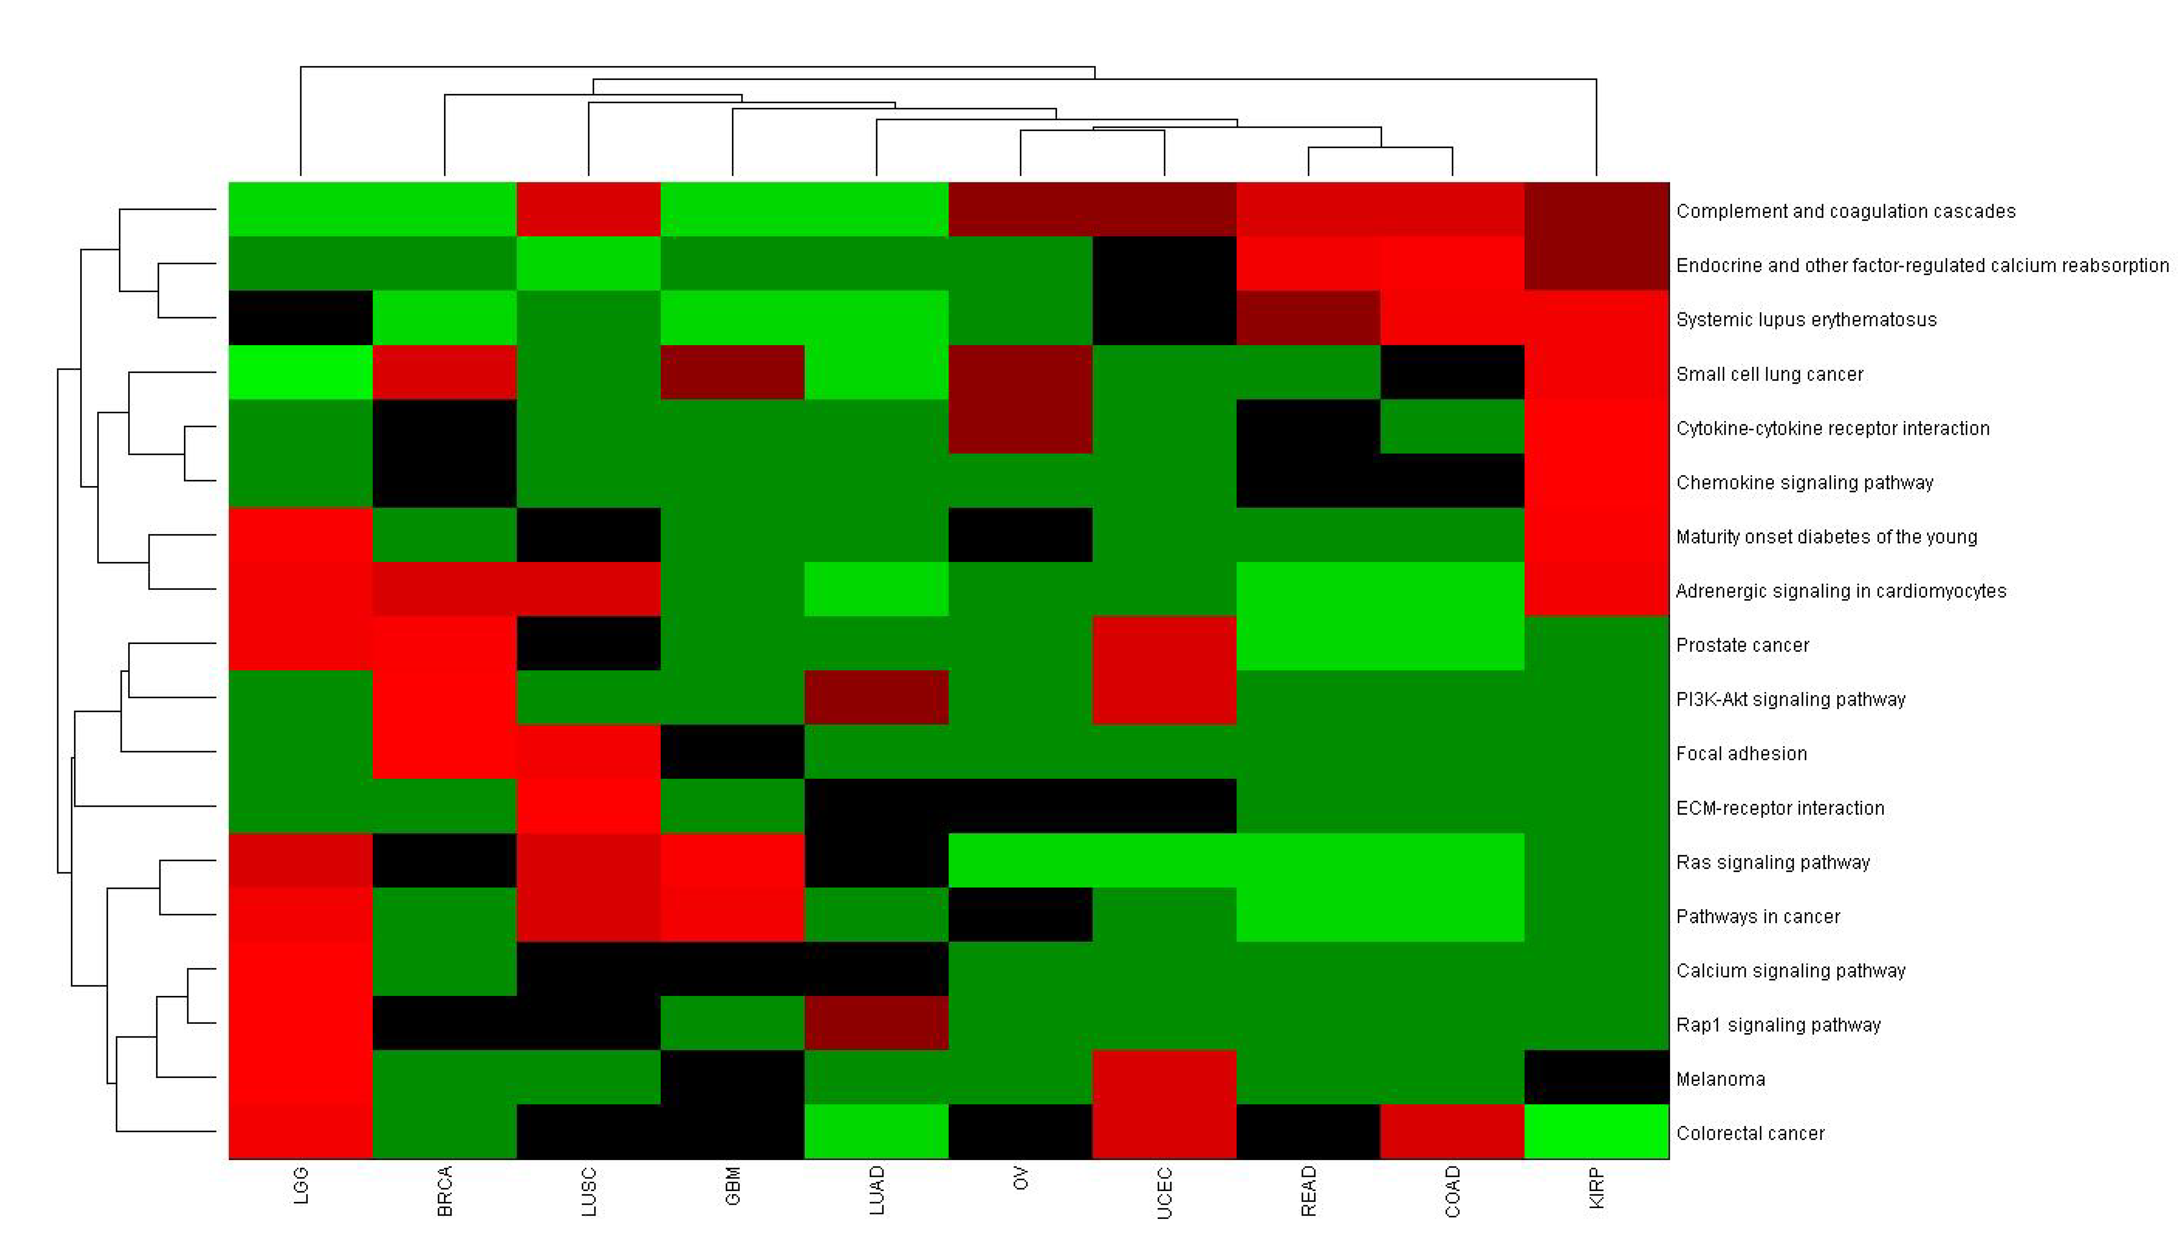
A New Generation Clinical Decision Support System
NIH/NLM R01, Role: PI. Grant Number:R01LM011663
Other ongoing research: pan cancer analyses
Our CaMIL model for prediction
Challenge 1. Learning interactive causes from datasets is important, but it is by no means a trivial task.
Challenge 2. Big data driven machine learning is not yet sophisticated.
A causal Pattern learned at step 1.
An influence diagram (developed using Netica)
Modeling and Discovery of Biomedical Knowledge (CCMD) from Big Data (BD2K)
NIH/NLM BD2K, Role: co-investigator.
Cure grant awarded by the Pennsylvania Department of Health ( PA DOH 4100070287).
Role: co-investigator.
Notes:
3

Slide 4
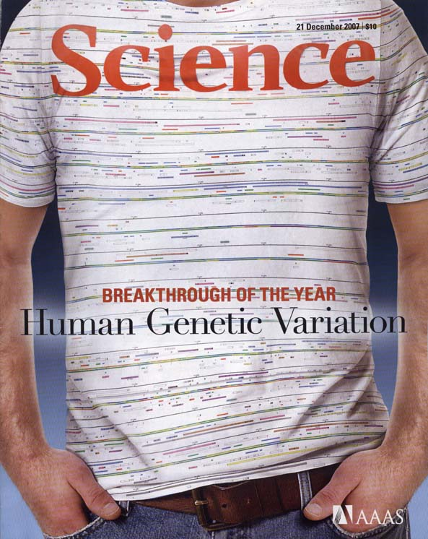
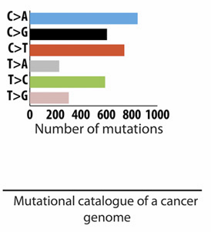
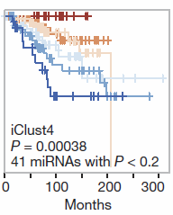
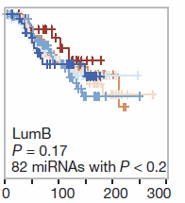
Long Term Goals for Jiang’s Lab
1. Continue to develop new methods for further understanding of genetic dark matter.
2. Continue to search for unknown molecular drivers for cancer.
Our central gist of research: informatics approach to precision medicine in cancer!
Image source: 21 DECEMBER 2007 VOL 318 SCIENCE
3. Continue to challenge big data in machine learning and AI.
miRNAs have an increased prognostic value in the genomically
stable iClust4
Image source: Alexandrov et al. Cell Reports 3.1 (2013): 246-259
Image source: Dvinge et al. Nature 497.7449 (2013): 378-382
Notes:
4

