Slide 1
Biomedical Knowledge Navigation: Interactive tools for clinical and research insight
University of Pittsburgh
Department of Biomedical Informatics
Harry Hochheiser, PhD harryh@pitt.edu
Assistant Professor Department of Biomedical Informatics
Assistant Professor Intelligent Systems Program
Director Biomedical Informatics Training Program
Center for Causal Discovery (www.ccd.pitt.edu)
University of Pittsburgh
Buck Cash
Notes:
Hello everyone. Thank you for coming. Today I will be talking about

Slide 2
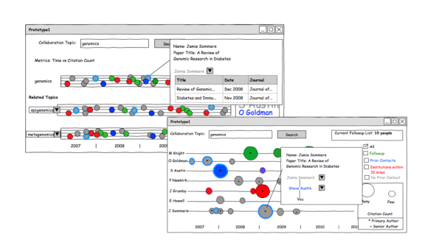
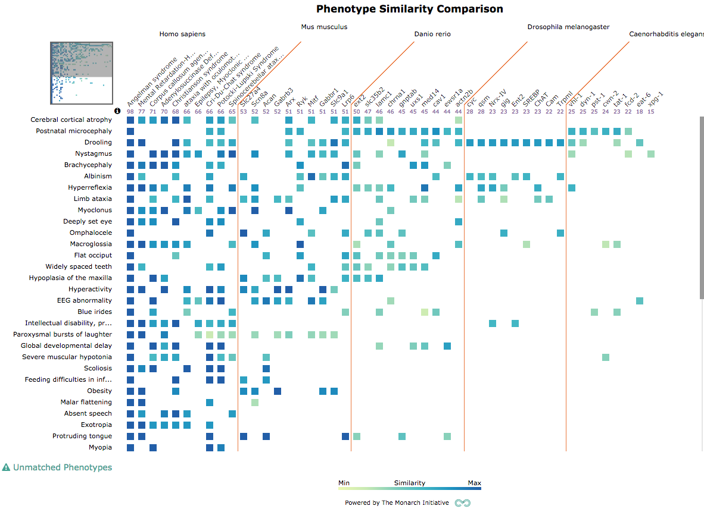
The data interpretation challenge
Clinicians and translational researchers are swamped with data
Lab measurements, meds, clinical notes, imaging data in EMRs
Genomics, microbiome, expression profiles, phenotypes..
Experts need tools that
Get them closer to the data
Facilitate exploration and hypothesis generation
Enable clear and semantically-well-founded descriptions of data
Support knowledge work as an ongoing process
Approach
Qualitative investigation of problem domains,user needs, and workflows
Iterative prototyping and refining of ideas
Mixed-methods (qualitative and quantitative) evaluations

Slide 3
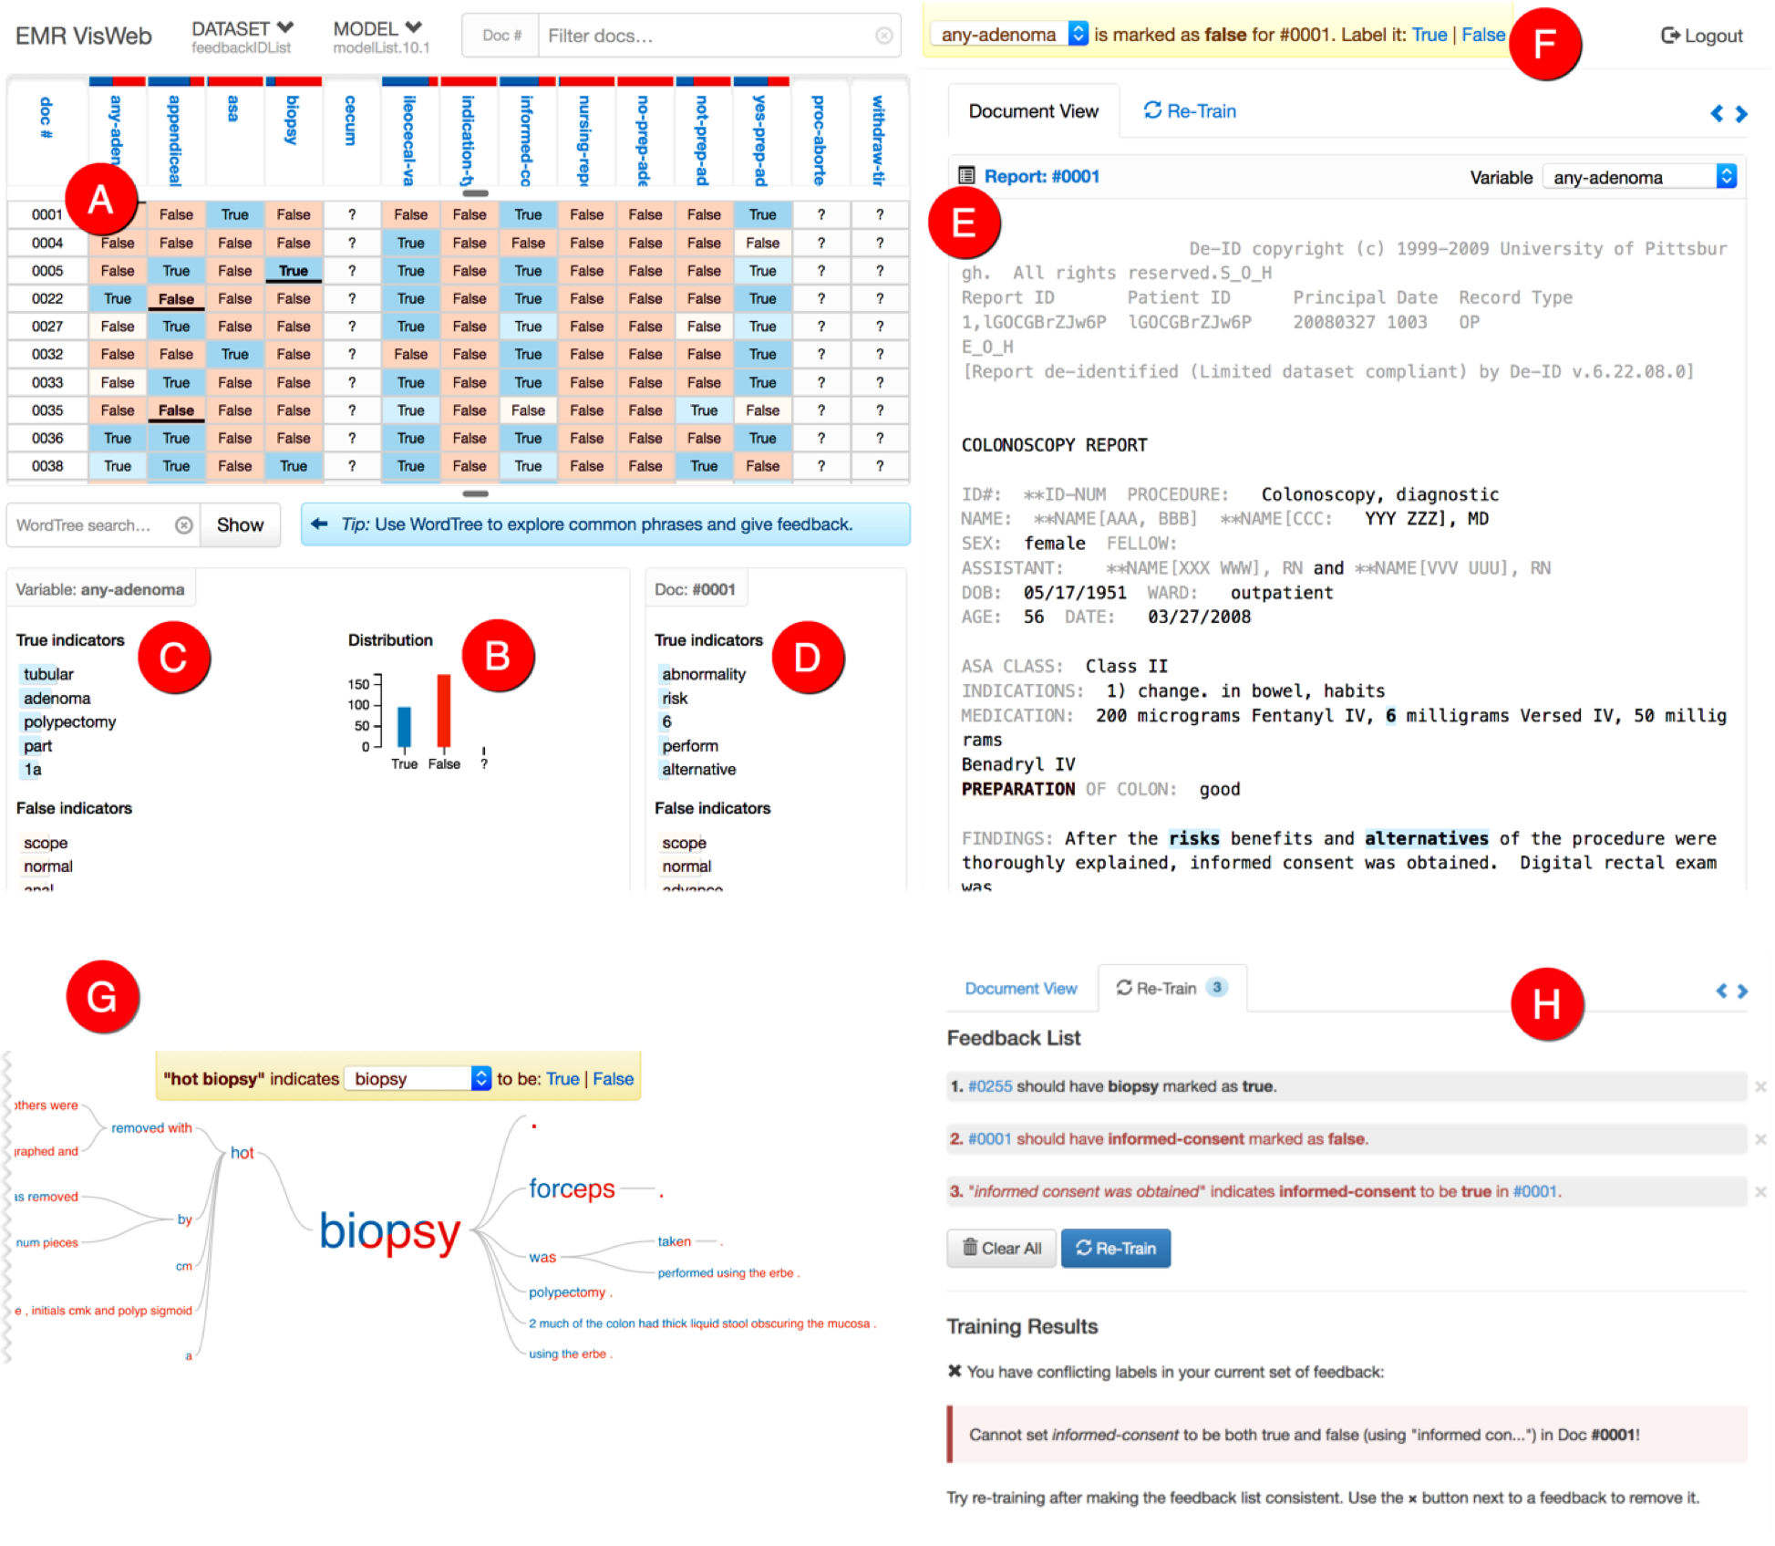
NLPReViz: an interactive tool for natural language processing on clinical text
Trivedi, et al. JAMIA 2017 doi: 10.1093/jamia/ocx070, nlpreviz.github.io
NLPReViz - NLP with expert-driven review and revision
Also .. Interactive sign-out note construction

Slide 4
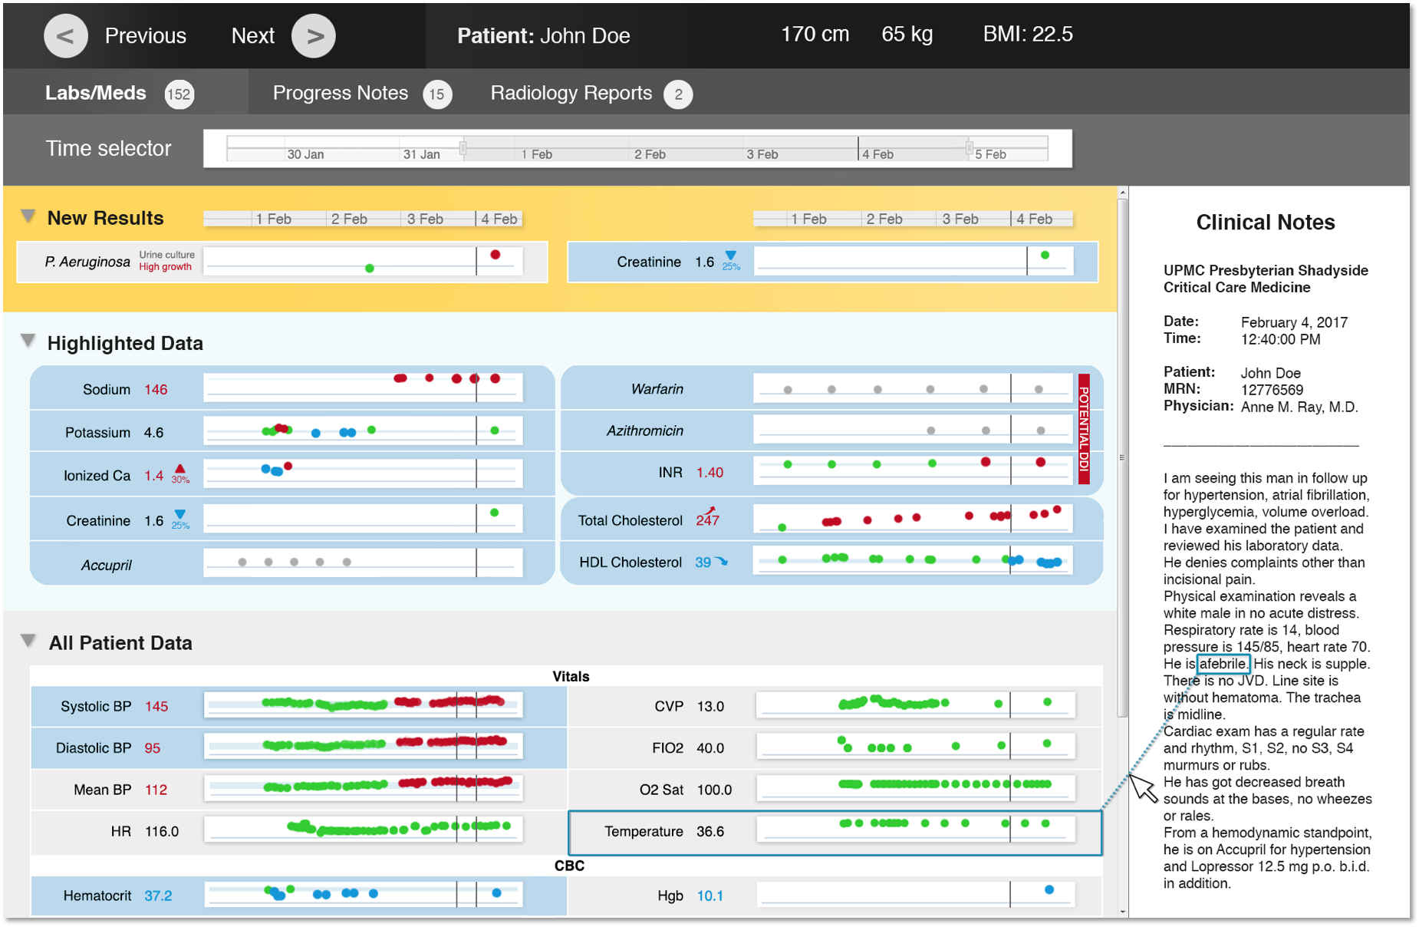
Learning EMR
Use predictive models to identify and highlight items of interest to clinicians reviewing cases with EMRS
King, et al. 2015, 2017, 2018.

Slide 5
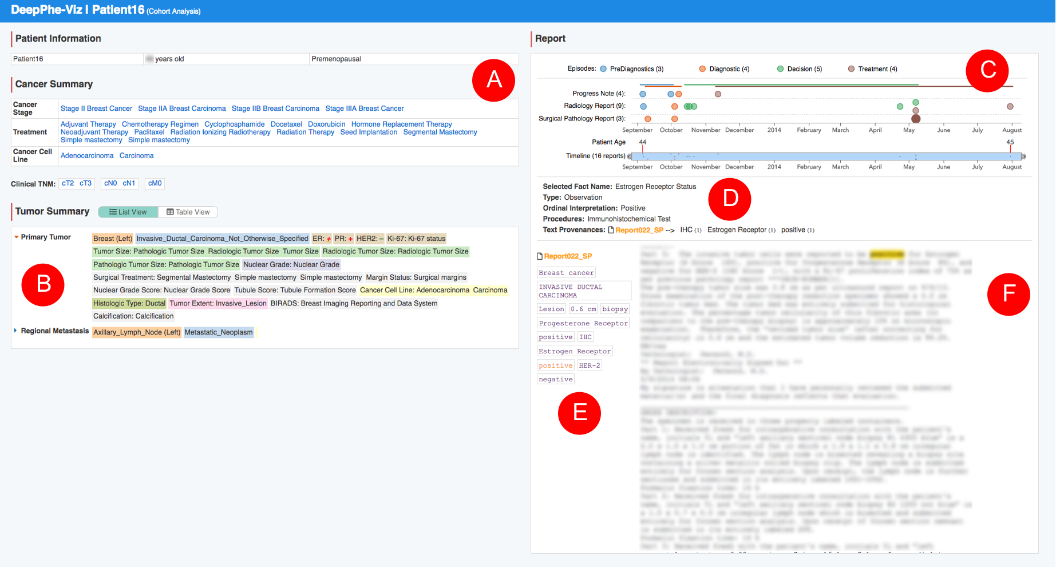
Cancer Deep Phenotyping
Develop multi-level data models for cancer progression and visual tools for cohort identification for retrospective studies
Hochheiser, et al. 2016, Savova, et al. 2017

Slide 6
Pittsburgh Biomedical Informatics Training Program
“The mission of the Pittsburgh Biomedical Informatics Training Program is to provide our students with a world‐class education that prepares them to become outstanding leaders in biomedical informatics research, education, and practice.”
Collaborations with other training programs in Gastroenterology and Population Neuroscience
NLM Supplements:
2017-2018 Development of Data Science educational modules
2018-2019 Data science curriculum enhancements for graduate health and biomedical sciences at Minority Serving Institutions

Slide 7
Other Projects
Center for Causal Discovery: Advancing the application of causal discovery to biomedicine
Goal : Tools and metadata support for reproducible causal analyses
Addressing gaps in clinically useful evidence on drug-drug interactions: Developing improved tools for interpreting potential drug-drug interaction information
Goal : Conduct inquiry into expert needs and workflows; design search engine over curated PDDI data.
Quantifying Electronic Medical Record Usability to Improve Clinical Workflow: Using in-situ recording of clinician interactions with EMR during patient visits to understand factors influencing usability and perceived workflow
Goal : Use understanding of EMR use in clinic to guide improved designs

Slide 8
Recent Grant Funding/Collaborations
GRADS: 1U01HL112707, N. Kaminski (Yale, PI), S. Wiesnewski (Pitt), M. Becich (Pitt), A. Morris (Pitt), B. Methe (Pittt), E. Ghedin (NYU)
DeepPhe: 1 U24 CA184407, R. Jacobson (Pitt, co-PI), G. Savova (Boston Children’s Hospital, co-PI)
Learning EMR: 1 R01 LM012095, S. Visweswaran (Pitt, PI), G. Cooper (Pitt), G. Clermont (Pitt), M. Hauskrecht (Pitt)
Center for Causal Discovery: U54HG008540, G. Cooper (Pitt, co-PI), I. Bahar (Pitt, co-PI), C. Glymour (CMU), R. Scheines (CMU), many others…
Addressing gaps in clinically useful evidence on drug-drug interactions: 1 R01 LM011838-01, R. Boyce (PI, Pitt)
Quantifying Electronic Medical Record Usability to Improve Clinical Workflow: 5R01HS021290, Z. Agha (West Health Foundation & UCSD, PI), C. Weir (Utah), N. Weibel (UCSD), Y. Chen (UC Irvine). R Street (Texas A&M)
Other Collaborators: W. Chapman (Utah), R. Hwa (Pitt), J. Wiebe (Pitt), P. Empey (Pitt)

