Slide 1
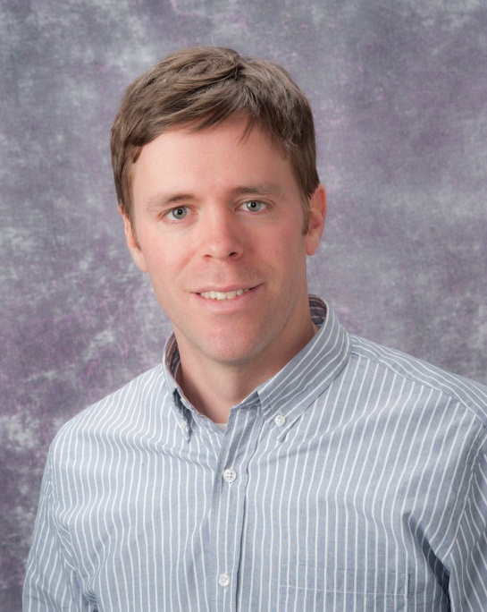
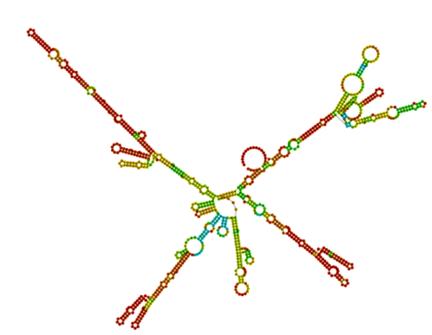
David Boone
Assistant Professor
Department of Biomedical Informatics
University of Pittsburgh
Director of Hillman Academy
Director of CoSBBI/iBRIC
dnb14@pitt.edu; 412-648-7231
Major interests:
lncRNAs in Breast Cancer
STEM Outreach/Pipeline

Slide 2
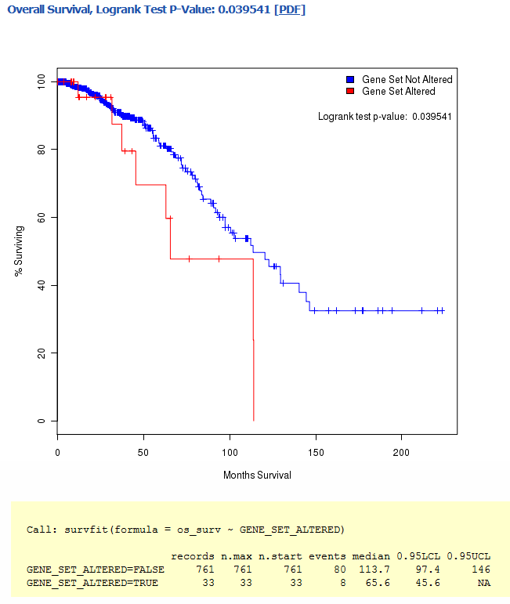
lncRNAs in Breast Cancer
ENCODE reveals there are more lncRNAs than protein coding genes.
The function of most are largely unknown.
Our interest is identifying and characterizing the regulation and function of lncRNAs in breast cancer.
Basal
Normal-like
Her2
LumA
LumB
IGF1
IGF1R
PI3K
AKT
-2.0
2.0
Logrank test p-value: 0.0395
100
Unaltered SNHG7
mTOR
MAPK
80
% Surviving
60
Upregulated SNHG7
Growth
Survival
40
Proliferation
20
0
0
50
100
150
200
Months Survival

Slide 3
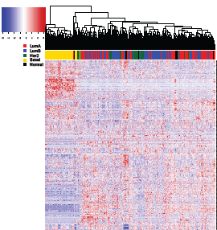
SNHG7 is a snoRNA HG that regulates proliferation through a novel feedback mechanism
Induced genes
MCF7 Proliferation
IGF Signaling Transcripts
siCtl siSNHG7
IGF1 signaling
SNHG7
Repressed genes
Proliferation

Slide 4
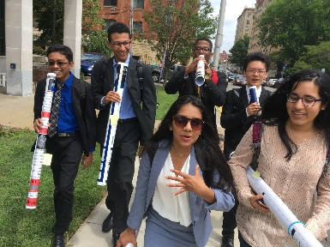
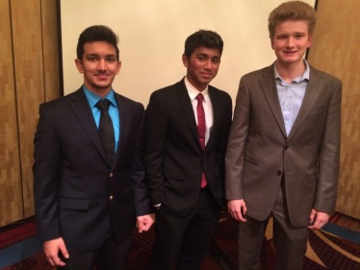
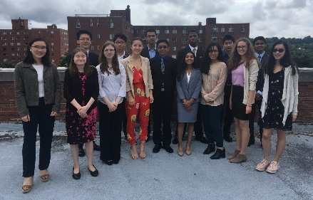
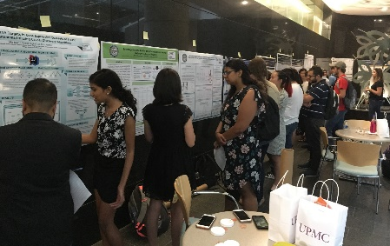
Hillman Academy - Computer Science, Biology and Biomedical Informatics (CoSBBI)
Mission
Elevate scientific research, critical thinking, and communication skills of highly motivated high school students and to provide close mentorship through formative years to create a pipeline to STEM careers.
CoSBBI
Outcomes
90% of alumni in STEM fields as undergrads
Enrolled in top institutions
Authorships
Awards
National Presentations
Details
8-week authentic research project
Mentorship
Academic preparatory experiences
Presentations
Hillman/CoSBBI– 65/15 students per summer respectively
~40% Underrepresented
Internship
Career
iBRIC
Notes:
I want to stress the pipeline and how CoSBBI is the beginning of our commitment to highly motivated students. CoSBBI establishes a foundation of research. In this 8 weeks the students are taught how to navigate through scientific literature through practice and feedback with the designated instructors (David Boone, PhD assistant professor, and a Graduate Teaching Fellow). The students choose a journal club article relevant to their research project and then present and critique the paper with the group. There is strong attention to create a learning environment among the students. Within the first two weeks the students present a proposal of their research for the summer to the group. Throughout the summer there are research roundtables where they discuss how their works has progressed, the problems that have emerged, the next steps, etc. The hope is to make them comfortable talking about science in a safe environment. It also prepares them for the end of the 8 weeks, when they present their work in a presentation and poster at a symposium. The presentation is tailored to guidelines for submission to AMIAs annual meeting, so that they can submit abstracts to that conference. Didactic lectures that cover a wide variety of topics are taught by the primary instructors, as well as, other faculty and graduate students. These serves two functions, 1) transfer knowledge, and more importantly, 2) expose the students to multiple STEM careers. Through surveys we find that the students significantly increase their understanding of what a scientific career is and how to pursue careers in STEM. We also see significant improvements in their perceived gains on communication of science, use of the primary literature, critical analysis of data, using scientific tools and technology.

Slide 5
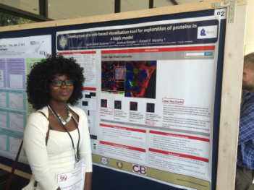
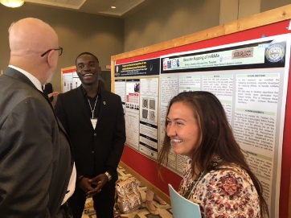
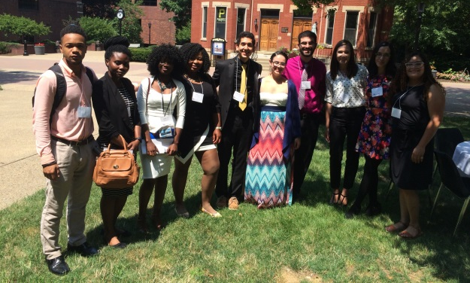
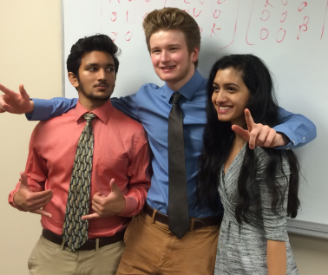
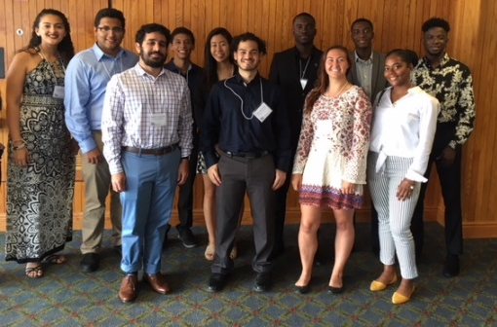
Internship in Biomedical Research, Informatics, and Computer Science (iBRIC)
Mission
Build a foundation for a career in biomedical data science for undergraduates from underrepresented backgrounds through immersive, challenging, authentic, and mentored research and training experiences in the emerging fields of big data, computer science, computational and systems biology, and biomedical informatics
CoSBBI
Details
10-week authentic research project
Mentorship
Academic preparatory experiences
Presentations
Internship
Career
iBRIC
Notes:
I want to stress the pipeline and how CoSBBI is the beginning of our commitment to highly motivated students. CoSBBI establishes a foundation of research. In this 8 weeks the students are taught how to navigate through scientific literature through practice and feedback with the designated instructors (David Boone, PhD assistant professor, and a Graduate Teaching Fellow). The students choose a journal club article relevant to their research project and then present and critique the paper with the group. There is strong attention to create a learning environment among the students. Within the first two weeks the students present a proposal of their research for the summer to the group. Throughout the summer there are research roundtables where they discuss how their works has progressed, the problems that have emerged, the next steps, etc. The hope is to make them comfortable talking about science in a safe environment. It also prepares them for the end of the 8 weeks, when they present their work in a presentation and poster at a symposium. The presentation is tailored to guidelines for submission to AMIAs annual meeting, so that they can submit abstracts to that conference. Didactic lectures that cover a wide variety of topics are taught by the primary instructors, as well as, other faculty and graduate students. These serves two functions, 1) transfer knowledge, and more importantly, 2) expose the students to multiple STEM careers. Through surveys we find that the students significantly increase their understanding of what a scientific career is and how to pursue careers in STEM. We also see significant improvements in their perceived gains on communication of science, use of the primary literature, critical analysis of data, using scientific tools and technology.

Slide 6
Outreach – Moonshot – Hillman Academy Year-wide and Outreach Program
Through R25 funding and key school and community partnerships, extend the Hillman Academy summer program to 2 years of scholarly activity with the mission of increasing the diversity of the biomedical workforce and drastically expand the community outreach component
2-year program
Outreach Program
Prepare students for research
Summer research
Communication course
Applications to Siemens, PRSEF, AMIA, etc
Professional development course
Take research to 10-15 high schools and community events/centers per year
Host events for FAME, Mpowerhouse, Homeless Childrens Education Fund, and Remake Learning

