Slide 1



Gregory F. Cooper, M.D., Ph.D.
Professor of Biomedical Informatics
Vice Chair of Research, Department of Biomedical Informatics gfc@pitt.edu 412-624-3308
The Cooper lab is developing and applying new machine learning, artificial intelligence, and Bayesian statistical methods to address biomedical informatics problems.
Lists of publications:
tinyurl.com/GFCGoogleScholar
tinyurl.com/DBMIGoogleScholar
www.dbmi.pitt.edu/pubs-with-pdfs/26

Slide 2

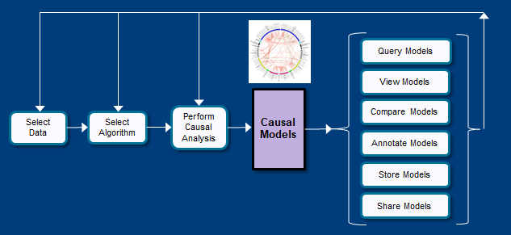
Causal Discovery from Clinical and Biomedical Observational Data
Problem: How to discover causal knowledge from observational data?
Approach: Learn graphical models that capture statistical patterns in the data that are highly likely to be causal and not merely associational.
Status: Ongoing basic research, as well as applications in cancer, severe sepsis, dementia, opioid epidemic, and environmental health. Developing ways to combine RCT data from the literature with EMR data to construct causal models that predict patient personalized response to therapies.
Project lead: Greg Cooper
Funding: NIH/NIGMS U54HG008540 (Role: Contact PI)
Cooper GF, Bahar I, Becich MJ, Benos PV, Berg J, Espino JU, Jacobson RC, Kienholz M, Lee AV, Lu X, Scheines R, Center for Causal Discovery team. The center for causal discovery of biomedical knowledge from big data. Journal of the American Medical Informatics Association, 22 (2015) 1132-1136.

Slide 3
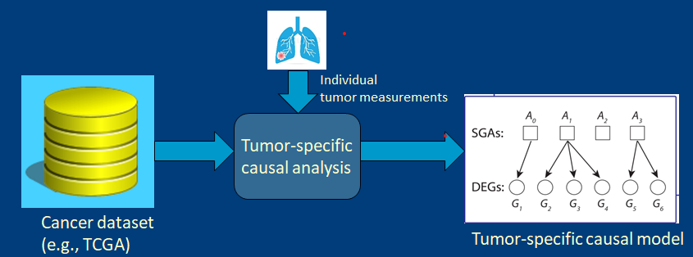
Discovery of Tumor-specific Drivers and Pathways of Cancer
Problem: How to discover the genomic drivers and aberrant pathways in an individual tumor?
Approach: Use an instance-specific causal discovery approach that learns a tumor-specific causal model between somatic genomic alterations (SGAs) and differential gene expression levels (DEGs).
Status: Detect the drivers of immune tolerance (and susceptibility) and use them to predict sensitivity to immunotherapy in melanoma and other cancers.
Project lead: Xinghua Lu
Funding: UPMC ITTC (Role: Co-PI), NIH/NLM R01LM012011 (Role: Co-I)
Cai C, Cooper GF, Lu KN, et al. Systematic discovery of the functional impact of somatic genome alterations in individual tumors through tumor-specific causal inference. PLOS Computational Biology (2019).

Slide 4
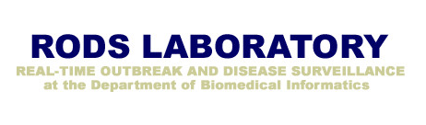
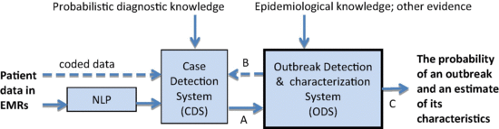
Detection and Characterization of
Disease Outbreaks Using Probabilistic Modeling
Problem: How to detect and characterize new outbreaks of infectious disease in the population?
Approach: Use Bayesian methods to learn epidemiological models from multiple sources of data, including EMR data and population measurements, such as positive test results.
Status: Current focus is on predicting Covid-19 population-level outcomes and on detecting outbreaks of novel diseases, such as a novel viral disease in the future.
Project lead: Greg Cooper
Funding: NIH/NLM R01LM011370 (Role: Co-I)
Cooper GF, Villamarin R, Tsui FC, Millett N, Espino JU, Wagner MM. A method for detecting and characterizing outbreaks of infectious disease from clinical reports. Journal of Biomedical Informatics, 53 (2015) 15-26.

Slide 5
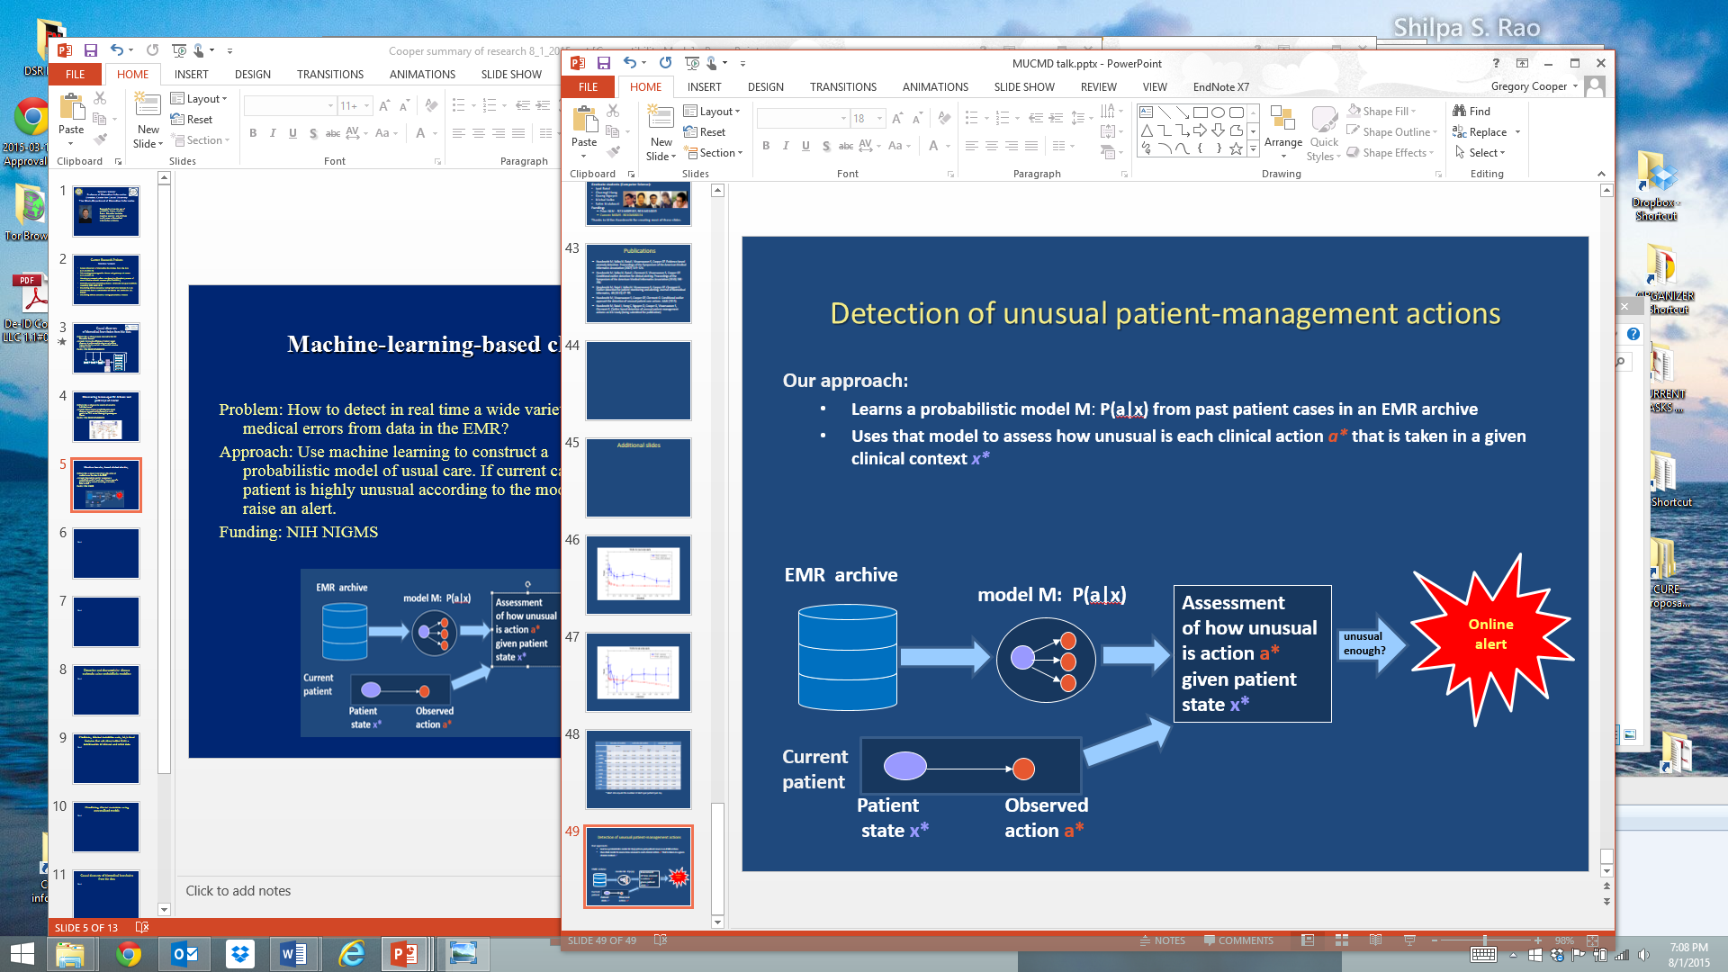
Machine-Learning-based Clinical Alerting
Problem: How to detect in real time a wide variety of medical errors from data in the EMR?
Approach: Use machine learning to construct a probabilistic model of usual care. If current care of a patient is highly unusual according to the model, raise an alert.
Status: An alerting system has been developed that can run in real time on UPMC ICU patients. A prospective evaluation of the method on ICU patient cases is being completed.
  Project lead: Milos Hauskrecht
Funding: NIH/NIGMS R01GM088224 (Role: Co-PI)
Hauskrecht M, Batal I, Hong C, Nguyen Q, Cooper GF, Visweswaran S, Clermont G. Outlier-based detection of unusual patient-management actions: An ICU study. Journal of Biomedical Informatics, 64 (2016) 211-221.

Slide 6
A Learning Electronic Medical Record (LEMR) System
Problem: How to develop an EMR system that learns how to highlight the right information at the right time?
Approach: Use machine learning to construct a probabilistic model that predicts which information will be viewed in a given patient context. Use that model to estimate the right information to highlight in a current patient record being used by a given clinician at the current time for a given purpose.
Status: A working research system has been developed and evaluated. Now planning ways to use eye tracking to train the system.
  Project lead: Shyam Visweswaran
Funding: NLM R01LM012095 (Role: Co-I)
King AJ, Cooper GF, Clermont G, Hochheiser H, Hauskrecht M, Sittig DF, Visweswaran S. Using machine learning to selectively highlight patient information. Journal of Biomedical Informatics, 100 (2019).
(This figure is adapted from Andrew King, AMIA 2015)

Slide 7
Additional Long Range Research Goals
  Combine decision theory and causal modeling & discovery to develop decisions aids that support clinical decision making
  Develop new machine learning algorithms for learning models that are optimized to predict well for individual patients
learn a patient-
specific model
training set of past patient cases
patient-specific
model for current
case
predict outcome
current
patient case
prediction for current case

