Slide 1




Developing deep learning models for precision oncology
Lujia Chen
Postdoc Associate
Department of Biomedical Informatics, School of Medicine, University of Pittsburgh
Contact: luc17@pitt.edu
Phone: 412-736-7952
Google scholar profile: https://scholar.google.com/citations?user=L7f-43gAAAAJ&hl=en

Slide 2
Major goals of current research
Uses machine learning, especially deep learning models, to simulate the hierarchical organization of cellular signaling systems and to systematically identify major cancer signaling pathways.
Detect tumor-specific aberrations in signaling pathways, and predict cancer cells’ sensitivity to anti-cancer drugs, which help guide the personalized treatment based on patients’ individual genomic status.
Use individual patient’s genomic data (e.g. bulk RNA-seq and single-cell RNA-seq) to select candidate drugs (single drug/drug combination) and predict drug response rate.
Provide insights on gene signatures and representation of cell signaling pathways that are most sensitive to drug response.
Publications:
1. Ding, M.Q., Chen, L., Cooper G.F., Young, J.D., Lu X. (2018) Precision Oncology beyond Targeted Therapy: Combining Omics Data with Machine Learning Matches the Majority of Cancer Cells to Effective Therapeutics, Molecular cancer research : MCR, 16, 269-278.
2. Chen, L., Cai C., Chen V., Lu X. (2016) Learning a hierarchical representation of the yeast transcriptomic machinery using an autoencoder model, BMC bioinformatics, 17 Suppl 1, 9.
Funding Support:
Developing deep learning models for precision oncology (PI, NIH K99, Dec 2019 -- Nov 2021)

Slide 3
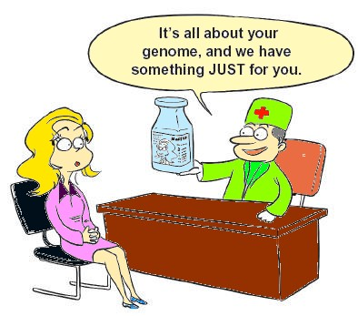
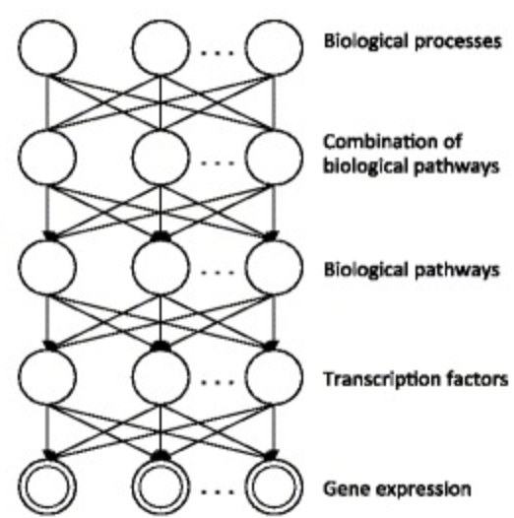
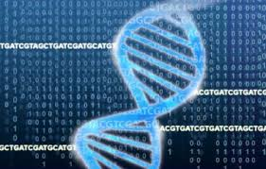
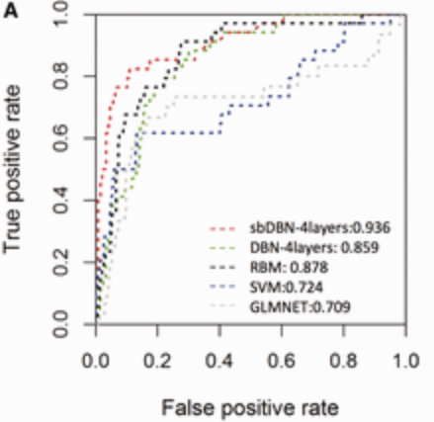

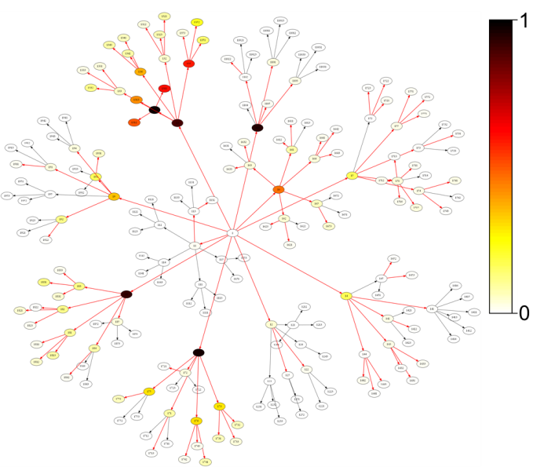
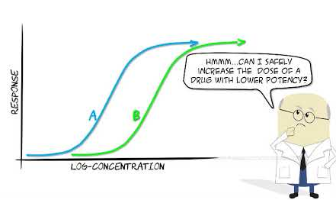

Deep Learning for precision oncology
e.g. Deep Autoencoder
Cancer Subtype Analysis
Personalized
medicine
Gene Modules/Pathways
Genomic Data
(single-cell and bulk-cell)
G1
G2
… …
Gn
T1
Tumors
Deep Learning Model
T2
… …
Tm
Drug prediction
Tumor Representation
Drug Sensitivity Analysis
Drug response
Diagonosis
e.g. Topic Modeling
Survival Analysis
Publications:
Ding, M.Q., Chen, L., Cooper G.F., Young, J.D., Lu X. (2018) Precision Oncology beyond Targeted Therapy: Combining Omics Data with Machine Learning Matches the Majority of Cancer Cells to Effective Therapeutics, Molecular cancer research : MCR, 16, 269-278.
Cai, C., et al. (2019) Systematic Discovery of the Functional Impact of Somatic Genome Alterations in Individual Tumors through Tumor-specific Causal Inference, PLoS Comput Biol.
Chen, L., Cai C., Chen V., Lu X. (2016) Learning a hierarchical representation of the yeast transcriptomic machinery using an autoencoder model, BMC bioinformatics, 17 Suppl 1, 9.
Notes:
https://medchrome.com/patient/the-promise-of-personalized-medicine/
https://www.shutterstock.com/search/drugs+cartoon
https://www.pngwing.com/en/free-png-bkaoc
https://www.niaid.nih.gov/research/genomic-data-sharing

Slide 4
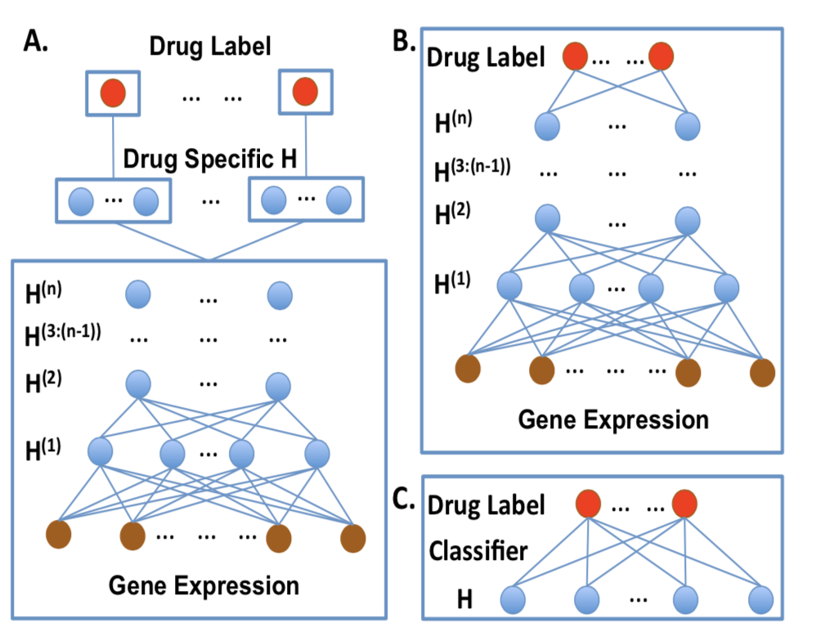
Develop Deep Learning Models (DLMs) for drug prediction
Develop DLMs to simulate the hierarchical organization of cellular signaling systems and to systematically identify major cancer signaling pathways.
Use the representations of cancer signaling pathways to improve the drug response prediction.
Example of three DLM multi-task learning models
(A) Supervised DLM with intermediate shared deep hidden layers and drug specific hidden layer on top.
(B) Supervised DLM with multi-task classifier;
(C) Semi-supervised DLM using hidden representation learned from unsupervised DLM with multi- task classifier.
Publications:
1. Chen, L., Lu, X. (2018) Discovering functional impacts of miRNAs in cancers using a causal deep learning model, BMC medical genomics, 11, 116.
2. Lu, S., Fan, X., Chen, L., Lu, X. (2018) A novel method of using Deep Belief Networks and genetic perturbation data to search for yeast signaling pathways, Plos One, 13, 9.
3. Chen, L., Cai C., Chen V., Lu X. (2016) Learning a hierarchical representation of the yeast transcriptomic machinery using an autoencoder model, BMC bioinformatics, 17 Suppl 1, 9.
4. Chen, L., Cai C., Chen V., Lu X. (2015) Trans-species learning of cellular signaling systems with bimodal deep belief networks, Bioinformatics, 31, 3008-3015.

Slide 5
Deep Learning in Precision Oncology
Develop and apply machine learning especially deep learning models and causal discovery, to systematically identify major cancer signaling pathways in cancer patients to improve the discovery of gene signature biomarkers and drug response prediction.
Collaborators in the following areas:
  Artificial Intelligence especially Deep Learning
  Cancer biology
  Drug discovery
  Immunotherapy

